Slide 2
Last time we learned that although we may feel that time moves too slowly or too quickly, it is always just perfect for God’s purposes.
God takes His time to allow us to grow into His image through a step-by-step process.

Slide 3
Suggested Next Slide - Song:
“I Know Who Holds Tomorrow”
Click or Ctrl Click Here:
“I Know Who Holds Tomorrow” (Be sure to read David Hill’s testimony in the “show more” area.)

Slide 4
Suggested Next Slide - Song:
“Thank You Lord for the Trials”
Click or Ctrl Click Here:
“Thank You Lord for the Trials” (with lyrics)

Slide 5
Suggested Next Slide - Song:
“Thank You Lord for the Trials” ( Live)
Click or Ctrl Click Here:
“Thank You Lord for the Trials” (Live Performance)

Slide 6
Suggested Next Slide - Song:
“My Life is in Your Hands”
Click or Ctrl Click Here:
“My Life is in Your Hands”

Slide 7
Last time, we studied how God uses TIME to help us grow in Christ.
It is a step-by-step process.
God not only created time; He also created the seasons.
Today’s lesson is called: “Times & Seasons”

Slide 8
Times & Seasons

Slide 9
Today, we are going to look at how God divided time into sections like day & night, Summer & Winter, light & dark, dormant & fruitful, etc.
Most of us would prefer one long-lasting pleasant season, but some seasons will involve suffering.

Slide 10
God the divided each 24-Hour day into 2 parts - Nighttime & Daylight.
He also divided the one-year period into 12 parts (or months) with each of those 12 months expressed through 4 seasons.
He also divided our lives into sections - such as infancy, childhood, adulthood and senior years.
He has carefully planned and organized our times in a way that best works for HIS purposes.
And what is best for HIS purposes, is also what is best for us.

Slide 12
Seasons & times may repeat yearly like Christmas or Springtime.
Or they may be single events like graduation day or one’s wedding day.
They might even be single life periods like one’s 20’s or one’s time spent in chemotherapy.
He has determined the various seasons of our lives and even the places we would live them out.

Slide 13
Act 17:26 HCSB
“From one man He has made every nationality to live over the whole earth and has determined their appointed times and the boundaries of where they live.”

Slide 14
Act 1:7 TLV
“He said to them, “It is not your place to know the times or seasons which the Father has placed under His own control.”

Slide 15
Question #1
God knows the times and seasons through which both nations and individuals will pass. He even knows the places we will live. Beginning with your early childhood, discuss some of the times and seasons that you have experienced in life.

Slide 16
“…determined their appointed times and the boundaries of where they live.” Act 17:26 HCSB

Slide 17
Just like our lives, the bible story is broken into times and seasons:
1) The period of beginnings (i.e., the creation, the fall of man & the great flood)
2) The forming of the Hebrew Nation (i.e., stories of early patriarchs)
3) The Egyptian bondage and deliverance
4) The wilderness wanderings and conquest of the Canaan land
5) The kingdom of Israel established then divided
6) The captivity years, then returning from captivity

Slide 18
7) The 400-year silence (no prophets-no word from God)
8) The Messiah arrives, suffers, dies and is resurrected
9) The gospel is proclaimed by the Church
10) The end time events
11) The New Heaven & Earth
12) The Lamb of God reigns forever
As He has done with both creation and the nation of Israel, God has organized our lives into times and seasons:

Slide 19
Ecc 3:1, 2 ESV
"For everything there is a season, and a time for every matter under heaven: a time to be born, and a time to die; a time to plant, and a time to pluck up what is planted;"

Slide 20
God often organizes our times into opposing periods of highs and lows
For example: night, then day, then night, then day, etc.
He has put one against the other.

Slide 21
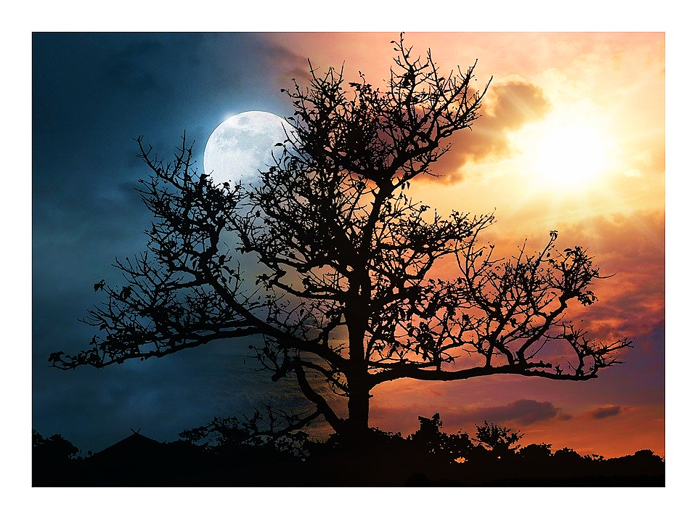
Night
Day

Slide 22
Gen 8:22 ESV
"While the earth remains, seedtime and harvest, cold and heat, summer and winter, day and night, shall not cease.“

Slide 23
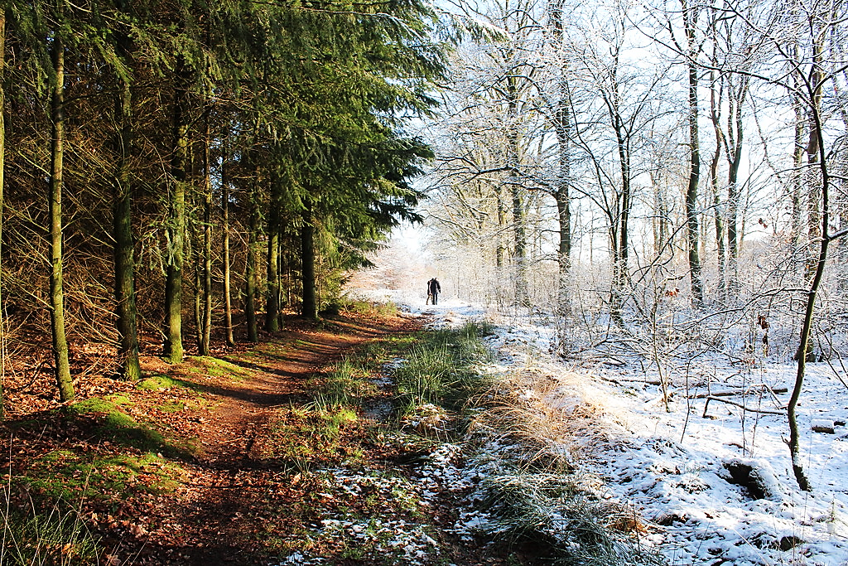
Springtime…………………….……Winter
“When life is good, enjoy it…
…But when life is hard remember: God gives good times…
…and hard times, and no one knows what tomorrow will bring.”
Ecl 7:14 EXB

Slide 24
Question #2:
Why do you think God puts good and hard times back-to-back, and how does He want us to respond to each?

Slide 25
Ps 145:14, 15 ERV
“The Lord lifts up people who have fallen. He helps those who are in trouble. All living things look to you for their food, and you give them their food at the right time.”

Slide 26
Dan 2:21 ICB
“He changes the times and seasons ... He takes away the power of kings. And he gives their power to new kings.”

Slide 27
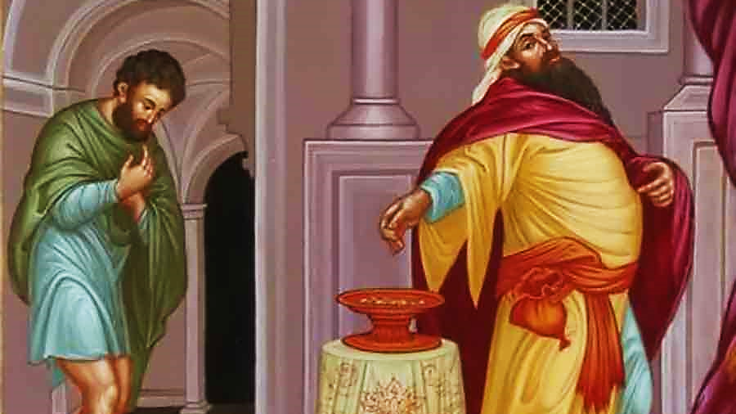
“Everyone who makes themselves important will be made humble. But everyone who makes themselves humble will be made important.” Lk 14:11 ERV

Slide 28
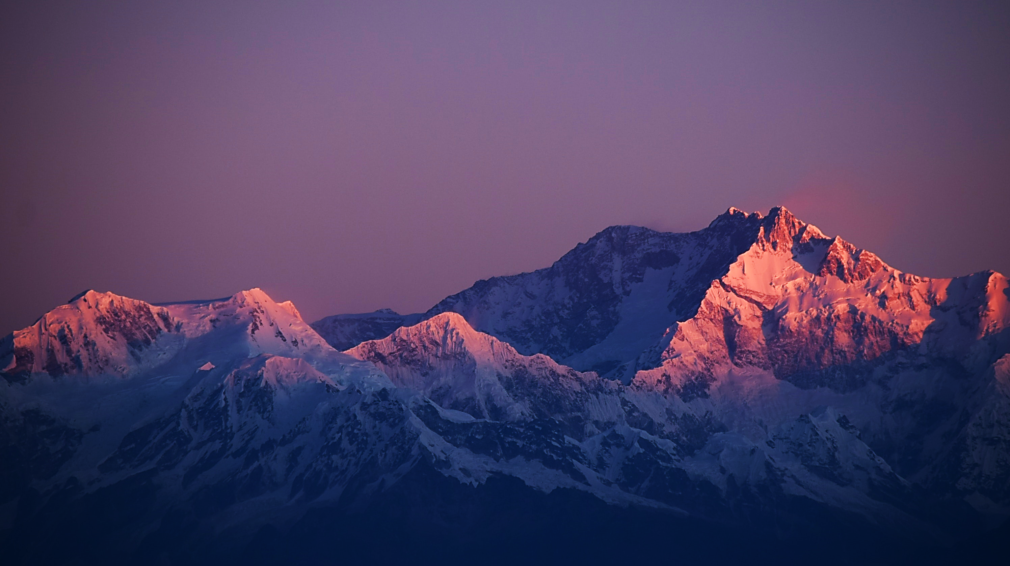
“Every valley shall be lifted up, and every mountain and hill be made low.” Isa. 40:4 ESV

Slide 29
Question #3
God gives us the perfect seasons that we need when we need them. What does the Lord do for people in need (at just the right time) and how is this different from what He does to some kings?

Slide 30
The seasons are sometimes very difficult:

Slide 31
1Pe 5:10 AMP
"After you have suffered for a little while, the God of all grace… complete, confirm, strengthen, and establish you [making you what you ought to be].”

Slide 32
Rom 8:18 NIV
"I consider that our present sufferings are not worth comparing with the glory that will be revealed in us.”

Slide 33
Heb 10:35 CEV
“Keep on being brave! It will bring you great rewards.”

Slide 34
Jesus understood that the times of suffering in His life were temporary but valuable.

Slide 35
Heb 12:2 HCSB
“…keeping our eyes on Jesus, the source and perfecter of our faith, who for the joy that lay before Him endured a cross and despised the shame and has sat down at the right hand of God’s throne.”

Slide 36
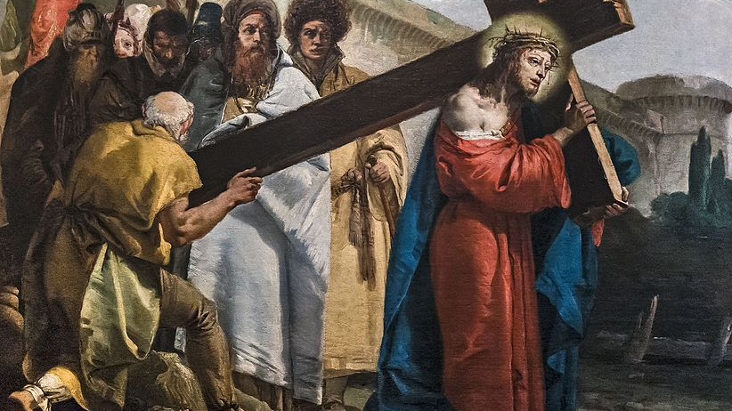
Jesus knew that times of suffering for the Gospel’s sake are worth it for the greater rewards which follow.

Slide 37
Ps 1:1-3 NIV
“Blessed is the one who does not walk in step with the wicked or stand in the way that sinners take or sit in the company of mockers, but whose delight is in the law of the Lord and who meditates on his law day and night…

Slide 38
Ps 1:1-3 NIV (cont.)
…That person is like a tree planted by streams of water, which yields its fruit in season and whose leaf does not wither— whatever they do prospers.”

Slide 39
That person is like a tree planted by streams of water.

Slide 40
Question #4
Describe the man whose life will always bear fruit in due season.

Slide 41
When our days are bright, it is easy to see HIM – He is the bright & shining SON!!!
Yet, even in our darkest hours, it is never completely dark for a believer.
God made lesser lights for even the darkest night.
When life seems dark and the Lord seems far off, look for Him reflected in His Church, His Word & His universe all around us.
Just as the moon reflects the sun throughout the night, Jesus will be quietly reflected, somehow, somewhere, until our nights have past.

Slide 42
Gen 1:14-17 ESV
“And God said, ‘Let there be lights in the expanse of the heavens to separate the day from the night. And let them be for signs and for seasons, and for days and years, and let them be lights in the expanse of the heavens to give light upon the earth.’ And it was so…

Slide 43
Gen 1:14-17 ESV (cont.)
…And God made the two great lights—the greater light to rule the day and the lesser light to rule the night—and the stars. And God set them in the expanse of the heavens to give light on the earth.”

Slide 44
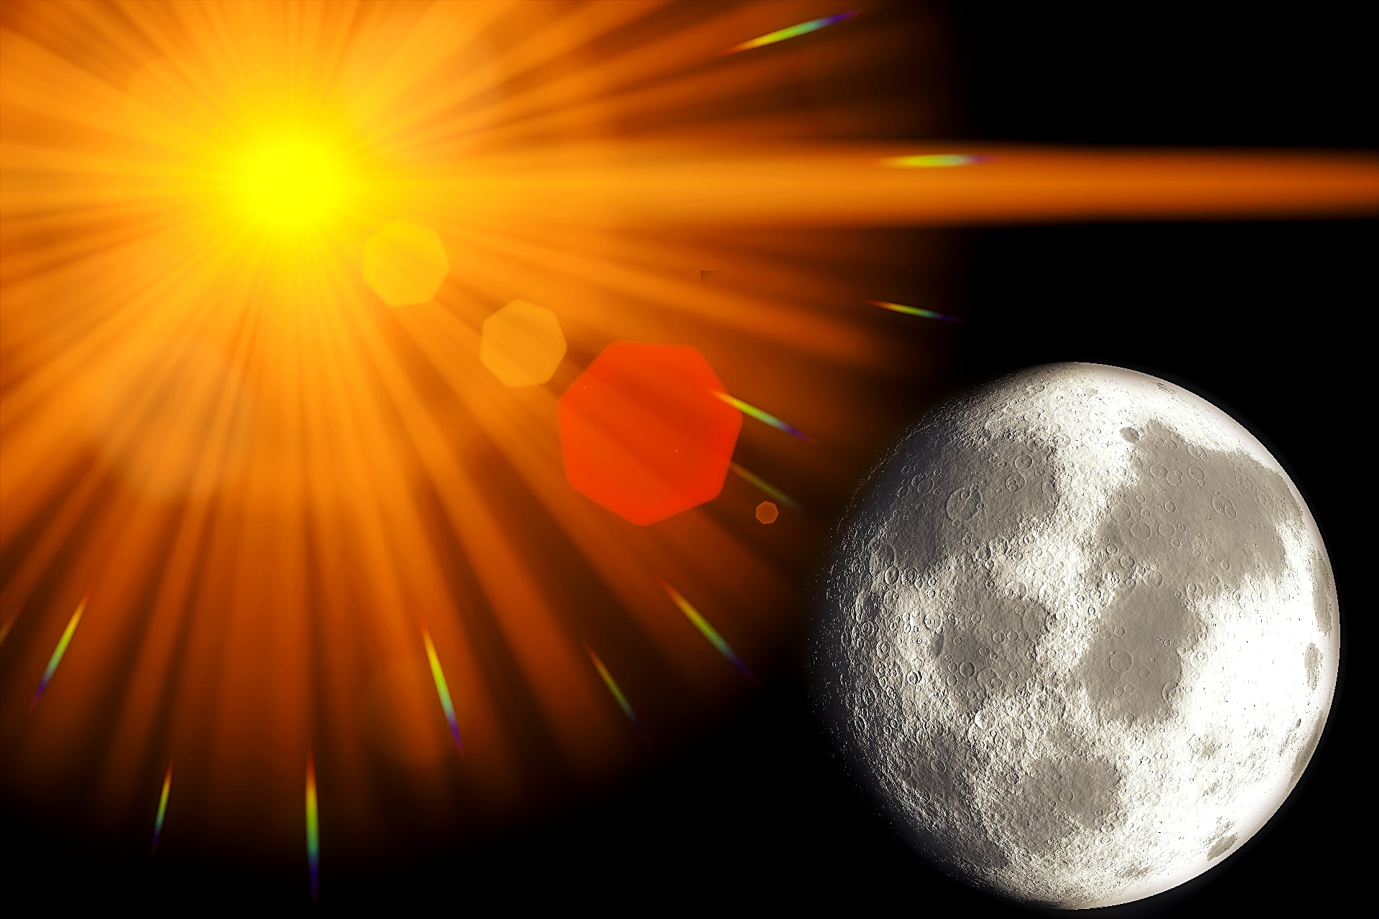
“And God made the two great lights—the greater light to rule the day and the lesser light to rule the night.”

Slide 45
Even through Earth’s darkest hours, He made a lesser light to rule the night.
It reflects the sun and tells us it’s still there.
Believers who keep their trust and hope in Jesus will have a smidgen of light throughout even their darkest seasons of life.
When Israel was escaping their Egyptian captors by crossing the great middle-eastern wilderness, their God went before them as a pillar of light.
Likewise, He is our pillar of light throughout our darkest nights.

Slide 46
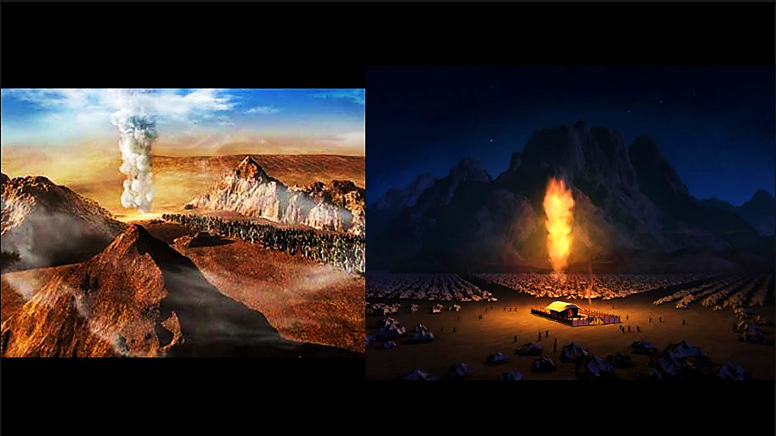
“And the Lord went before them by day in a pillar of cloud to lead them along the way, and by night in a pillar of fire to give them light, that they might travel by day and by night.” Ex 13:21 ESV

Slide 47
Harsh seasons do end and are replaced by refreshing seasons:

Slide 48
Song 2:11, 12 NLV
“For see, the winter is past. The rain is over and gone. The flowers are coming through the ground. The time for singing has come...”

Slide 49
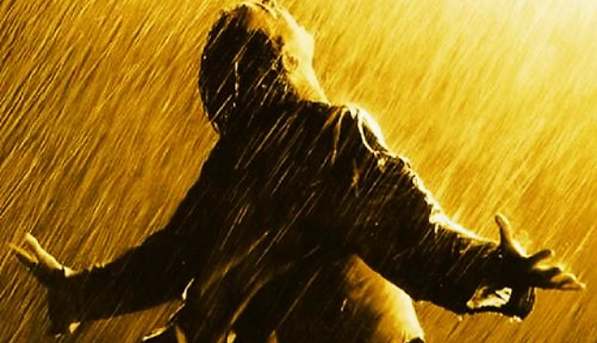
“… I will send down the showers in their season; they shall be showers of blessing.”
Ezk 34:26 ESV

Slide 50
Ecc. 3:11 BRG
"He hath made everything beautiful in His time…”

Slide 51
In nature, times and seasons are entirely in God’s jurisdiction, humans have no say in it.
The sun actually knows its own bedtime and always obeys its Lord & master.

Slide 52
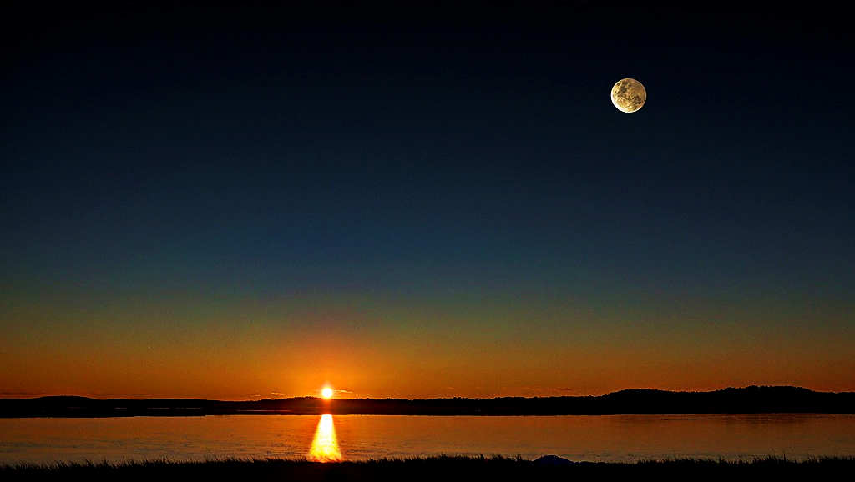
“He made the moon to mark the seasons;
the sun knows it’s time for setting.” Ps. 104:19 ESV

Slide 53
Yet, David had the boldness to pray to God to shorten his difficult time.

Slide 54
Psa 31:15 ESV
"My times are in your hand; rescue me from the hand of my enemies and from my persecutors!"

Slide 55
Joshua was even bolder.

Slide 56
Josh 10:12-14 ICB
“…And that day Joshua stood before all the people of Israel and said to the Lord: ‘Sun, stand still... Moon, stand still ...’ So, the sun stood still, and the moon stopped until the people defeated their enemies…

Slide 57
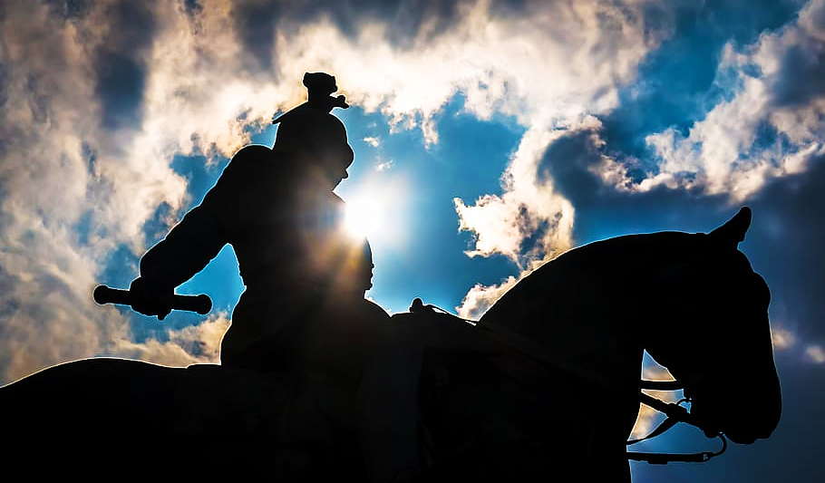
“Sun, stand still... Moon, stand still ... So, the sun stood still, and the moon stopped until the people defeated their enemies…”

Slide 58
Josh 10:12-14 ICB (cont.)
…The sun stopped in the middle of the sky. It waited to go down for a full day. That has never happened at any time before that day or since. That was the day the Lord listened to a man. Truly the Lord was fighting for Israel!”

Slide 59
Prayer can move God in powerful ways.
Yes, times and seasons are in His jurisdiction, so, He can stretch or shorten time if He wants to.
But that’s not the most amazing thing.
The amazing thing is that He wanted to because a man of faith asked Him to.
Remember, His ultimate pleasure is in being in relationship with & sharing a partnership with His beloved humankind.
He is very keen to answer our prayers of faith.

Slide 60
John 15:7 TPT
“But if you live in life-union with me and if my words live powerfully within you—then you can ask whatever you desire, and it will be done.”

Slide 61
Question #5
According to John 15:7, what sort of man must Joshua have been that God would change the very rules of the universe for him?

Slide 63
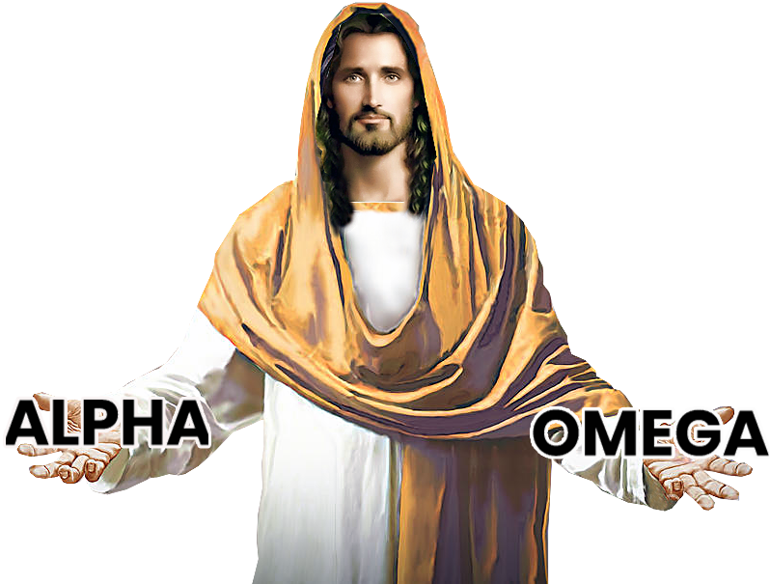
Lesson # 7
God’s Timetable pt. 1
Jesus: The Beginning
Jesus: The Middle
Jesus: The End
The Scope
of the Story

