Slide 1
“How shall we escape, if we neglect so great salvation?” Heb. 2:3

Slide 2
We would love to know more about the people who download our lessons & sermons.
We invite you to email us & let us know where & how you use them.
info@ckusa.org

Slide 3
“How shall we escape, if we neglect so great salvation?” Heb. 2:3

Slide 4
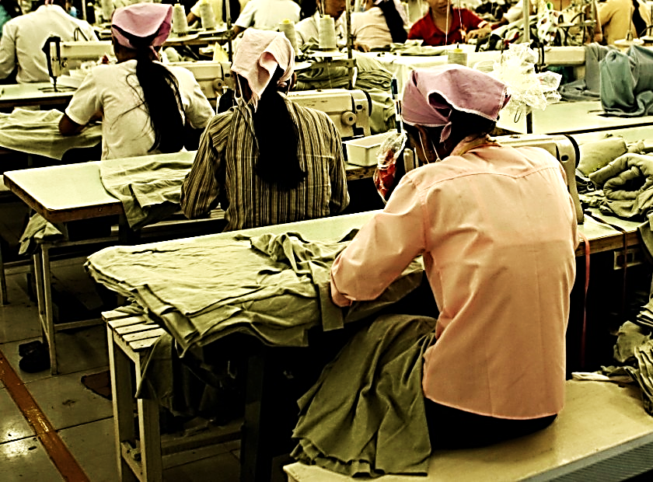
This is the story of a tragic incident that happened
in the U.S. on March 25, 1911.
On that day 146 innocent workers died due to cruel neglect alone!

Slide 5
Suggested Next Slide - Video:
The True Story of:
“The Triangle Shirtwaist Factory Fire”
Click or Ctrl Click Here:
http://www.youtube.com/watch?v=XxycBCfMt_I

Slide 6
Man’s plans failed to save the workers from the factory fire…
The door was locked…

Slide 7
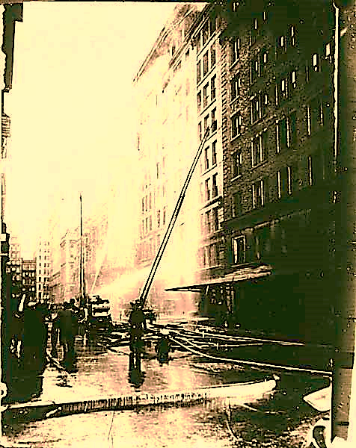
Man’s Plans Failed…
The ladders didn’t reach…

Slide 8
Man’s Plans
Failed…
The fire escapes were too weak…

Slide 9
Man’s Plans Failed …
The Net Broke!

Slide 10
The bible tells us of a coming fire that some will escape but many, sadly, will not.
“Those who emerge victorious will inherit these things. I will be their God, and they will be my sons and daughters…

Slide 11
…But for the cowardly, the faithless, the vile, the murderers, those who commit sexual immorality, those who use drugs and cast spells, the idolaters and all liars—their share will be in the lake that burns with fire and sulfur. This is the second death.” Rev. 21:7,8

Slide 12
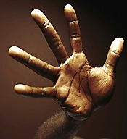
As it was at the Triangle Shirtwaist Factory, all of man’s plans will fail to save sinners from the final fire.
No man or woman
(even if well-meaning) can save us from our sins.
Their reach is just too short.
No TV “Guru”
No Educator or Advisor
No Loved One

Slide 13
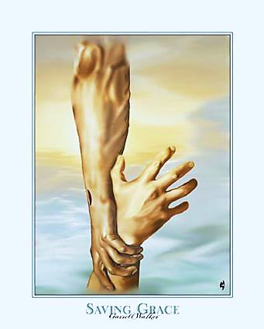
But God’s plan never fails to save.
Unlike that skimpy ladder, God’s reach is more than long enough!
“Surely the arm of the LORD is not too short to save…” Isa. 59:1
Only He can reach from Heaven to Earth.
Only He can reach down so deeply into our hearts.

Slide 14
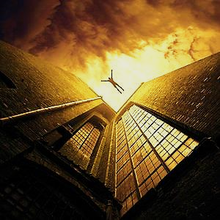
Man’s plans fail:
Like that flimsy ladder, man’s plans are too weak to save a man’s soul.
We cannot save ourselves.
Our “fire escapes” are too weak.
Good deeds & charitable giving won’t save us.
New Year’s resolutions will fail.
Last minute conversions may not be possible.

Slide 15
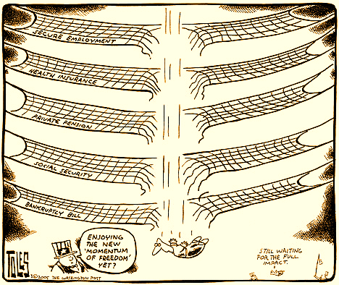
Man’s Plans Will Break
Human nets can’t save!
We may attempt to protect ourselves from things like health or financial problems.
But no net of man’s making can save us from eternal fire.

Slide 16
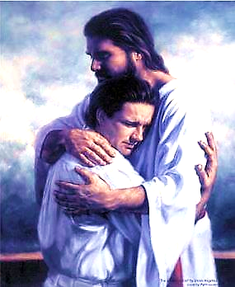
God’s Plan Saves
His Love is Strong
“No power in the sky above or in the earth below--indeed, nothing in all creation will ever be able to separate us from the love of God that is revealed in Christ Jesus our Lord.”
Rom. 8:39
No, not our sins, our past, our failures – nothing can separate us from God’s love.

Slide 17
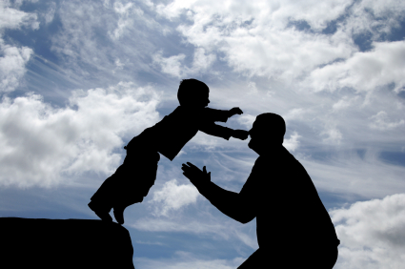
God’s Plan Saves
His net holds: We can jump into
His strong hands and be saved.

Slide 18
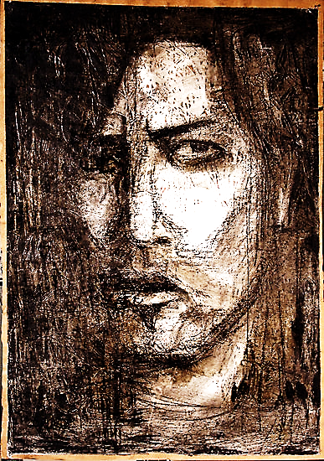
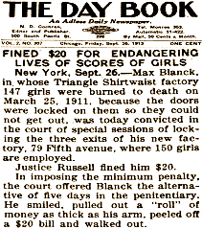
A Cruel Man Locked the Critical Doors
The Door to Heaven is only Locked by Cruel Unbelief !!

Slide 19
Jesus is the door to salvation.
"I am the door; if anyone enters through Me, he will be saved…”
John 10:9

Slide 20
Jesus is THE DOOR
through which mankind can be saved, but cruel UNBELIEF keeps it locked..

Slide 21
Soon, we will all face judgment.
Those who believe and enter through the DOOR (Jesus) will be saved.
Other people can’t save us – they can’t even save themselves.
Many famous people live & die unhappy.
Money can’t save.
Severe depression is highest in the richest countries.
Our real enemy is unbelief.
It locks the only Door we need to escape! Our Great Savior Jesus!

Slide 22
Mankind has NO safety net strong enough to save him from the eternal ‘Lake of Fire.’

Slide 23
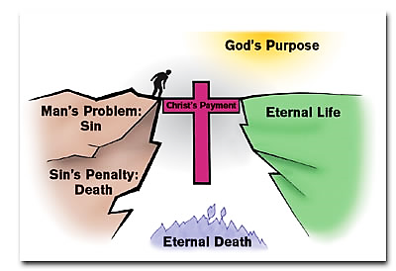
Jesus Alone is our Salvation. Therefore, the question remains: “How shall we escape, if we neglect so great salvation?” Heb. 2:3

Slide 24
What is the Sinner‘s Prayer?
This is a prayer we can pray when we are ready to admit we are sinners and need Christ’s forgiveness.
It must be prayed with faith in our hearts and a readiness to have a life-changing encounter with Jesus Christ.

Slide 26
John Wesley’s Testimony
“…the preacher was describing the change which God works in the heart through faith in Christ and I felt my heart strangely warmed.”
Disciple’s Testimony
“They said to each other, ‘Did not our hearts burn within us while he talked to us on the road, while he opened to us the Scriptures?’”

Slide 27
A Prayer of Faith → Pray this rayer if :
If you never have before
You have in the past, but you think it would mean more today.
You have been walking afar off and you want to come back.
You want to set an example & show others how it is done.
You just like to give your heart to Jesus again & again.
Faith

Slide 28
We Declare Our Faith Publicly Because Jesus Declared His LOVE Publicly
“If you stand before others and are willing to say you believe in me, then I will tell my Father in heaven that you belong to me.” Mat 10:32

Slide 29
Dear Jesus,
I know I am a sinner & need your forgiveness.
I believe you died for my sins.
I now turn from sin.
Come into my heart I pray.
Please wash away my sin.
Do you want to meet Jesus as your savior right now?
Do you believe He died to save you from your sins & that He rose from the dead?
Do you believe that He is waiting to save you right now?

Slide 30
“But some people did accept him. They believed in him, and he gave them the right to become children of God.” John 1:12

Slide 32
“If you openly say, ‘Jesus is Lord’ and believe in your heart that God raised him from death, you will be saved.”
Rom. 10:9
What did you learn today?
What have you been thinking about God lately?
What do you want to tell the world about Jesus?

Slide 33
“Draw near to God, and He will draw near to you…
…Cleanse your hands, you sinners, and make your hearts pure, you who are half-hearted towards God.” James 4:8 WNT

Slide 34
Close in Prayer

