Slide 1
God’s Timetable, pt. 1 –
The Alpha & the Omega
(The Scope of the Story)

Slide 2
The Scope of the Story

Slide 3
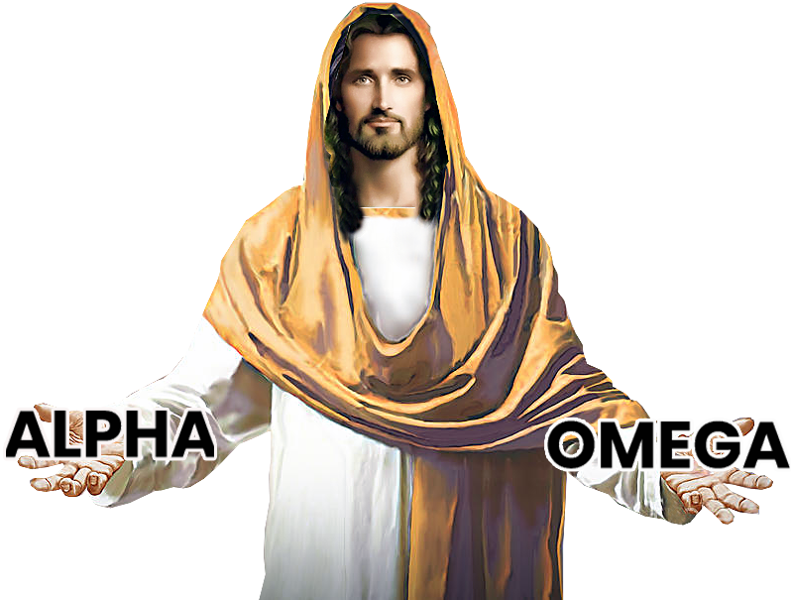
Lesson # 7
God’s Timetable pt. 1
Jesus: The Beginning
Jesus: The Middle
Jesus: The End
The Scope
of the Story

Slide 4
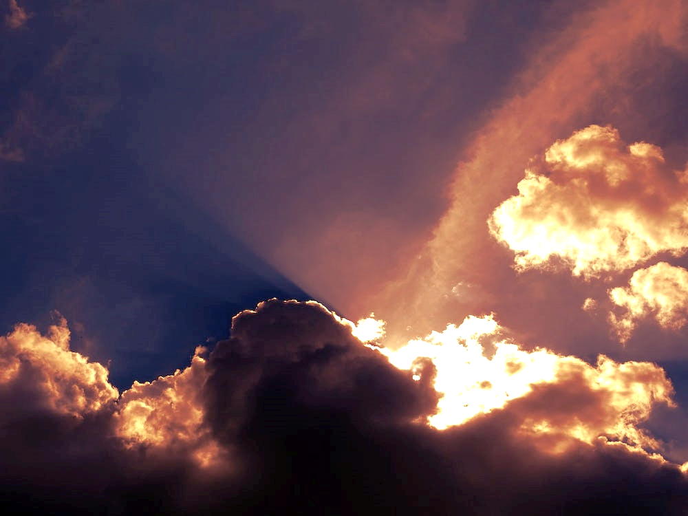
So far, we have learned that God made His plans before He even made time.
His pre-production plans included creation, the fall, redemption via Christ’s death on the cross, victory over God’s enemies and the final exaltation of Jesus Christ!

Slide 5
“In the Beginning” not only refers to the beginning of Creation…
It also refers to the beginning of God’s timetable…

Slide 6
God is working from a timetable!
He has everything scheduled for rest of time.

Slide 7
This lesson is God’s timetable, Pt 1.
Jesus uses a timetable both for our lives and for Himself to follow.
He doesn’t do things until they come up on His timetable.

Slide 8
Our story starts with a Creator who then has everything He created stolen from Him.
As a result, He gives His all to get it all back.
In the end, it is all brought back to Him and laid at His feet—End of story!!

Slide 9
Genesis 1:1 Speaks of “The Beginning” and how God Created the Heavens and the Earth.
Everything, including the garden, was filled with life.
Today, we will look at how there is not only a beginning – there is also an ending—a plan of God to fix everything broken by man’s sin.
A plan to bring back life where there is now death.

Slide 10
“In the beginning, God created the heavens and the earth.”
Gen 1:1 ESV

Slide 11
Smart writers know how their book will end before it even begins.
They make an outline of every chapter how the story will play out.
God knew the beginning, the end and the timing of every scene in the story line.

Slide 12
“From the beginning I told you what would happen in the end. A long time ago I told you things that have not yet happened.
When I plan something, it happens. What I want to do, I will do.”
ISA 46:10 NCV

Slide 13
Question #1
How long has Jesus had His plans and why is He so sure they will Happen? How is that different from our plans?

Slide 14
Now, the show must go on! The plot has been worked out, the script is written, and the production must begin!
The story of Creation has a beginning and a happily-ever-after.
Creation is also a picture (or metaphor) of our salvation and God’s plan for our lives.
What happens to Creation is like what happens to us when walk with Christ.

Slide 15
Like Creation itself, our life in Christ began with God speaking life to us and with the Light of God shining into our dark lives.
God said, “Let there be light and there was light.”
Like Creation, We are being perfected through a step-by-step process.

Slide 16
Creation’s Heavenly bodies (including Earth) will pass away and be burned by fire.
So too, our old, sinful nature is tried by, and destroyed by God’s righteous, purifying fire.
God will replace the old Heaven and Earth with new ones.
We too begin a new life, with a new beginning, as new Creations.

Slide 17
God’s fervent effort to save mankind and mankind’s response to His effort is the only theme of the entire bible.
The conclusion of the story—the finishing of His plan—is fixing the broken world and restoring His relationship with mankind.

Slide 18
This is the great Reconciliation.
It is about returning to Jesus Christ everything that was taken from Him the moment mankind sinned in the garden.
It’s not just about what we lost in the Garden (that’s our view-point), but more importantly, What Jesus Lost When We Sinned.

Slide 19
In Genesis 1 & 2, Jesus had just created everything including a male & female to be His personal friends.
He also created a world for them to live & thrive in.
God is the source of life, and when the relationship was broken with man, it was also broken with the creation made for man.

Slide 20
Christ’s beloved creation, the heavens, the animals and His beloved mankind were dying from separation from Him.
All Creation is meant to be thriving with LIFE.
That is because Jesus is LIFE itself.
When mankind rejected Him, both man and creation were left without the source of life.
Both man and creation were doomed to “die on the vine” figuratively and literally.

Slide 21
Both human life and the universe are falling apart - all matter is tending toward disorder.
Because of sin, all life is born already dying.
Originally, Creation was created alive (experiencing never-ending growth).
Creation wants this perpetual LIFE.
Scripture tells us, Creation itself hates the sin that separated it from its true destiny and life-emanating state of being.

Slide 22
“For all creation is waiting patiently and hopefully for that future day when God will resurrect his children. For on that day thorns and thistles, sin, death, and decay…

Slide 23
…The things that overcame the world against its will at God’s command, will all disappear, and the world around us will share in the glorious freedom from sin which God’s children enjoy.”
ROM 8:19-21 TLB

Slide 24
“…the creation looks forward to the day when it will join God’s children in glorious freedom from death and decay. For we know that all creation has been groaning as in the pains of childbirth right up to the present time. ROM 8:21, 22 NLT

Slide 25
According to scripture, stones and wood can testify to everything they have heard us say.
They can even testify as to how much we have heard and know of the Gospel and God’s will for our lives.
They can also testify of our vows and promises to God.
Their testimony can reveal just how accountable we are before God.

Slide 26
“and (Joshua) told the people, “Look at this stone. It has heard everything that the Lord has said to us. Our God can call this stone as a witness if we ever reject him.” JOSHUA 24:27 CEV

Slide 27
“You're doomed! You made your family rich at the expense of others. You even said to yourself, ‘I'm above the law.’ But you will bring shame on your family and ruin to yourself for what you did to others. The very stones and wood in your home will testify against you."
HAB 2:9-11 CEV

Slide 28
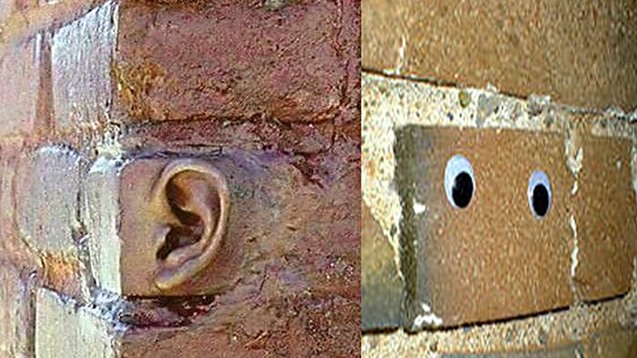
“The very stones and wood in your home will testify against you."

Slide 29
Makes you wonder how much have I said and done in my house and now my house is going to tell on me?
There is coming a day when all creation will be restored to its former,
life-emanating, non-decaying condition.
This will be its state once it has been reunited with the source of life Himself.

Slide 30
“So, you will go out with joy and be led out in peace. The mountains and hills will burst into song before you, and all the trees in the fields will clap their hands.” ISA 55:12 ICBB

Slide 31
“This is what God planned for the climax of all times: to bring all things together in Christ, the things in heaven along with the things on earth. EPH 1:10 CEB

Slide 32
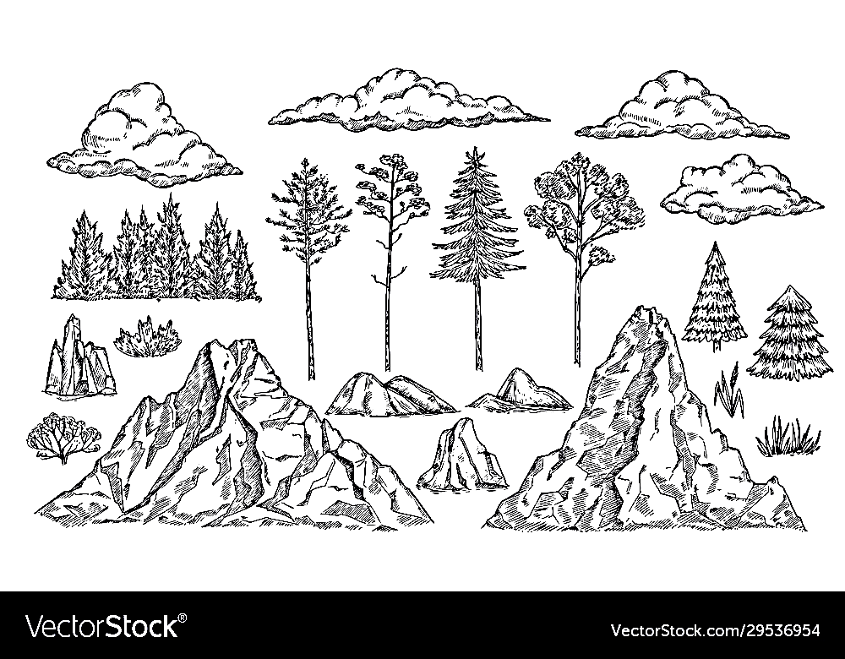
Rocks, Trees and Mountains will Praise Him.

Slide 34
“That at the Name of Jesus should every knee bow, both of things in heaven, and things in earth, and things under the earth.. PHIL 2:10 GNV

Slide 35
However, there was a time when the stones almost cried-out before the final reconciliation of all things to Christ.
That was when Jesus was on a donkey on His way to pay the price of reconciliation with His own life—making it possible for mankind and creation to be freed from the consequences of sin.

Slide 36
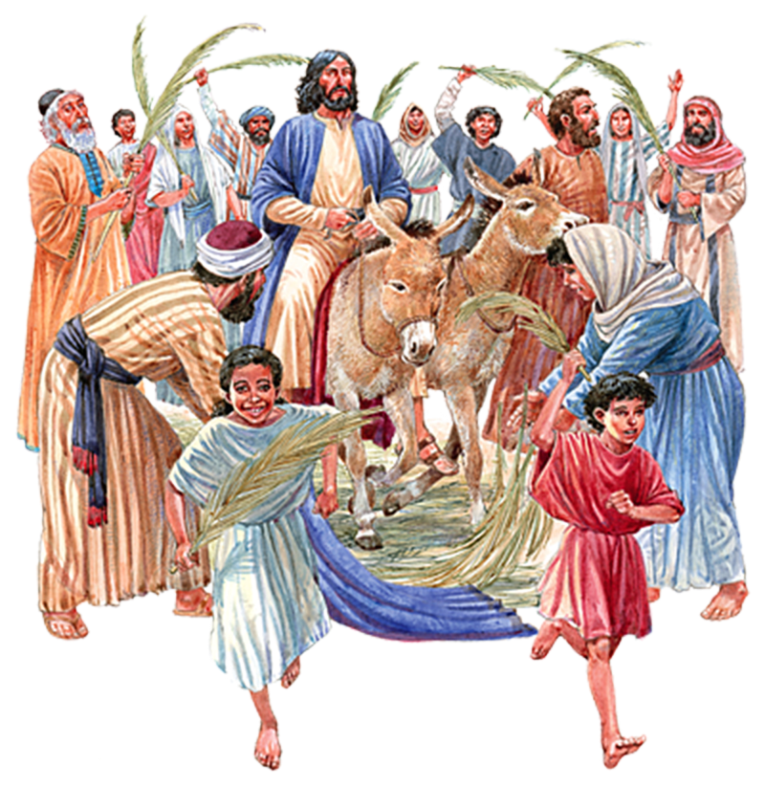
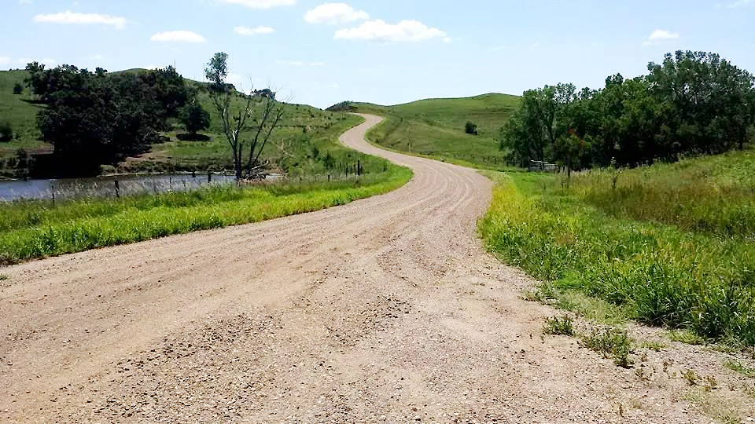

Slide 37
“There were some Pharisees in the crowd who said to Jesus, “Master, restrain your disciples!” To which he replied, “I tell you that if they kept quiet, the very stones in the road would burst out cheering!”
LUKE 19:39,40 PHILLIPS

Slide 38
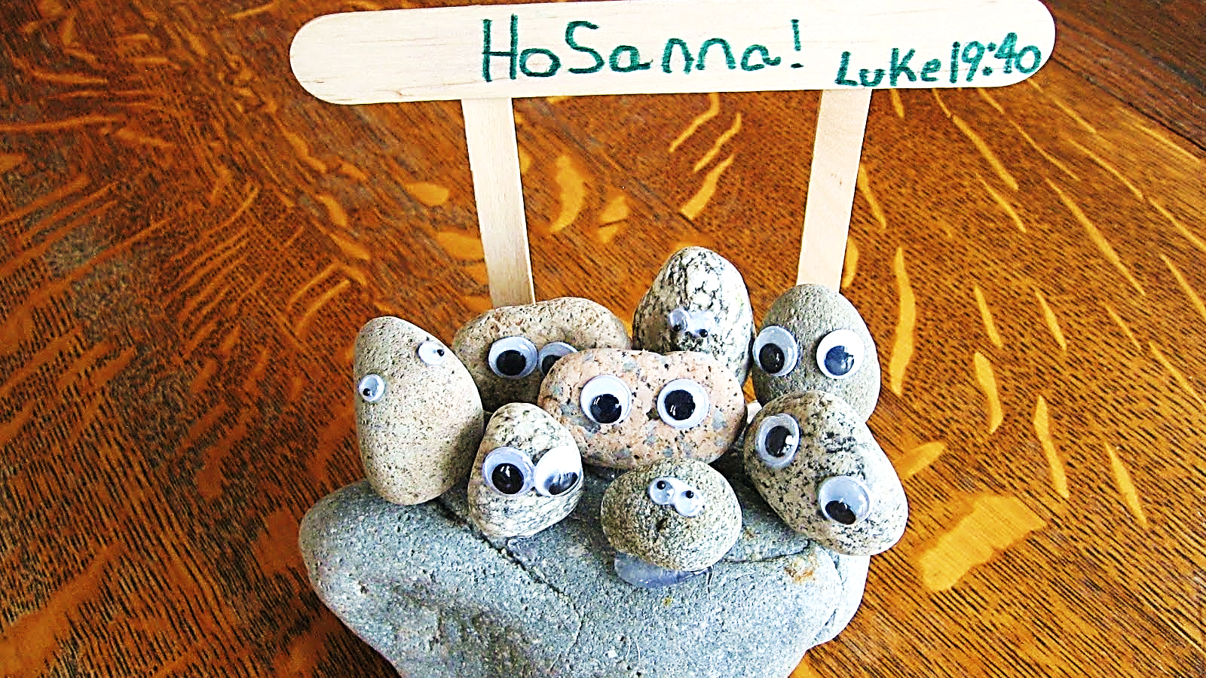
z
If you
won’t praise Jesus…
…we will.

Slide 40
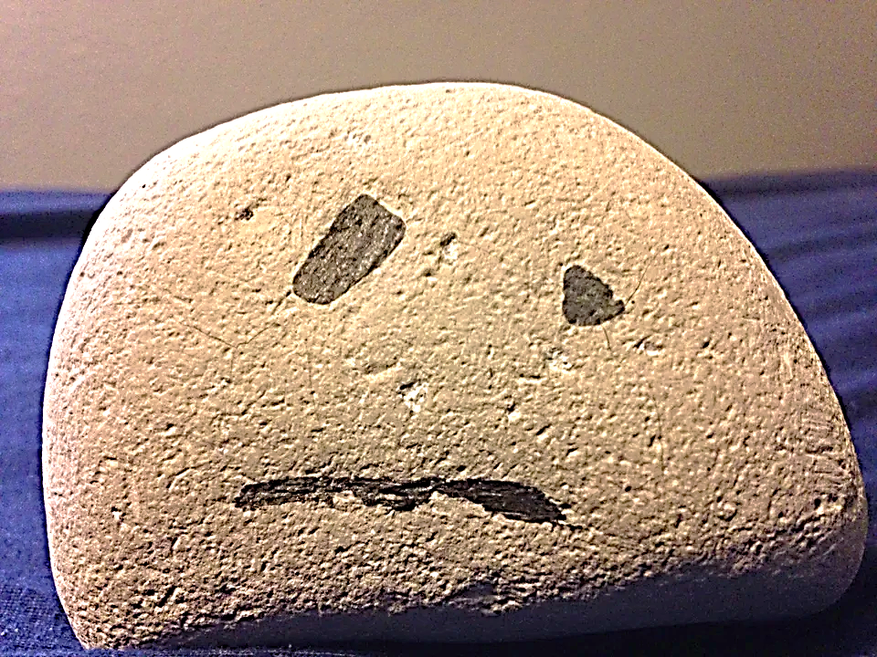
For now, rocks are silent (except they do groan and travail until the day believers have been resurrected and brought into their full glory).

Slide 41
If they could speak now, and when they can speak, they have two subjects to talk about.
1) They are witnesses to the all the works of both man & God.
(Rocks have been here from the beginning.)
2) They will sing the praises of Jesus Christ and glorify His name.

Slide 42
In a moment, we will talk about another creation (angels) which also have the same two duties.
Furthermore, we too are called to this same dual purpose.
1) To be His witnesses and tell the world what we have seen and experienced of His salvation.
2) To worship Him, continually and loudly!!! For we have already been set free to do so!

Slide 43
A famous catechism question (known to many Presbyterian children) is this:
Question: “What is the chief end of man?”
Answer: “Man's chief end is to glorify God, and to enjoy him forever.”
This answer combines the two things that Jesus lost in the Garden—the worship due Him from all creation and the companionship He craves from mankind.

Slide 44
The creation of Eve is another important metaphor (type/shadow).
It wasn’t good for man to be alone, and therefore God made a bride for Adam…
…God also longed for a companion and made a bride for Himself.
Ultimately, Jesus will regain the worship of His creation plus fellowship with His bride (the Church).

Slide 45
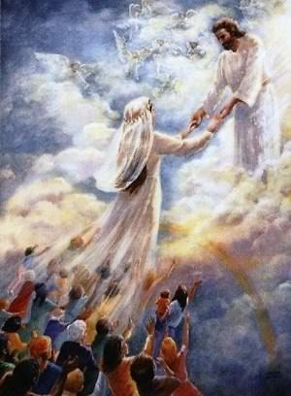

Slide 46
The end of God’s plan will bring about these very two things.
#1 God will be glorified as He destroys the curse and provides Creation with new life.
#2 God will be brought back into sweet fellowship with His most valued creation – mankind.

Slide 47
“This is what God planned for the climax of all times: to bring all things together in Christ, the things in heaven along with the things on earth.” EPH 1:10 CEB

Slide 48
“I am the Alpha and the Omega, the first and the last, the beginning and the end." Rev 22:13 ESV

Slide 49
Question #2
What is Jesus saying about Himself in this verses?

Slide 50
The Alpha – Jesus is the source where all things began.
Jesus was not only there at the beginning, He IS The Beginning!!!
The source-The Life!
Jesus is the Omega – It is to Jesus that all things are headed.
Everything springs forth from Him and everything ultimately returns to Him.

Slide 51
When the whole story ends—Jesus is Exalted –– Evil is defeated, and Heaven and Earth are fully back in Christ’s care.
The effects of sin are overturned, and Jesus is Lord of all!
From the beginning God was planning the ending.

Slide 52
“Bethlehem Ephrathah, you are too little to be among the family groups of Judah. But from you One will come who will rule for Me in Israel. His coming was planned long ago, from the beginning.” MIC 4:12 NLV

Slide 53
Question #3
Why do you think Jesus chose such a small town to start His mission on Earth?

Slide 54
“We are writing to you about something which has always existed yet which we ourselves actually saw and heard: something which we had an opportunity to observe closely and even to hold in our hands, and yet, as we know now, was something of the very Word of life himself…

Slide 55
…For it was life which appeared before us: we saw it, we are eye-witnesses of it, and are now writing to you about it. It was the very life of all ages, the life that has always existed with the Father, which actually became visible in person to us mortal men. We repeat, we really saw and heard what we are now writing to you about.” 1 Jhn 1:1,2 Phillips

Slide 56
Jesus was the beginning. Creation began with Him. Life began with Him.
Now the story continues. It is a production that is perfectly planned and exactly timed.
And for this story, God first made an everlasting audience.
God created the heavens & angels before He started on the Earth and mankind.

Slide 57
They were to be witnesses of His glory.
In the book of Job, God tells Job that he (Job) has no idea how to make an Earth.
God also tells Job that the angels shouted great praises with each amazing thing Jesus did as He created Earth.

Slide 58
“Where were you when I made the earth’s foundation? Tell me, if you understand. Who marked off how big it should be? Surely you know! What were the earth’s foundations set on? Or who put its cornerstone in place? Who did all this while the morning stars sang together? Who did this while the angels shouted with joy?” Job 38:4-7 ICB

Slide 59
Question #4
If you were a Heavenly angel, what would your average day be like?

Slide 60
We think of angels helping people like us and they do but their primary role, their original purpose was and is to be eyewitnesses of God’s unfolding plan, and to whole-heartedly applaud His every move.

Slide 61
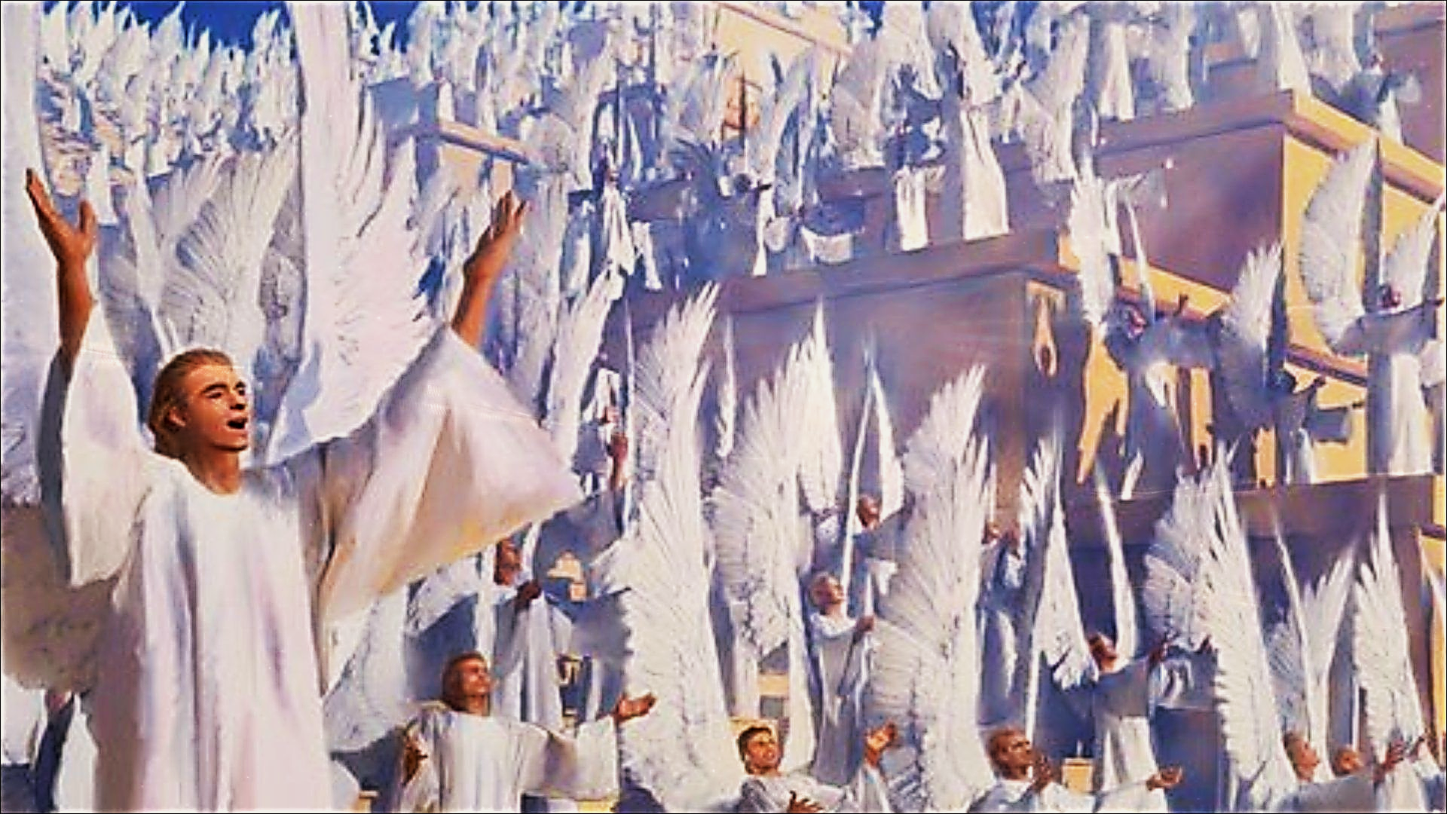
“Holy, Holy, Holy”

Slide 62
“Shout praises to the Lord! Shout the Lord’s praises in the highest heavens. All of you angels, and all who serve him above, come and offer praise.” Psalm 148:1,2

Slide 63
Question #5
If angels (who only know Jesus as their creator) spend all their time shouting praises to the Lord, how should we be responding to Him who has both created us and who died to save us?

Slide 64
God uses both Creation & His work of redemption to testify to men & angels of BOTH His greatness and His goodness.
Angels have always and will always witness every step of God’s plan:
The creation of Earth & man plus the fall,
Christ’s sacrificial redemption of man and ultimately, His final glorification.
Angels were even at His birth praising Him for what He was doing for lost mankind.

Slide 65
Angels witness it
all and they are in AWE!

Slide 66
“Then all at once, a vast number of glorious angels appeared, the very armies of heaven! And they all praised God, singing: “Glory to God in the highest realms of heaven! For there is peace and a good hope given to the sons of men.” Luke 2:13,14 TPT

Slide 67
For the angels, the birth of Jesus (as a human man) was an occasion to offer great praise to their God… “Glory to God in the highest realms of heaven!”
The angels knew that this was mankind’s opportunity to make peace with God… “For there is peace and a good hope given to the sons of men.”

Slide 68
“And so here I am, preaching and writing about things that are way over my head, the inexhaustible riches and generosity of Christ. My task is to bring out in the open and make plain what God, who created all this in the first place, has been doing in secret and behind the scenes all along…

Slide 69
…Through followers of Jesus like yourselves gathered in churches, this extraordinary plan of God is becoming known and talked about even among the angels!” EPH 3:8-10 MSG

Slide 70
This big secret was God’s timetable—God’s plan for the ages.
It was His plan to fix everything man had broken through sin.
And the big secret that would fix everything—began with sending JESUS to come to Earth to save man.
Firstly, His incarnation (becoming flesh) then, His death and resurrection.

Slide 71
The greatness of His love and kindness to man is the final thing the angels desire to witness and comprehend!
You see, Jesus kept His plan a secret from the Old Testament prophets and even the hosts of angels.
The prophets foretold Jesus but couldn’t make heads or tails of their own prophecies.
But now, He has revealed it to us…and His name is Jesus!

Slide 72
“The prophets of old did their utmost to discover and obtain this salvation. They did not find it, but they prophesied of this grace that has now come to you. They tried hard to discover to what time and to what sort of circumstances the Spirit of Christ working in them was referring. For he foretold the sufferings of Christ and the glories that should follow them…

Slide 73
…It was then made clear to them that they were dealing with matters not meant for themselves, but for you. It is these very matters which have been made plain to you by those who preached the Gospel to you by the same Spirit sent from Heaven—and these are facts to command the interest of the very angels!
1 PET 1:10-12 Phillips

Slide 74
It may seem that God’s plan is taking a long time…But God is not late or slow…
He is right on time according to His timetable.
He’s an on-time God, Yes, He is!

Slide 76
JFMQP:
Lesson 8
God’s Timetable pt. 2
Timing is Everything!

