Slide 1
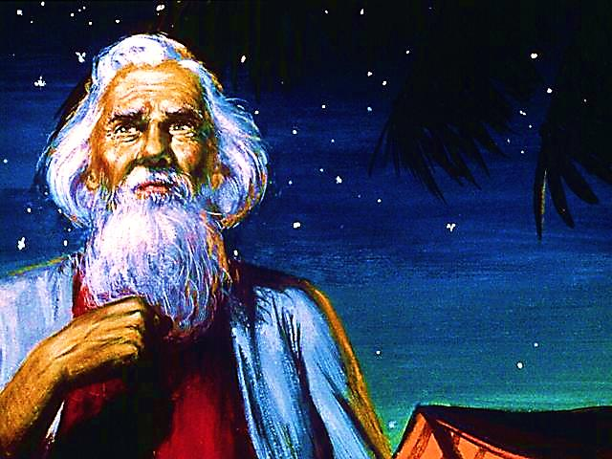
God Calling

Slide 2



If you would like to watch the video of this live service, click here:
https://campaignkerusso.org/?p=7580
We would love to know more about the people who download our lessons & sermons. We invite you to email us & let us know where & how you use them.
info@ckusa.org

Slide 3
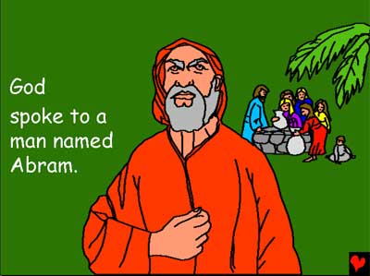

Slide 4
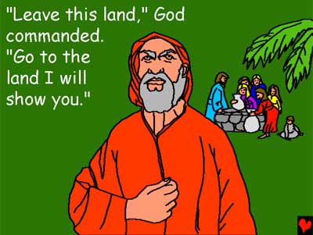

Slide 5

Gen 12:1 CEV
“The Lord said to Abram: Leave your country, your family, and your relatives and go to the land that I will show you.”

Slide 6
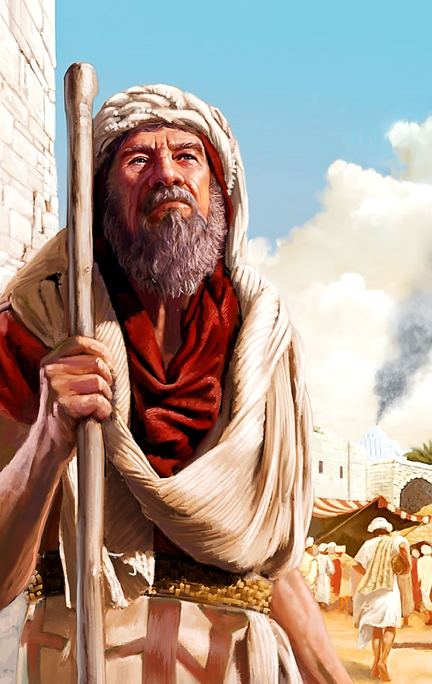
When God speaks to your heart (and you know He is calling you) you will be asked to leave everything behind for a future you cannot see… you will only have God’s Word.

Slide 7
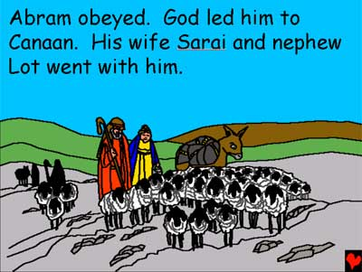

Slide 8
Heb. 11:8 TLB
“Abraham trusted God, and when God told him to leave home and go far away to another land that he promised to give him, Abraham obeyed. Away he went, not even knowing where he was going.”

Slide 9
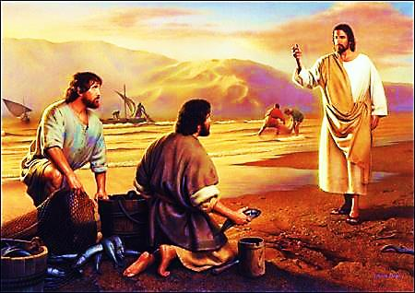
Later, Jesus called two tradesmen and told them to leave everything and follow Him.
They immediately dropped everything and followed Him.

Slide 10
Matthew 4:18-20 ERV
“As Jesus was walking by Lake Galilee, he saw two brothers, Simon (called Peter) and Simon’s brother Andrew. These brothers were fishermen, and they were fishing in the lake with a net…

Slide 11
Matthew 4:18-20 ERV (cont.)
…Jesus said to them, “Come, follow me, and I will make you a different kind of fishermen. You will bring in people, not fish.” Simon and Andrew immediately left their nets and followed him.”

Slide 12
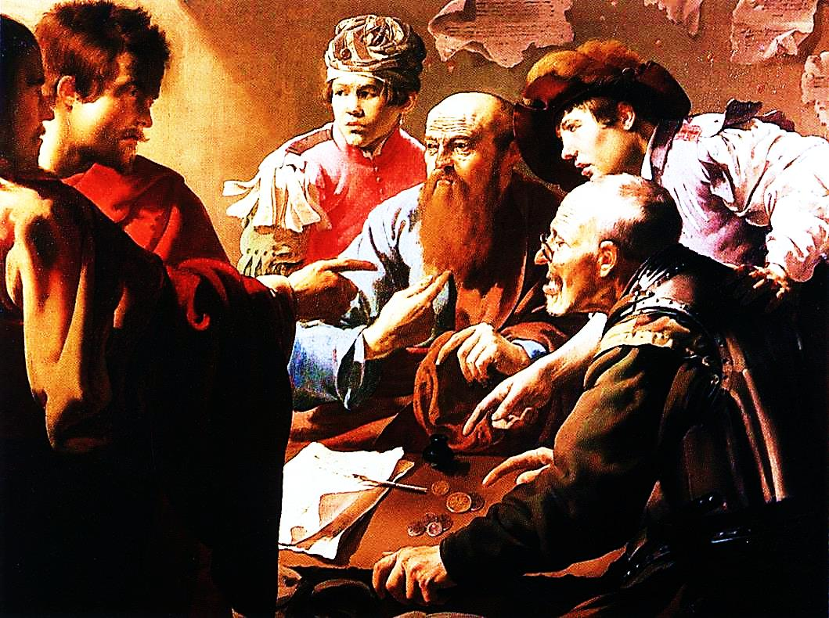
Then, Jesus called a businessman and told him to leave his business and follow Him.
The man immediately dropped everything and followed Jesus.

Slide 13
Matthew 9:9 ISV
“As Jesus went on from there, he saw a man named Matthew sitting at the tax collector’s desk and told him, “Follow me.” So, he got up and followed him.”

Slide 14
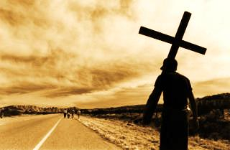
There is only one way to answer the call of God…
Let go of your life and choose to follow Him…
No matter what!

Slide 15
Mark 8:38
“Jesus called the people and His followers to Him. He said to them, "If anyone wants to be My follower, he must give up himself and his own desires. He must take up his cross and follow Me.”

Slide 16

Peter asked Jesus the question that was probably on every one’s mind.

Slide 17
Mat. 19:27 ICB
“Peter said to Jesus, “We left everything we had and followed you. So, what will we have?”

Slide 18
Mat. 19:28, 29 ICB
“Jesus said to them… everyone who has left houses, brothers, sisters, father, mother, children, or farms to follow me will get much more than he left. And he will have life forever.”

Slide 19
Let’s look at everything God promised Abram if he would trust Him enough to leave everything he knew and follow the Lord’s call.

Slide 20
Gen. 12:2-3 CEV
“I will bless you and make your descendants into a great nation. You will become famous and be a blessing to others. I will bless those who bless you, but I will put a curse on anyone who puts a curse on you. Everyone on earth will be blessed because of you.

Slide 21
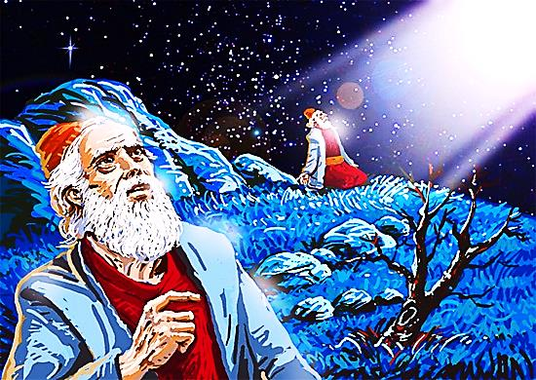
God blessed him and changed his name from Abram to Abraham.
Abram means “Father”
Abraham means “Father of Multitudes”
You can’t out-give God → Whatever you leave for Him, He will give you so much more!

Slide 22
He Promised Abraham a City →
It was HEAVEN!
He promised Abraham many children →
It was every Christian believer!

Slide 23
Rom. 4:3, 11 NCV
“because the Scripture says, ‘Abraham believed God, and God accepted Abraham’s faith, and that faith made him right with God.’”
…So, Abraham is the father of all those who believe…”

Slide 24
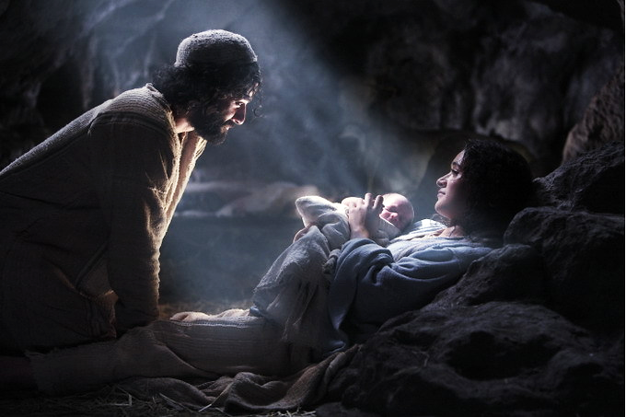
AND… He promised Abraham that one of his great, great, great grandchildren would one day do something to help everyone in the Whole World!!!
It was Jesus! He paid for man’s sin when He died on the cross.

Slide 25

Best of All…

Slide 26
James 2:23 NCV
“…Abraham believed God, and God accepted Abraham’s faith, and that faith made him right with God.” And Abraham was called God’s friend”

Slide 27
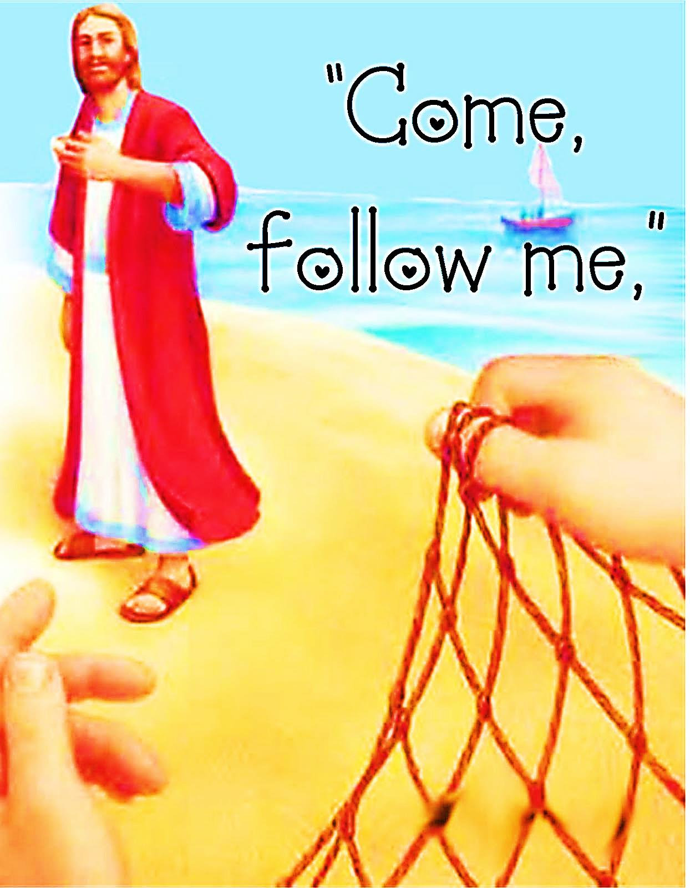
It takes faith to step out when God is calling
You might have to leave things or people behind. but…
God is worth it & He will bless you more than you can imagine & you will be a friend of God.

Slide 28
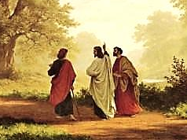
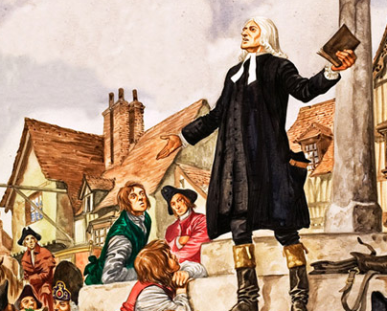
Is Jesus
Speaking to You?
“They said to each other, ‘Did not our hearts burn within us while he talked to us on the road, while he opened to us the Scriptures?’”
John Wesley Said:
“…the preacher was describing the change which God works in the heart through faith in Christ and I felt my heart strangely warmed.”
Jesus makes His presence Known by a small voice!

Slide 29
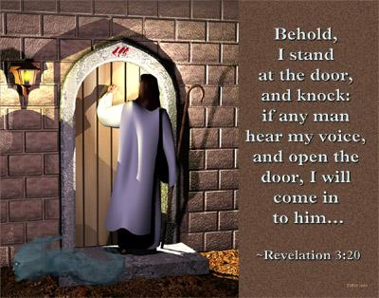

Slide 30
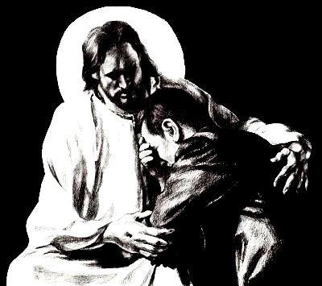
What is the Sinner‘s Prayer?
This is a prayer we can pray when we are ready to admit we are sinners and need Christ’s forgiveness.
It must be prayed with faith in our hearts and a readiness to have a life-changing encounter with Jesus Christ.

Slide 31

“Draw near to God, and He will draw near to you…
…Cleanse your hands, you sinners, and make your hearts pure, you who are half-hearted towards God.” James 4:8 WNT

Slide 32

A prayer of faith → Pray this prayer if :
If you never have before
You have in the past, but you think it would mean more today
You have been walking afar off and you want to come back
You want to set an example & show others how it is done
You just like to give your heart to Jesus again & again
Faith

Slide 33

Dear Jesus,
I know I am a sinner & need your forgiveness.
I believe you died for my sins.
I now turn from sin.
Come into my heart I pray.
Please wash away my sin.
Do you want to meet Jesus as your savior right now?
Do you believe He died to save you from your sins & that He rose from the dead?
Do you believe that He is waiting to save you right now?

Slide 34


“But some people did accept him. They believed in him, and he gave them the right to become children of God.”
John 1:12

Slide 35



Slide 36
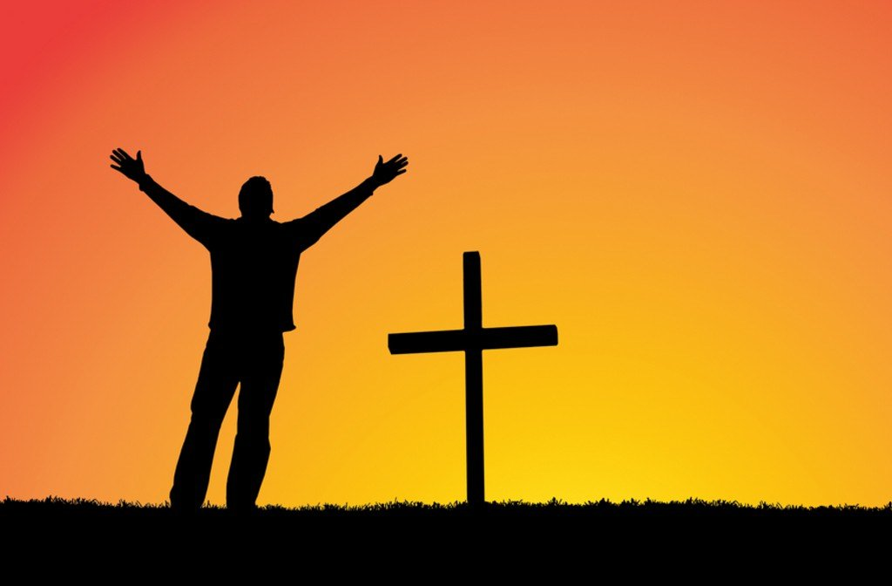
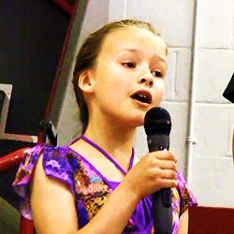
We Declare Our Faith Publicly Because Jesus Declared His LOVE Publicly
“If you stand before others and are willing to say you believe in me, then I will tell my Father in heaven that you belong to me.” Mat 10:32

Slide 37


“If you openly say, ‘Jesus is Lord’ and believe in your heart that God raised him from death, you will be saved.”
Rom. 10:9
What did you learn today?
What have you been thinking about God lately?
What do you want to tell others about Jesus?

Slide 38
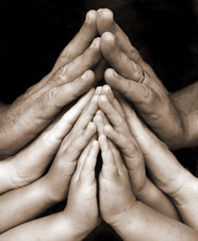
Close in Prayer

