Slide 1
God’s Timetable, pt. 4 –
Jesus Watches the Father’s Clock

Slide 2
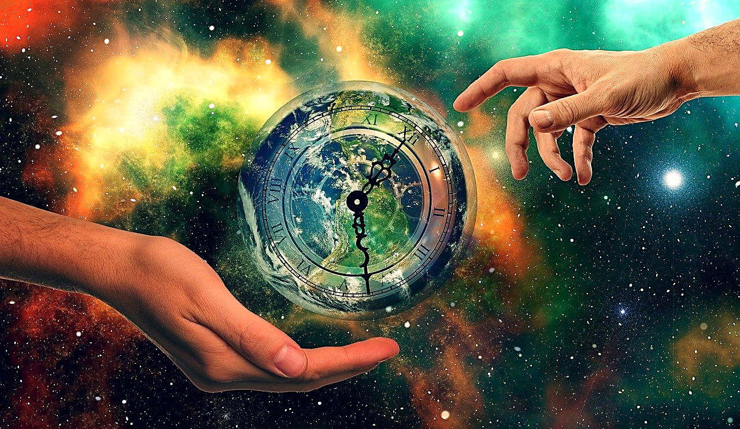
Lesson #10
God’s Timetable pt. 4
“Jesus Watches the Father’s Clock”

Slide 3
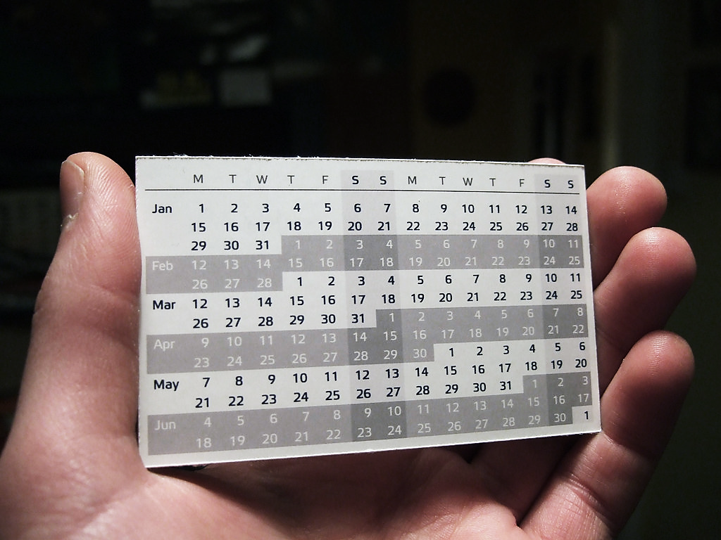
God’s Timetable Pt. 4

Slide 4
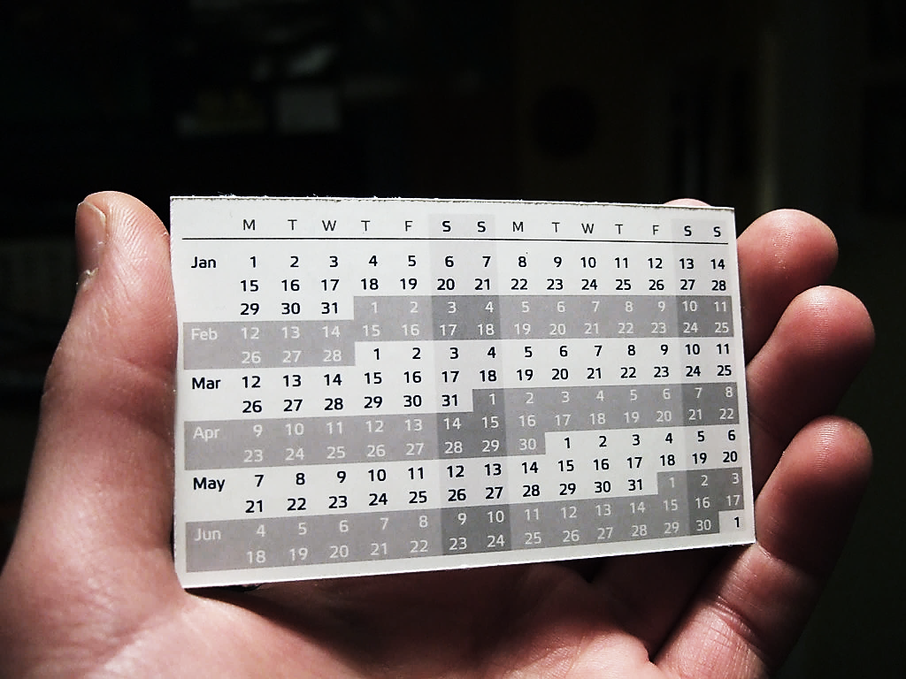
Here we see a large hand holding a small planner—this is like God looking at His timetable.
To Him, time is a very small thing, and it is entirely under His control.
The Old Testament is written in a way that progressively unveils a coming “Promised One.”
It’s the main theme of all scripture!

Slide 5
In Genesis, we read the words, “In the beginning.”
The beginning of what?
It was the beginning of time itself.
It was the beginning of God’s plan for the ages.
God’s plan was to save mankind and glorify His son Jesus.
God has made a very detailed timetable, which both the Father and the Son follow.

Slide 6
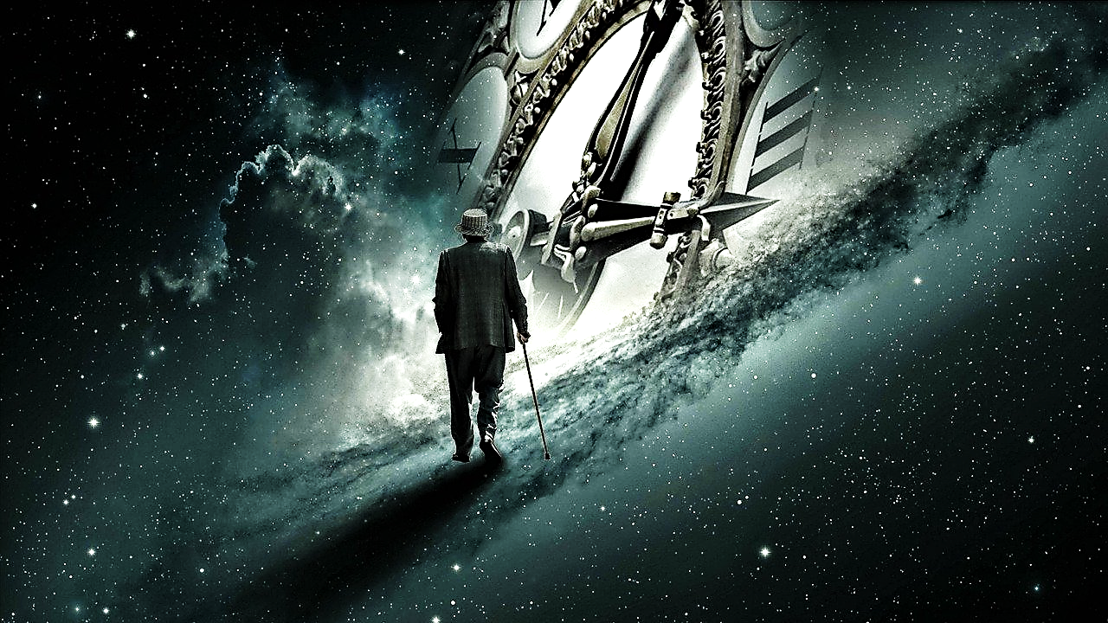
Jesus Watches the Father’s Clock.
Jesus was born late in history, yet, exactly on time.
It looks like this man has gotten old watching the great clock of history…
But our Jesus is just getting started.

Slide 7
Throughout the Old Testament, God was laying a foundation, preparing the whole world (especially Israel) for the coming of His great gift.
His preparations included using:
In Review:

Slide 8
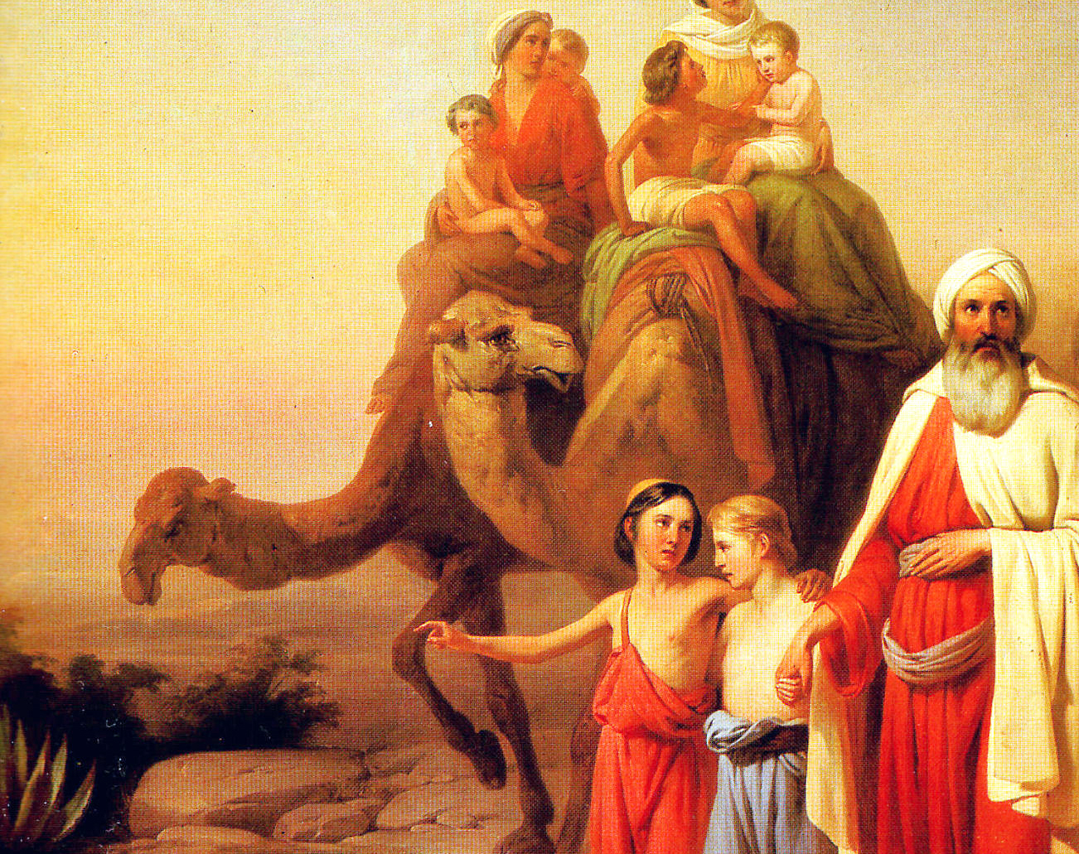
His People

Slide 9
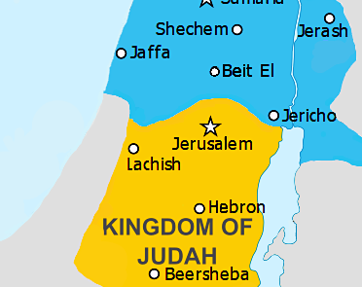
His Place

Slide 10
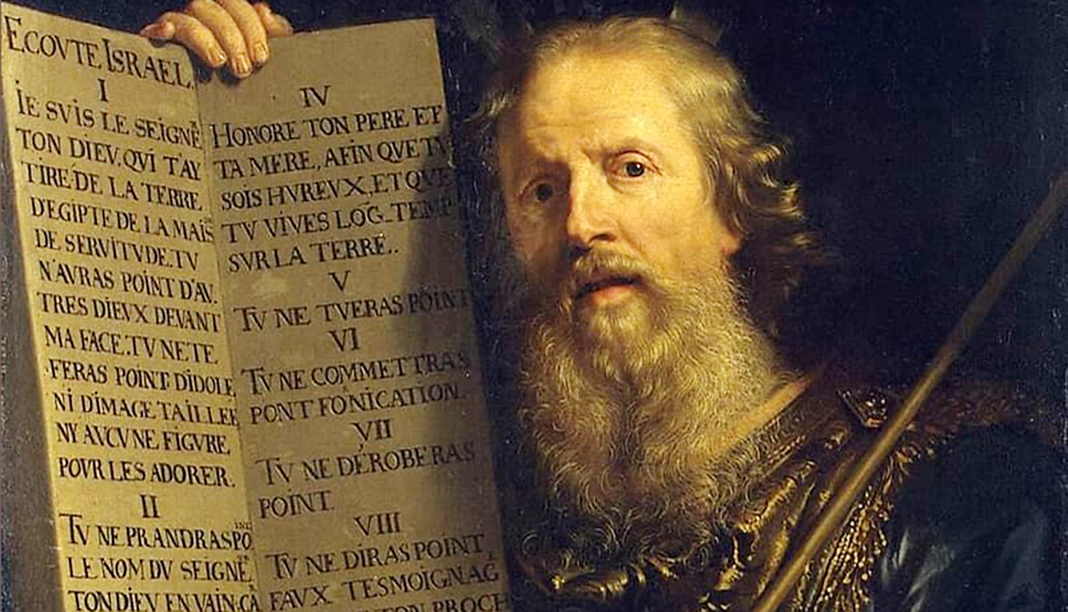
His Professor

Slide 11
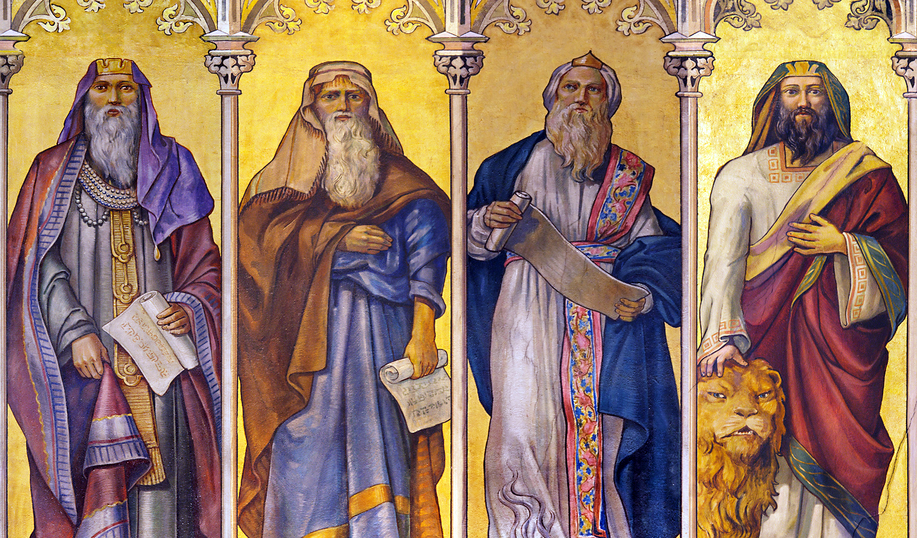
His Prophets

Slide 12
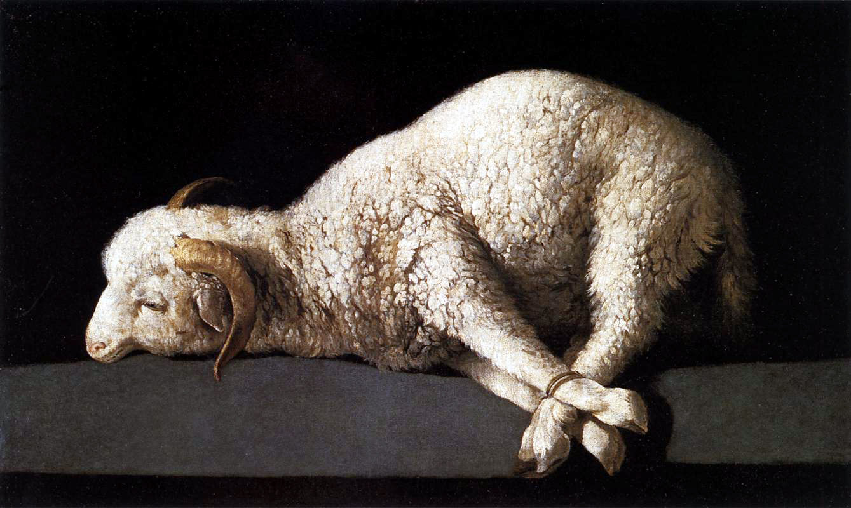
His Pictures

Slide 13
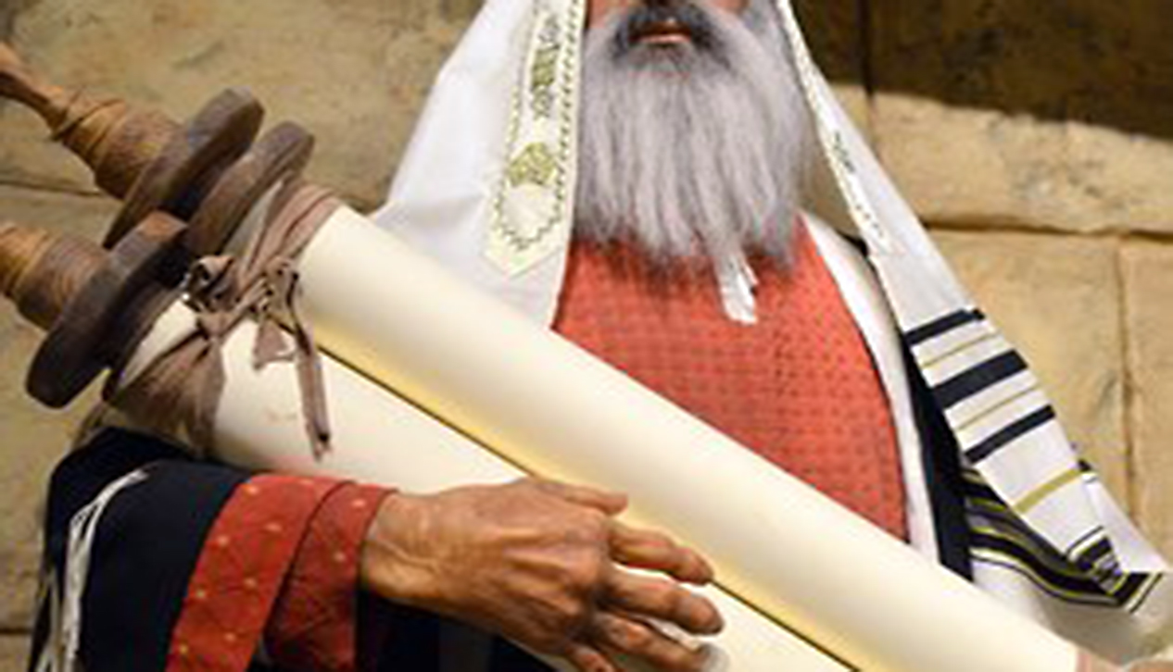
His Pages

Slide 14
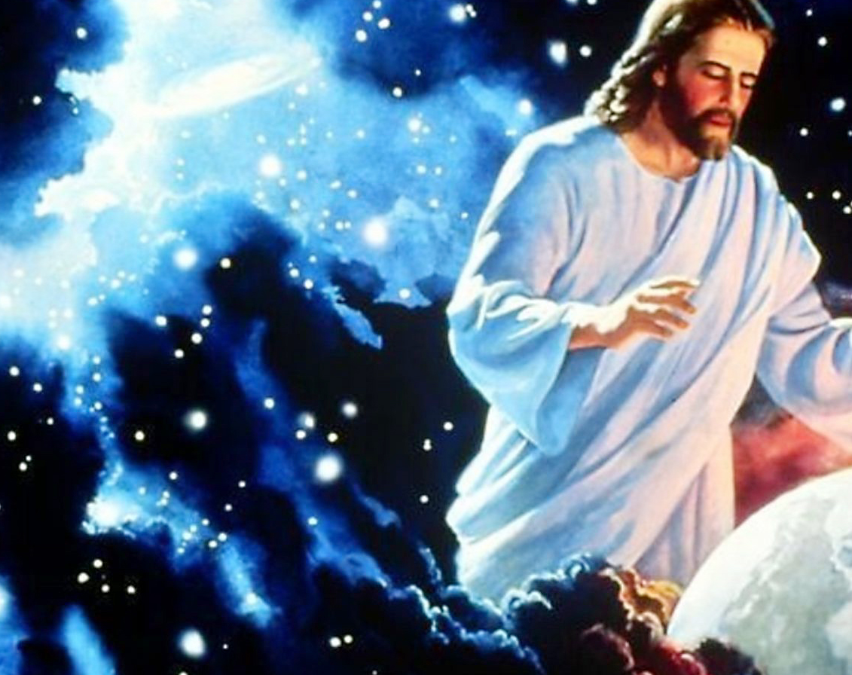
His Patience

Slide 15
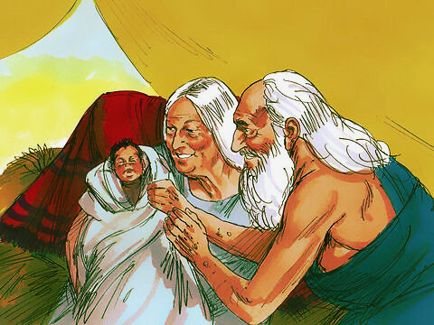
The bible is full of pictures of Jesus.
In the Old Testament, we read about Abraham’s son, Isaac.
Through Isaac,
Jesus would
one day
come.
Like Jesus, Isaac was a promised child, a miracle child, and a long-awaited child.
Just as Jesus came late in history, Isaac’s mom, Sarah, was 90 years old (near Sarah’s last days) when Isaac was born.

Slide 16
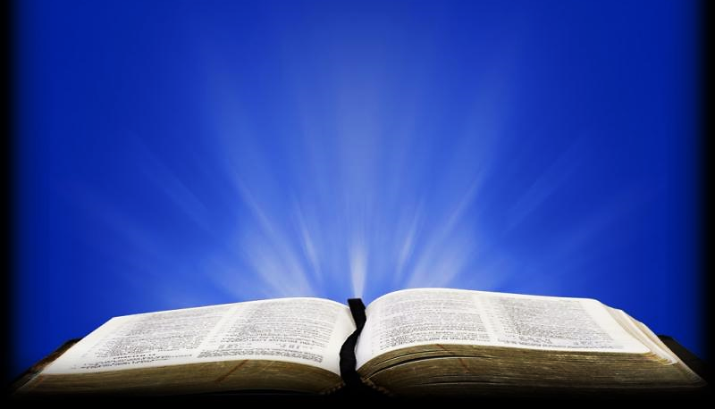
Genesis 18:14 ESV
“Is anything too hard for the Lord? At the appointed time I will return to you, about this time next year, and Sarah shall have a son.”

Slide 17
Question #1:
Why do you think Sarah had to wait one more whole year to have her promised child?
Why do we sometimes have to wait on God?

Slide 18
Gal 4:4 ESV
"But when the fullness of time had come, God sent forth his Son, born of woman…”

Slide 19
Question #2:
How does the birth of Sarah’s son Isaac (at the appointed time) and the birth of Jesus (at the appointed time) remind us that God is working on a timetable?

Slide 20
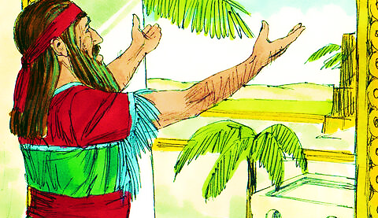
God’s timetable is planned in detail:
While Daniel (from the lion’s den story) was in prayer one day, the angel Gabriel came to explain a secret about God’s timetable to him.
He would tell Him exactly when the Messiah King— Jesus was to come.

Slide 21
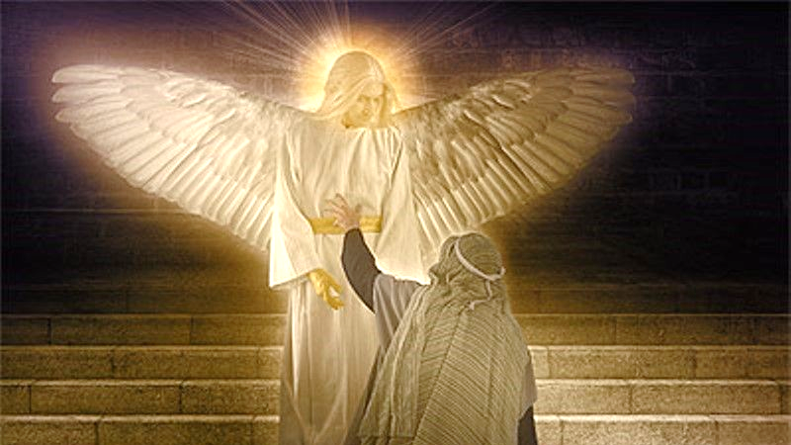
Why did the angel choose to tell him?
Daniel was a man of prayer, prayers which consisted of confession of his own sins and of the nation’s.
It is to men and women of prayer and penitence, that God promises revival.
In this case, God was so moved He sent an angel to Daniel to tell him His plans concerning the Christ.

Slide 22
Daniel 9:20-26 TLB
“…Even while I was praying and confessing my sin and the sins of my people… Gabriel, whom I had seen in the earlier vision… said to me, “Daniel, I am here to help you understand God’s plans.

Slide 23
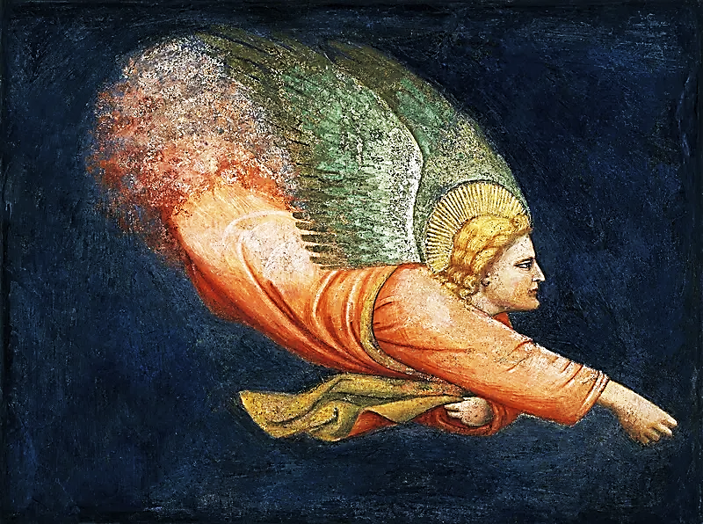
At this time, the Jews were in captivity, the Temple was in ruins, and it all seemed hopeless.
The angel gave Daniel a very detailed timetable concerning the remainder of the Old Testament and the first coming of the Christ.

Slide 24
Daniel 9:20-26 TLB cont.
…The moment you began praying a command was given. I am here to tell you what it was, for God loves you very much. Listen and try to understand the meaning of the vision that you saw! …

Slide 25
Daniel 9:20-26 TLB cont.
…The Lord has commanded 490 years… Then at last they will learn to stay away from sin, and their guilt will be cleansed; then the kingdom of everlasting righteousness will begin…

Slide 26
Daniel 9:20-26 TLB cont.
…It will be 49 years plus 434 years from the time the command is given to rebuild Jerusalem until the Anointed One comes! Jerusalem’s streets and walls will be rebuilt despite the perilous times…

Slide 27
Daniel 9:20-26 TLB cont.
…After this period of 434 years, the Anointed One will be killed, his kingdom still unrealized . . . and a king will arise whose armies will destroy the city and the Temple.”

Slide 28
It all happened exactly as Gabriel said it would.
The king of Persia gave the order to restore the Temple of the Lord.
This work took 49 years to complete… just as the angel had told Daniel.
After the completion of the second temple, there was a long wait…

Slide 29
Then, as the angel said, 434 years later, Jesus rode a colt into Jerusalem on His way to be crucified.
As the Angel said, the promised One was killed (crucified), and Jerusalem fell very shortly after (in 70 AD) and the temple was destroyed (again).

Slide 30
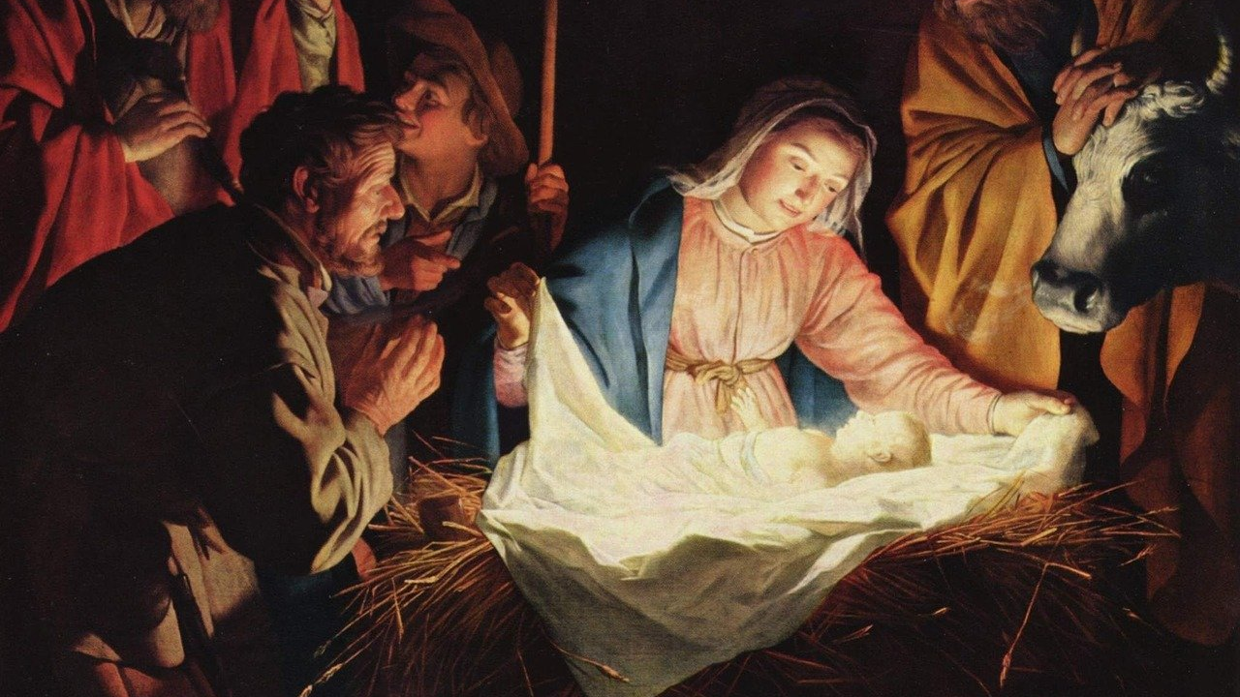
In due time(the appointed time), this hidden, mysterious, plan of God to save mankind was to be unveiled.
The gift was given.
The gift was Jesus, God in the flesh, and the plan was for Him to save mankind from their sins.
So, we see, near to the very end of Earth’s history, Jesus was born right on schedule.

Slide 31
Eph 1:9 ERV
“He let US know his secret plan. This was what God wanted, and he planned to do it through Christ.”

Slide 32
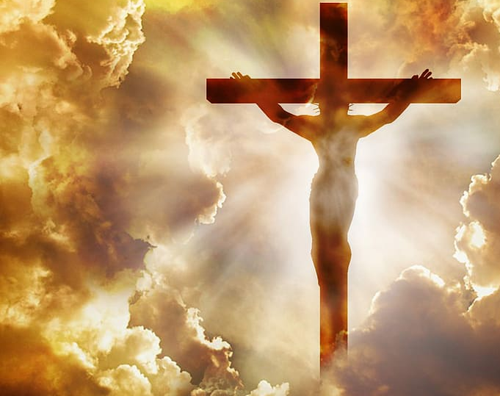
But before the completion of this plan, we must have the main event.
The event that changed everything.
The Cross!
Jesus called it:
“His Time” or “His Hour.”

Slide 33
The Promised One would finally, in the last days, be sacrificed on the cross to pay for our sins.
In that one moment, He would purchase the salvation of all mankind with His own precious blood.
The most expensive gift ever given!

Slide 34
1 Peter 1:19-20 NLV
“The blood of Christ saved you. This blood is of great worth and no amount of money can buy it. Christ was given as a lamb without sin and without spot. Long before the world was made, God chose Christ to be given to you in these last days.”

Slide 35
Did you ever pick out a gift for a friend long before their birthday ever came? Explain how this is like the Father’s gift of Jesus to the world.

Slide 36
1 John 1:1-3 NLT
“We proclaim to you the one who existed from the beginning, whom we have heard and seen. We saw him with our own eyes and touched him with our own hands. He is the Word of life.”

Slide 37
Question #5:
Why did John think it was so special and thrilling for him to have seen this man Jesus with his own eyes, heard Him with his ears and touched Him with his own hands—was Jesus so special?

Slide 38
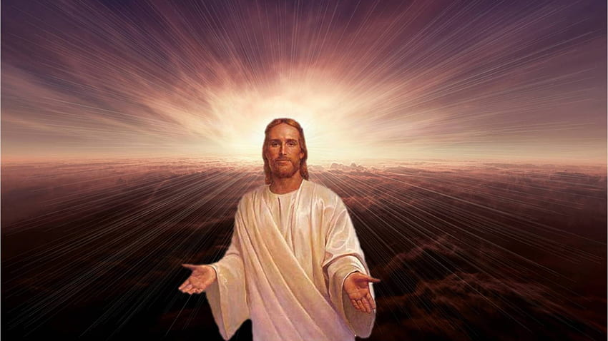
But it was slightly different in Old Testament times.
Old Testament believers put their faith in a coming redeemer, and…
New Testament believers put their faith in a redeemer who has already come.
God was faithful to His timetable.
To quote Scottish Poet, Alexander Smith—
"Christmas is the day that holds all time together.“
The way to be saved has always been by faith alone.

Slide 40
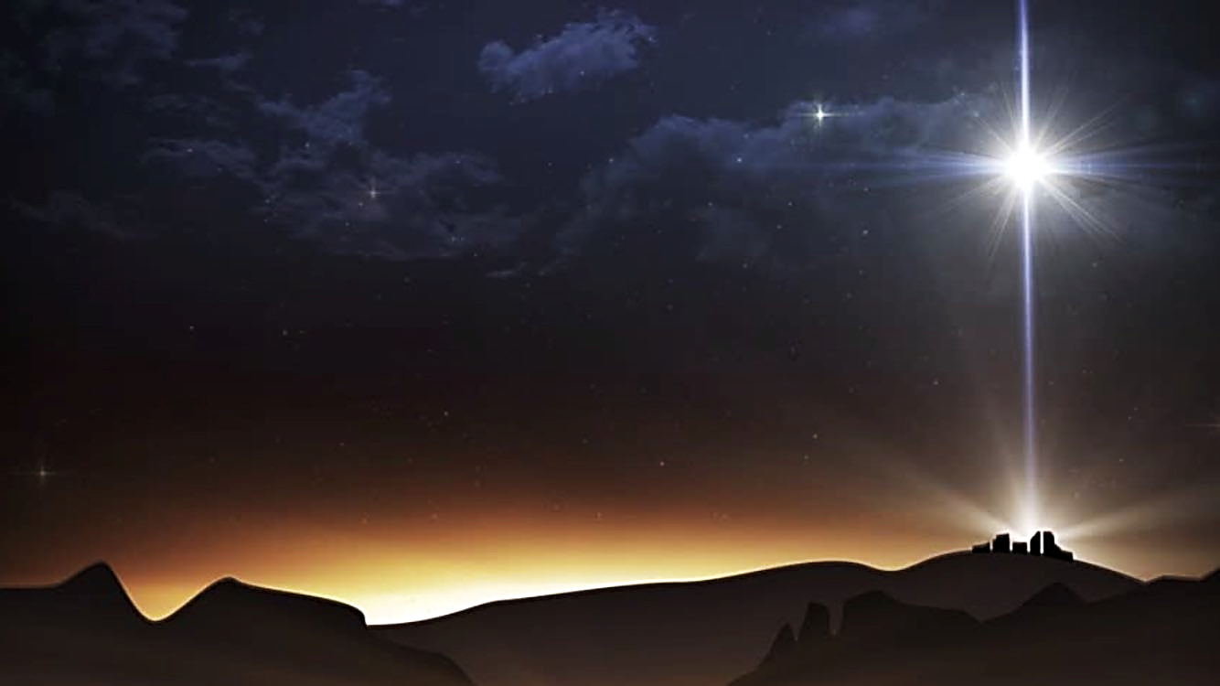
Although Jesus was born late in time, He was born exactly on time.
There was a single celestial event in the sky that marked the moment that began the earthly life of the Christ—now in human flesh.
At that second, the star would appear that would divide the Testaments.

Slide 41
Num. 24:17 ICB
“I see someone who will come some day.
I see someone who will come, but not soon.
A star will come from Jacob.
A ruler will rise from Israel…”

Slide 42
This very special star appeared over Bethlehem in Israel and signaled to the whole world that The Great King of the Universe has been born.
It appeared over Israel when Jesus was born and was a heavenly sign of both His birth and His importance.
The Star of Bethlehem would signal to the world and to Israel that the promised “Lion of Judah” was born—the prophesied powerful King who would rule the world.

Slide 43
The Lion of Judah was mentioned
by Jacob when
he prophesied
over his son Judah.
The families of Jacob’s sons would become the 12 tribes of Israel.

Slide 44
Jacob prophesied over each of his sons.
When he got to Judah, he gave a very special prophecy all about Jesus.
It was a prophecy about a mighty ruler—the Christ, who would come from Judah’s tribe.

Slide 45
Genesis 49:8-10 GNT
“Judah, your brothers will praise you. You hold your enemies by the neck. Your brothers will bow down before you. Judah is like a lion, killing his victim and returning to his den, stretching out and lying down…

Slide 46
Genesis 49:8-10 GNT (cont.)
…No one dares disturb him. Judah will hold the royal scepter, and his descendants will always rule. Nations will bring him tribute and bow in obedience before him.”

Slide 47
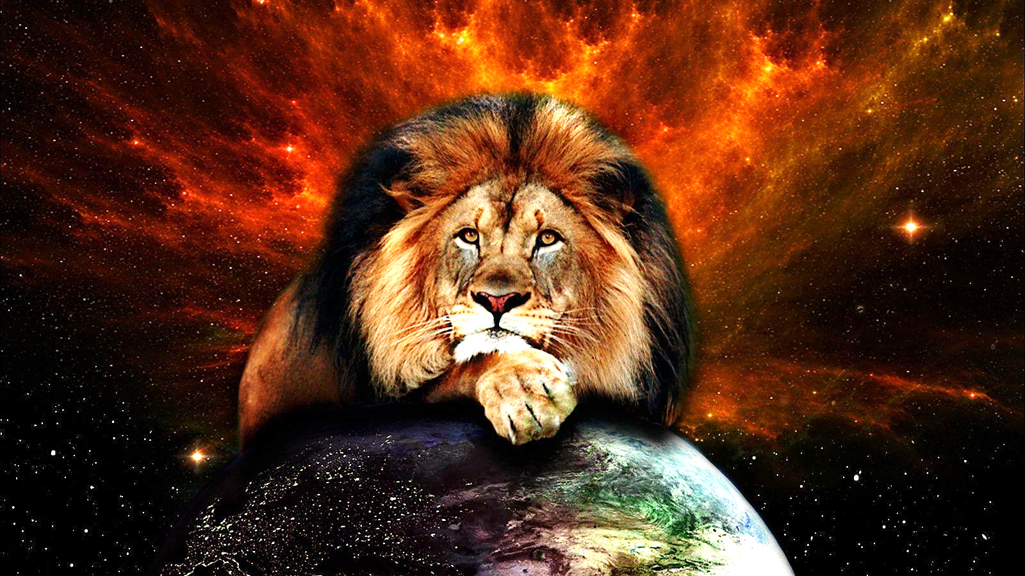
He will stand on the necks of all His enemies.
Remember, Jesus crushed His enemy, Satan, at the Cross!!
This Lion that comes from the tribe of Judah will be worshipped by His brothers (the Israelites).

Slide 48
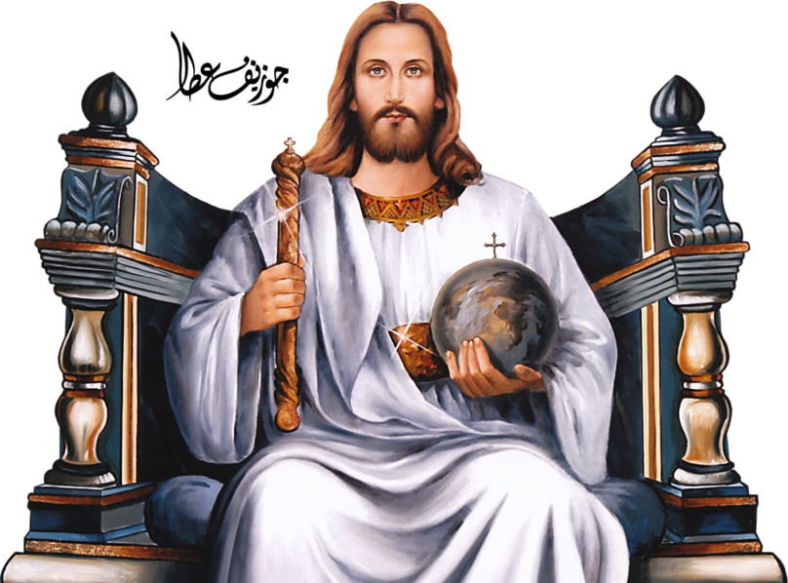
After the cross, Jesus returned to His Heavenly home because there, on the cross,the Lord’s enemy was crushed.
It was done, finished!
After this prophesied Lion crushes His enemies, He returns to His den. He’s done
It is finished!

Slide 49
Jesus as the Lion of Judah, is first mentioned in Genesis when Jacob prophesied over Judah.
It was mentioned lastly in John’s vision in Revelation.
Jesus is called the Lion of Judah in the beginning of the story and the end of the story.

Slide 50
Revelation 5:1-5 GNT
“I saw a scroll in the right hand of the one who sits on the throne; it was covered with writing on both sides and was sealed with seven seals...

Slide 51
Revelation 5:1-5 GNT (cont.)
…And I saw a mighty angel, who announced in a loud voice, “Who is worthy to break the seals and open the scroll?” But there was no one in heaven or on earth or in the world below…

Slide 52
Revelation 5:1-5 GNT (cont.)
…who could open the scroll and look inside it. I cried bitterly because no one could be found who was worthy to open the scroll or look inside it…

Slide 53
Revelation 5:1-5 GNT (cont.)
…Then one of the elders said to me, “Don't cry. Look! The Lion from Judah's tribe, the great descendant of David, has won the victory, and he can break the seven seals and open the scroll.”

Slide 54
Of all Jacob’s sons, the great lion (the one with the scepter, the one who will rule over all nations) was to come through Judah’s line.
Jesus alone has this place in destiny!
Jesus came on time, and we will see that He was always faithful to the timetable which He and the Father had planned from eternity.

Slide 56
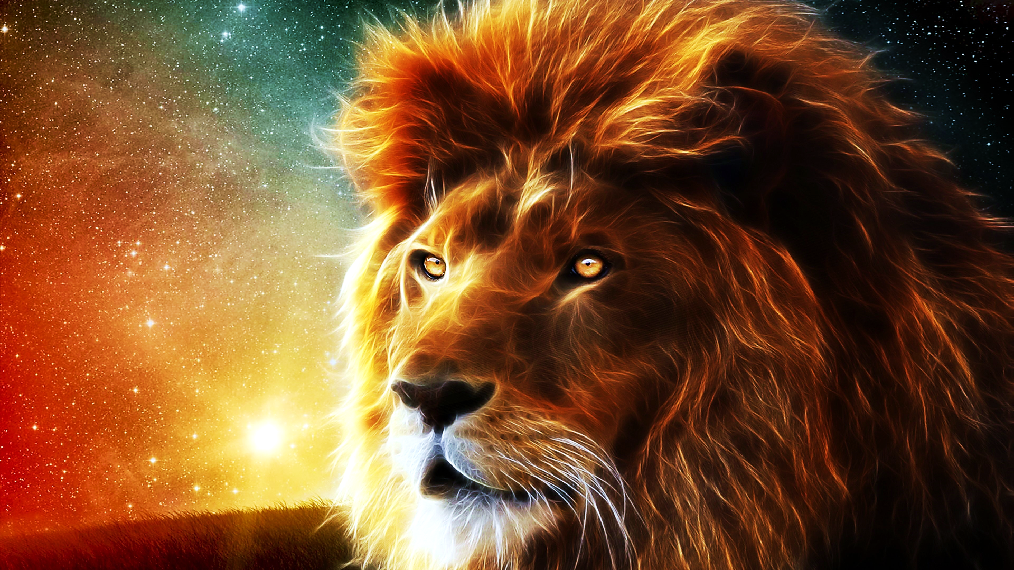
Lesson #11
God’s Timetable
pt. 5
“Wise Men Still Fear Him.”

