Slide 1
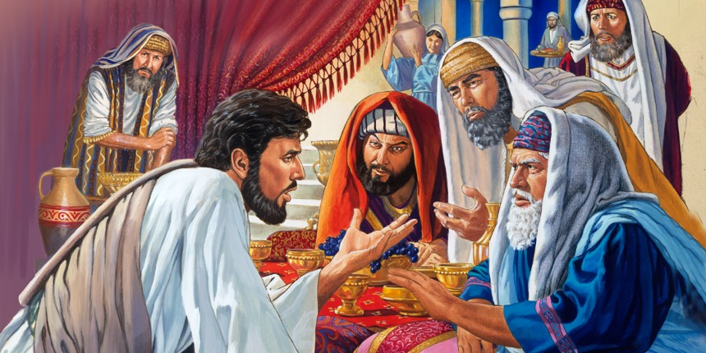
Dinner with the Pharisees
Four Lessons on True Leadership
from Luke 14:1-24

Slide 2
If you would like to watch the video of this live service, click here:
http://campaignkerusso.org/?p=12881
We would love to know more about the people who download our lessons & sermons. We invite you to email us & let us know where & how you use them.
info@ckusa.org

Slide 3
Dinner with the Pharisees
Four Lessons on True Leadership
from Luke 14:1-24

Slide 4
Luke 14:1 (ESV)
“One Sabbath, when he went to dine at the house of a ruler of the Pharisees, they were watching him carefully.”

Slide 5
Like Jesus, we (as His disciples) are carefully watched by others.
Not to see what we know, but to see how we behave…
To check up on our character.

Slide 6
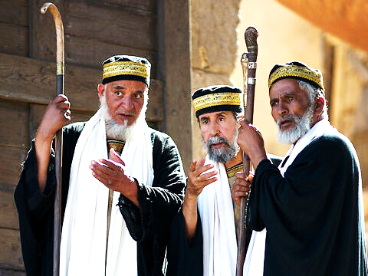
In Jesus’ time, the Pharisees were the teachers of the Jewish people.
So, Jesus takes time to teach the teachers.
What does He teach them?

Slide 7
Let’s look at four lessons Jesus taught the Jewish Pharisees on true leadership.

Slide 8
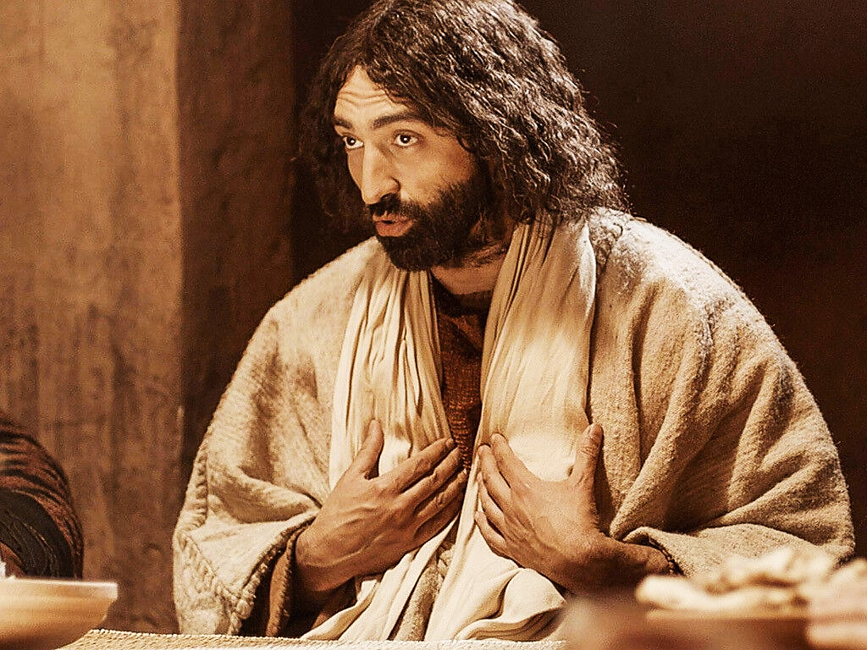
He doesn’t teach them about Jewish history or prophecy or secrets of scripture.
He teaches them how to be good leaders.
Here in Luke 14 are four lessons for them and us.
Lesson #1 is about Sincerity vs. Hypocrisy

Slide 10
Luke 14:2-6 (ESV)
“There was a man there whose arms and legs were swollen. Jesus asked the Pharisees and experts in religious law, “Is it permitted in the law to heal people on the Sabbath day, or not?”

Slide 11
Luke 14:2-6 (ESV) cont.
…When they refused to answer, Jesus touched the sick man and healed him and sent him away. Then he turned to them and said, “Which of you doesn’t work on the Sabbath?...

Slide 12
Luke 14:2-6 (ESV) cont.
…If your son or your cow falls into a pit, don’t you rush to get him out?” Again, they could not answer.”

Slide 13
Luke 14:2-6 (ESV) cont.
…If your son or your cow falls into a pit, don’t you rush to get him out?” Again, they could not answer.”

Slide 14
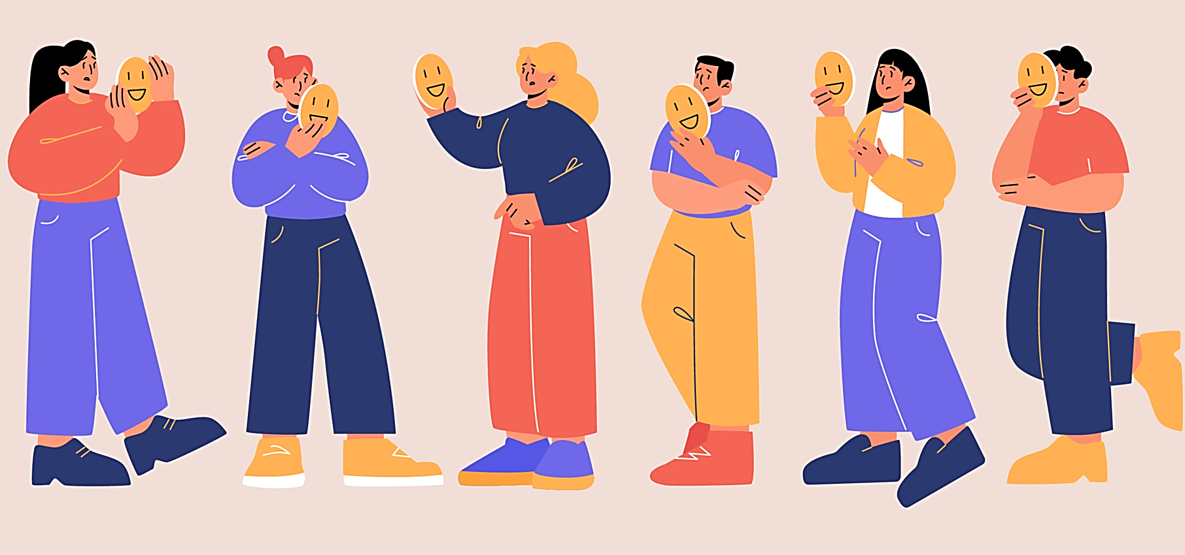
Sincerity & Hypocrisy are opposites.
Being sincere means you let people see who you really are.
Being a hypocrite means to act one way in private & another in front of people.

Slide 15
Suggested Next Slide - Video:
Man with Dropsy
Click or Ctrl Click Here:
https://youtu.be/RQel9ge82mo

Slide 16
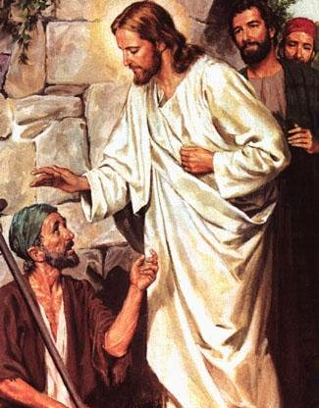
One of the leading Pharisees invited Jesus to dinner on the Sabbath.
A man with dropsy appeared at the door.
Jesus asked, "Is it lawful to cure people on the Sabbath, or not?"
Then Jesus asked: What if your son or even your cow falls into a pit… you would try to get them out … even on a Sabbath, right?
He challenged them to be honest, be real.
They didn’t answer-they knew He was right.

Slide 17
Consider how strict Jewish Sabbath law was.
Sabbath was the Jewish day of the week (Saturday) when every Jew was supposed to rest & take a day off from work.
No work of any kind was allowed other than eating, breathing or walking to synagogue.
Even cooking was done the day before.
But the Pharisees were hypocrites. They expected others to obey the Sabbath but not themselves.
Saving your cow: would take work.
Saving your son: would take work.

Slide 18
They knew in their hearts they would save their son or even their cow.
But they couldn’t admit it, because they were the first to judge other Jews for doing needful work on the Sabbath.
They knew they would be exposed as hypocrites.
I think we all can remember a time or two when we have been hypocrites.

Slide 19
Being a hypocrite takes away our ability to be good leaders, parents, husbands, wives or anyone who needs to set a proper example.
Why? Others will see through me and know I’m a fake.
Why else? God will not bless us if we are hypocrites.
It’s always easier to see when someone else is being a hypocrite.
Let’s ask the Lord to help us see ourselves, whether we are hypocrites.

Slide 20
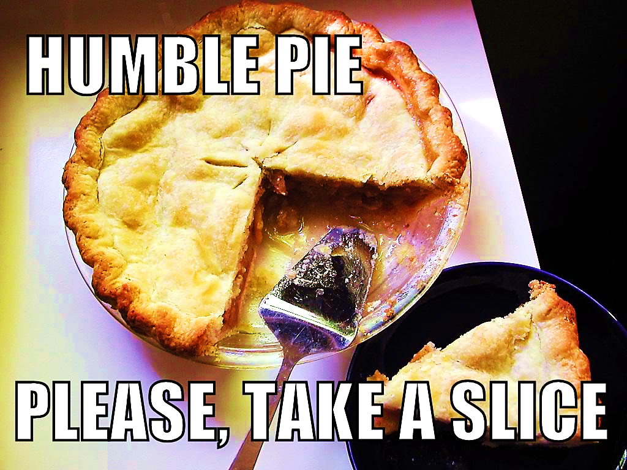
Leadership Lesson
#2 Ambition vs. Humility

Slide 21
Luke 14:7-9 (NLT)
“When Jesus noticed that all who had come to the dinner were trying to sit in the seats of honor near the head of the table, he gave them this advice: “When you are invited to a wedding feast, don’t sit in the seat of honor…

Slide 22
Luke 14:7-9 (NLT) cont.
…What if someone who is more distinguished than you has also been invited? The host will come and say, ‘Give this person your seat.’ Then you will be embarrassed, and you will have to take whatever seat is left at the foot of the table!”

Slide 23
Ambition can make us do things the Lord does not approve of.
We may not even admit we’re doing it, but God sees what’s in our hearts.
Let’s ask the Lord to help us be more humble and less ambitious.

Slide 24
Suggested Next Slide - Video:
Best Seats
Click or Ctrl Click Here:
https://youtu.be/zto7JZHOQgI

Slide 25
Lesson #3 Favoritism vs. Faith

Slide 26
Luke 14:12-14 (NLT) cont.
“Then he turned to his host. “When you put on a luncheon or a banquet,” he said, “don’t invite your friends, brothers, relatives, and rich neighbors. For they will invite you back, and that will be your only reward…

Slide 27
Luke 14:12-14 (NLT) cont.
…Instead, invite the poor, the crippled, the lame, and the blind. Then at the resurrection of the righteous, God will reward you for inviting those who could not repay you.”

Slide 28
Suggested Next Slide - Video:
Freely Serve
Click or Ctrl Click Here:
https://youtu.be/fBfyhwfp77g

Slide 29
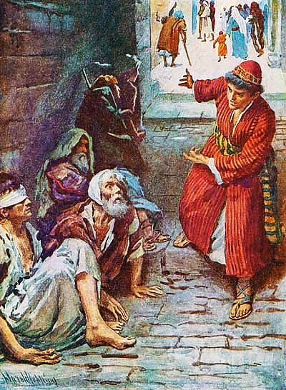
When you throw a party, don't invite only your close friends & relatives, plus the rich & famous.
You expect favors in return. You want to be invited to their parties.
You should invite people who can't repay you.
Your favor will be returned at the end of time… the resurrection.

Slide 30
We like to give people favors only if they can pay us back with another favor.
This is favoritism.
But God wants us to have faith in Him, and not expect someone to pay us back.

Slide 31
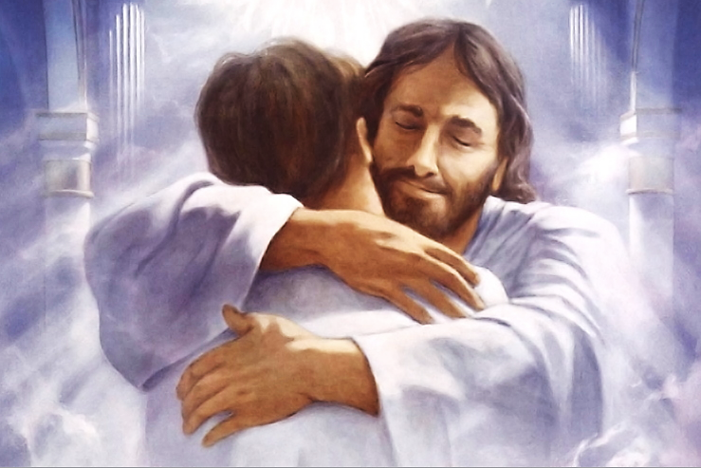
When we do favors for those who cannot return the favor, it means we have faith in God and how He wants to pay us back.

Slide 32
Leadership Lesson #4 Procrastination vs. Urgency (Regarding Christ’s Return)

Slide 33
Luke 14:16-24 (NLT)
“Jesus replied with this story: “A man prepared a great feast and sent out many invitations. When the banquet was ready, he sent his servant to tell the guests, ‘Come, the banquet is ready.’

Slide 34
Luke 14:16-24 (NLT) cont.
…But they all began making excuses. One said, ‘I have just bought a field and must inspect it. Please excuse me.’ Another said, ‘I have just bought five pairs of oxen, and I want to try them out. Please excuse me.’…

Slide 35
Luke 14:16-24 (NLT) cont.
… Another said, ‘I just got married, so I can’t come.’ “The servant returned and told his master what they had said. His master was furious and said, ‘Go quickly into the streets and alleys of the town and invite the poor, the crippled, the blind, and the lame.’…

Slide 36
Luke 14:16-24 (NLT) cont.
… After the servant had done this, he reported, ‘There is still room for more.’ So his master said, ‘Go out into the country lanes and behind the hedges and urge anyone you find to come, so that the house will be full. For none of those I first invited will get even the smallest taste of my banquet.’”

Slide 37
Procrastination is putting off
for tomorrow
what you
should do
today.

Slide 38
Suggested Next Slide - Video:
Ministry Procrastination
Click or Ctrl Click Here:
https://youtu.be/1LyPAT2UO00

Slide 39
A man's planning a big party and sends out many invitations.
When the day comes, he sends his servant to gather the invited, "Come; for everything is ready.“ But each has an excuse why he is unable to attend.
The first, has purchased a field and he wants to see it.
The second, has purchased five oxen and he wants to test them.
Notes:
Let’s go over this story again

Slide 40
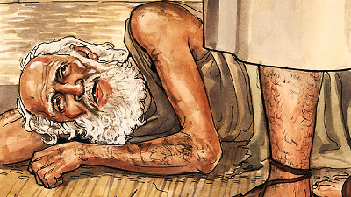
The third, just got married and has responsibilities at home.
The servant returns and reports to his master that everyone's busy.
The master orders
His servant to search go into the city and alley-ways
and invite "the poor,
the crippled, the blind,
and the lame.“
The master concludes: “None of those first invited, will taste my dinner."

Slide 41
This last lesson is both a call to the Christian believers & a warning to those who put off receiving Jesus with excuses.
Those the master of the house first invited made excuses and would not come, so the master of the house sent an open invitation to anyone who would like to come.

Slide 42
Salvation is an open invitation to the world, & also an urgent reminder to Christians.
We need to get God’s invitation to salvation out now.
Also, those who receive the invitation must not put off the invitation with procrastination & constant excuses.
Remember what Jesus warned: “None of those first invited will taste my dinner.”

Slide 43
Jesus’ Four Lessons for True Church Leadership
Be Honest & Genuine
(Not a Hypocrite)
Be a Humble Servant
(Not Ambitious)
Give Freely
(Not Seeking Favors)
Salvation is an Urgent Message

Slide 44
Is Jesus
Speaking to You?
“They said to each other, ‘Did not our hearts burn within us while he talked to us on the road, while he opened to us the Scriptures?’”
John Wesley Said:
“…the preacher was describing the change which God works in the heart through faith in Christ and I felt my heart strangely warmed.”
Jesus makes His presence Known by a small voice!

Slide 46
What is the Sinner‘s Prayer?
This is a prayer we can pray when we are ready to admit we are sinners and need Christ’s forgiveness.
It must be prayed with faith in our hearts and a readiness to have a life-changing encounter with Jesus Christ.

Slide 47
“Draw near to God, and He will draw near to you…
…Cleanse your hands, you sinners, and make your hearts pure, you who are half-hearted towards God.” James 4:8 WNT

Slide 48
A prayer of faith → Pray this prayer if :
If you never have before
You have in the past, but you think it would mean more today
You have been walking afar off and you want to come back
You want to set an example & show others how it is done
You just like to give your heart to Jesus again & again
Faith

Slide 49
Dear Jesus,
I know I am a sinner & need your forgiveness.
I believe you died for my sins.
I now turn from sin.
Come into my heart I pray.
Please wash away my sin.
Do you want to meet Jesus as your savior right now?
Do you believe He died to save you from your sins & that He rose from the dead?
Do you believe that He is waiting to save you right now?

Slide 50
“But some people did accept him. They believed in him, and he gave them the right to become children of God.”
John 1:12

Slide 52
We Declare Our Faith Publicly Because Jesus Declared His LOVE Publicly
“If you stand before others and are willing to say you believe in me, then I will tell my Father in heaven that you belong to me.” Mat 10:32

Slide 53
“If you openly say, ‘Jesus is Lord’ and believe in your heart that God raised him from death, you will be saved.”
Rom. 10:9
What did you learn today?
What have you been thinking about God lately?
What do you want to tell others about Jesus?

Slide 54
Close in Prayer

