Slide 1
Are Believers

Slide 2
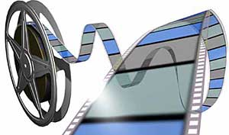
If you would like to watch the video of this live service, click here:
https://campaignkerusso.org/?p=7555
We would love to know more about the people who download our lessons & sermons. We invite you to email us & let us know where & how you use them.
info@ckusa.org

Slide 3
Believers Aren’t Really Bonkers They Just Believe God & Obey

Slide 5
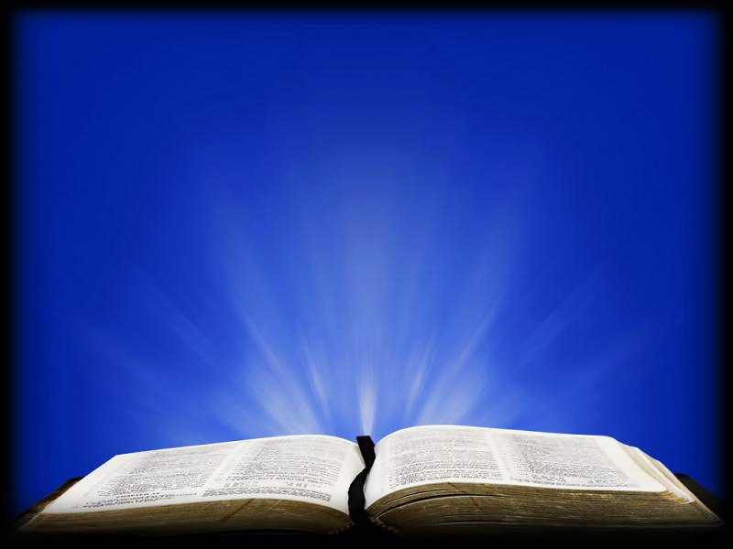
Heb. 1:1 GNT
“To have faith is to be sure of the things we hope for, to be certain of the things we cannot see.”

Slide 6
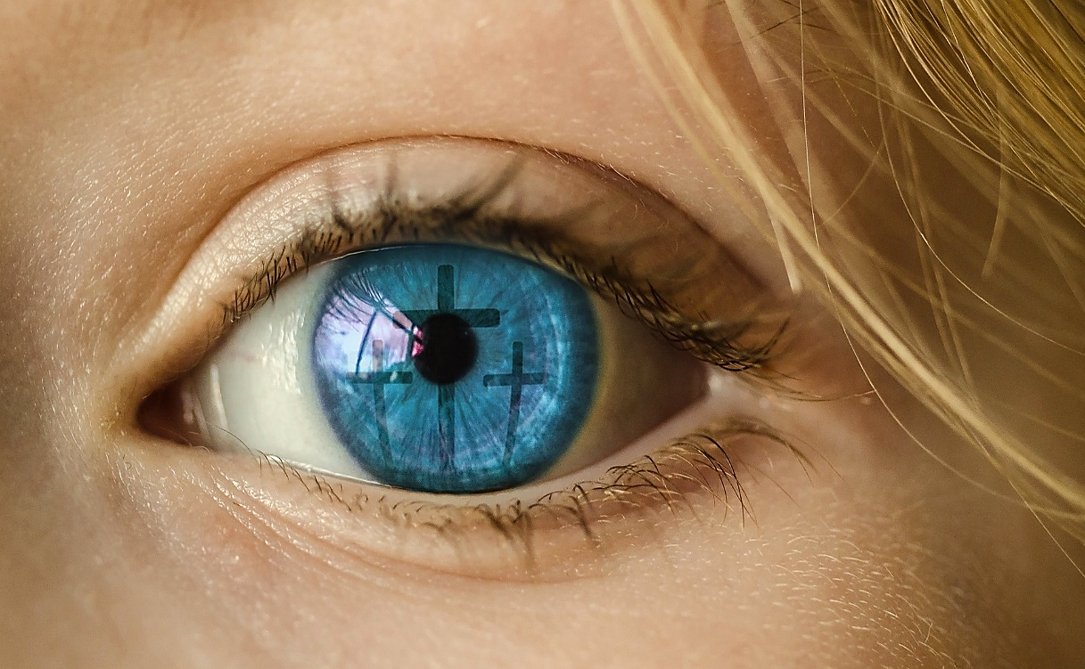
Faith embraces the unseen promises of God as being more real than anything else.

Slide 7
True believers seem to be “bonkers” because they always begin things they can’t possibly finish.
Human
wisdom says: “Never begin something you can’t possibly finish.”

Slide 8
Abraham started something he couldn’t possibly finish.

Slide 9
Heb. 11:8-10 ICB
“It was faith that made Abraham obey when God called him to go out to a country which God had promised to give him.
He left his own country without knowing where he was going…

Slide 10
Heb. 11:8-10 ICB cont.
…He lived in tents, as did Isaac and Jacob, who received the same promise from God.
For Abraham was waiting for the city which God has designed and built…”

Slide 11
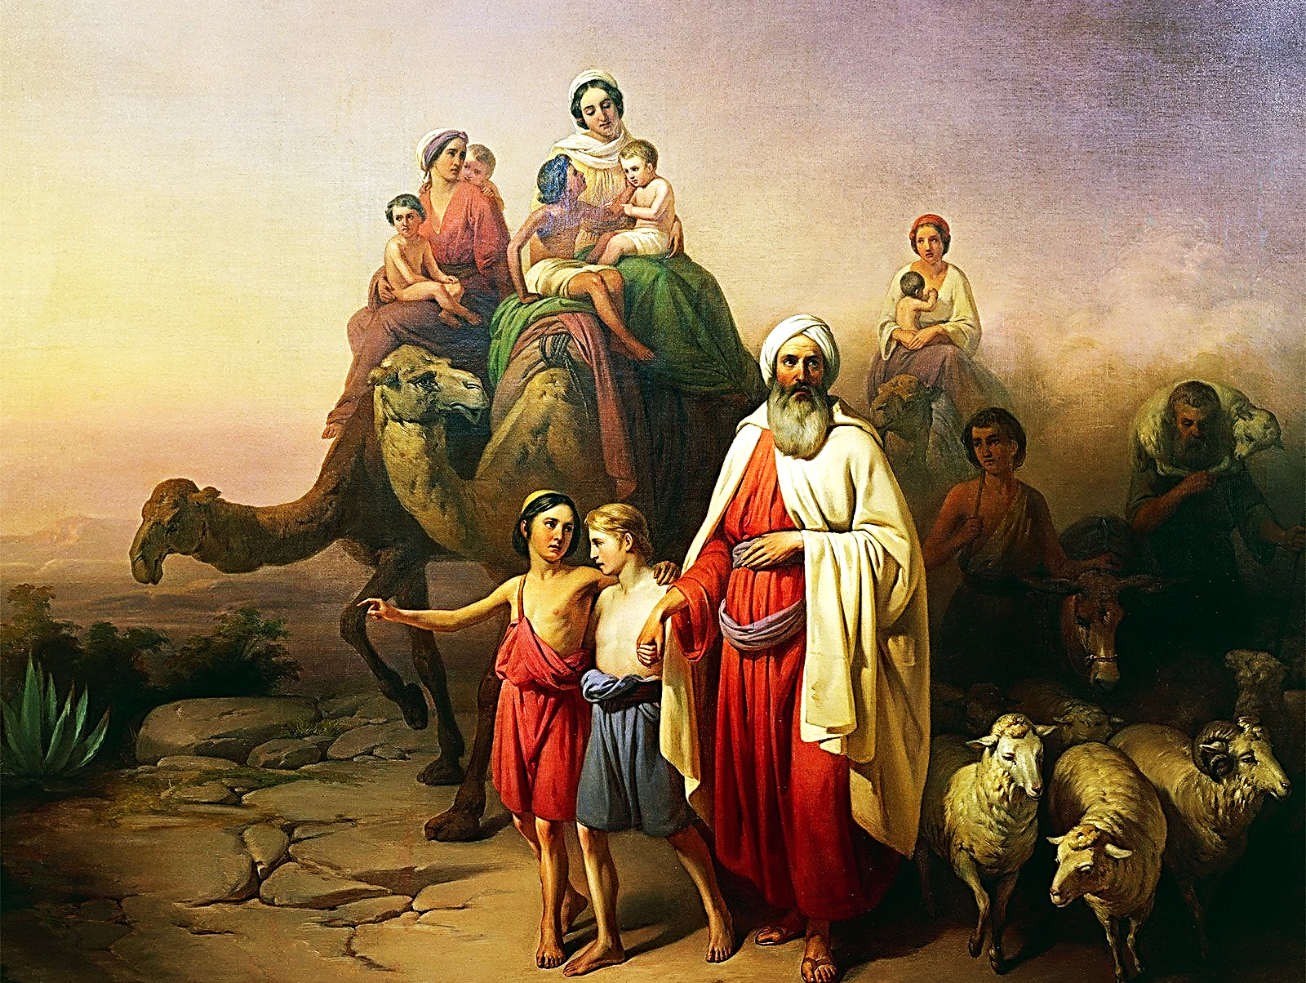
They had no idea where God was leading them.

Slide 12
Heb. 11:11-14 GNT
“It was in faith that all these persons died. They did not receive the things God had promised, but from a long way off they saw them and welcomed them and admitted openly that they were foreigners and refugees on earth.”

Slide 13
Abraham teaches us how to walk by faith.
From the beginning of his journey, (in his mind and heart) he had already arrived.
Because he had already arrived to a place of faith!

Slide 14
Heb. 11:14-16 GNT
“Those who say such things make it clear that they are looking for a country of their own. They did not keep thinking about the country they had left; if they had, they would have had the chance to return…

Slide 15
Heb. 11:11-14 GNT cont.
“…Instead, it was a better country they longed for, the heavenly country. And so, God is not ashamed for them to call him their God, because he has prepared a city for them.

Slide 16
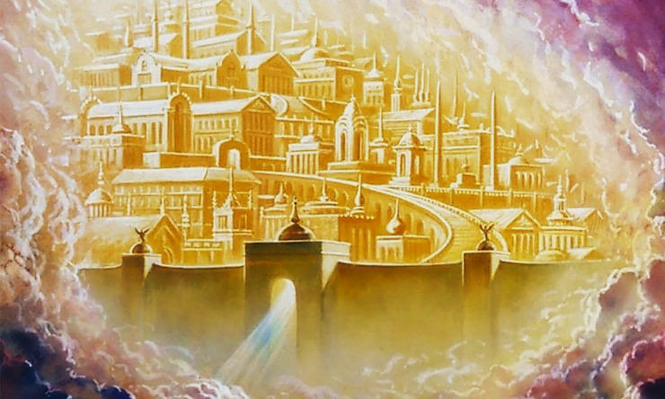
Abram was given promises he would never see fulfilled in his lifetime.
He was looking for a city that is in Heaven.
Every believer has taken up this same quest and keeps pressing on.

Slide 17
Rev. 11:2-3 ERV
“And I saw the holy city, the new Jerusalem, coming down out of heaven from God. It was prepared like a bride dressed for her husband. I heard a loud voice from the throne. It said, “Now God’s home is with people. He will live with them. They will be his people. God himself will be with them and will be their God.”

Slide 18
Abraham, Isaac and Jacob seemed bonkers because they were looking for a city that only God could build and only God knew the way.
All they did was believe and obey God.
They started a journey that only God could finish.

Slide 19
Believers seem bonkers because they battle enemies they can’t possibly defeat.
Human Wisdom Says: “Pick your battles.”

Slide 20
Num. 13:27-31 ERV
“The men told Moses, “We went to the land where you sent us. It is a land filled with many good things. Here is some of the fruit that grows there. But the people living there are very powerful…

Slide 21
Num. 13:27-31 ERV cont.
…Then Caleb said, “We should go up and take that land for ourselves. We can easily take that land.”
But the men who had gone with him said, “We cannot fight those people! They are much stronger than we are.”

Slide 22
If God sends us and we are walking in obedient faith, then we can be assured that the battle is the Lords, not ours.

Slide 23
Heb. 11:30 GNT
“It was faith that made the walls of Jericho fall down after the Israelites had marched around them for seven days.”

Slide 24
The Israelites seemed to be bonkers because they believed God and fought a battle they KNEW they could not win.
They fought a battle that only God could win.
All they did was believe and obey God.

Slide 25
Believers may seem bonkers because they believe in blessings they can’t see.
Human Wisdom Says: “Seeing is believing.”

Slide 26
Heb. 11:7 GNT
“It was faith that made Noah hear God's warnings about things in the future that he could not see. He obeyed God and built a boat in which he and his family were saved. As a result, the world was condemned, and Noah received from God the righteousness that comes by faith.”

Slide 27
Believers trust they have blessings they may never see or fully understand in this life.
They may not understand how God is using them or why He has them doing what they are doing.
Noah believed for a blessing that only God fully understood.
Noah just obeyed.

Slide 28
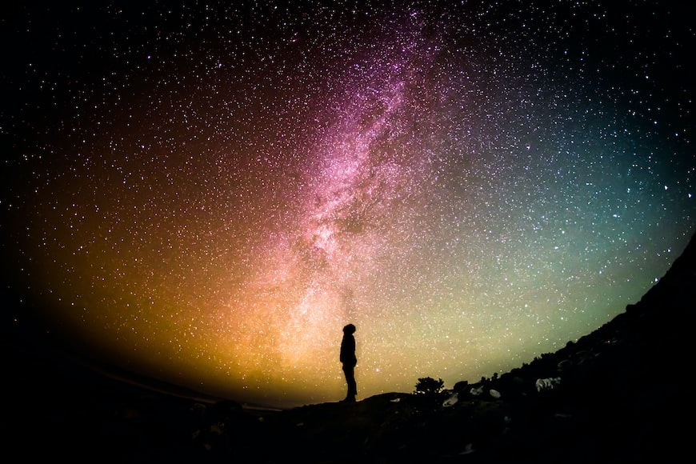
We are not able, in our own strength, to finish what God asks us to do for Him.
Nor can we fight His battles without His help.
We may not even understand what He is doing or why He has us doing what we are doing.
But, if we believe and obey, we will, one day, understand how our part fits into His overall plan.

Slide 29
If Believers are bonkers,
then God likes bonkers!

Slide 30
Suggested Next Slide - Song:
“Thank You for Giving”
Click or Ctrl Click Here:
https://youtu.be/UFrdJ2V3r7Y

Slide 31
Is Jesus
Speaking to You?
“They said to each other, ‘Did not our hearts burn within us while he talked to us on the road, while he opened to us the Scriptures?’”
John Wesley Said:
“…the preacher was describing the change which God works in the heart through faith in Christ and I felt my heart strangely warmed.”
Jesus makes His presence Known by a small voice!

Slide 33
What is the Sinner‘s Prayer?
This is a prayer we can pray when we are ready to admit we are sinners and need Christ’s forgiveness.
It must be prayed with faith in our hearts and a readiness to have a life-changing encounter with Jesus Christ.

Slide 34
“Draw near to God, and He will draw near to you…
…Cleanse your hands, you sinners, and make your hearts pure, you who are half-hearted towards God.” James 4:8 WNT

Slide 35
A prayer of faith → Pray this prayer if :
If you never have before
You have in the past, but you think it would mean more today
You have been walking afar off and you want to come back
You want to set an example & show others how it is done
You just like to give your heart to Jesus again & again
Faith

Slide 36
Dear Jesus,
I know I am a sinner & need your forgiveness.
I believe you died for my sins.
I now turn from sin.
Come into my heart I pray.
Please wash away my sin.
Do you want to meet Jesus as your savior right now?
Do you believe He died to save you from your sins & that He rose from the dead?
Do you believe that He is waiting to save you right now?

Slide 37
“But some people did accept him. They believed in him, and he gave them the right to become children of God.”
John 1:12

Slide 39
We Declare Our Faith Publicly Because Jesus Declared His LOVE Publicly
“If you stand before others and are willing to say you believe in me, then I will tell my Father in heaven that you belong to me.” Mat 10:32

Slide 40
“If you openly say, ‘Jesus is Lord’ and believe in your heart that God raised him from death, you will be saved.”
Rom. 10:9
What did you learn today?
What have you been thinking about God lately?
What do you want to tell others about Jesus?

Slide 41
Close in Prayer

