Slide 1
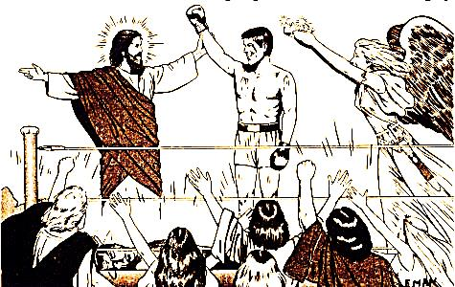
How Do We Fight Temptation?

Slide 2



If you would like to watch the video of this live service, click here:
https://campaignkerusso.org/?p=9128
We would love to know more about the people who download our lessons & sermons. We invite you to email us & let us know where & how you use them.
info@ckusa.org

Slide 3
Suggested Next Slide - Video:
“Jesus tempted by Satan ”
Click or Ctrl Click Here:
http://www.youtube.com/watch?v=ijTKOI74LWI

Slide 4
Suggested Next Slide - Video:
“Jesus is Tempted by Satan – cool kid’s version ”
Click or Ctrl Click Here:
http://www.youtube.com/watch?v=up1-28oH_1Q

Slide 5
How Do We Fight Temptation?

Slide 6
With God’s Word,
the Bible!

Slide 7
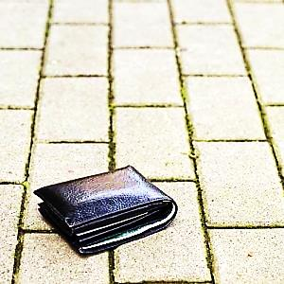
What if you find a wallet with an ID and money inside?
You might be tempted to:
You finally decide to:
Why?

Slide 8
What if you find a wallet with an ID and money inside?
You might be tempted to:
You finally decide to:
Why?
Proverbs 28:20
A truthful person
will have many blessings,
but those eager to get rich
will be punished.

Slide 9
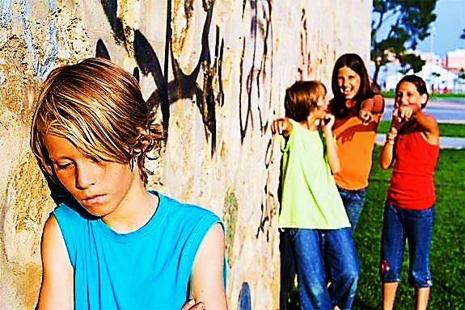
What if your friends start making fun of the new kid at school?
You might be tempted to:
You finally decide to:
Why?

Slide 10
What if your friends start making fun of the new kid at school?
You might be tempted to:
You finally decide to:
Why?
Matthew 5:46-48
And if you are nice only to your friends, you are no better than other people. Even those who don't know God are nice to their friends. ⁴⁸ So you must be perfect, just as your Father in heaven is perfect.

Slide 11
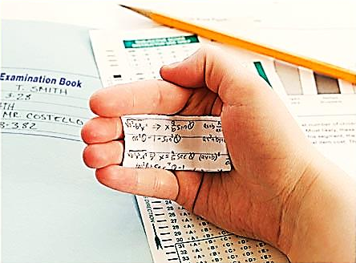
What if your friends cheat on a test and want you to help them?
You might be tempted to:
You finally decide to:
Why?

Slide 12
What if your friends cheat on a test and want you to help them?
You might be tempted to:
You finally decide to:
Why?
Proverbs 10:9
The honest person will
live in safety,
but the dishonest will
be caught.

Slide 13
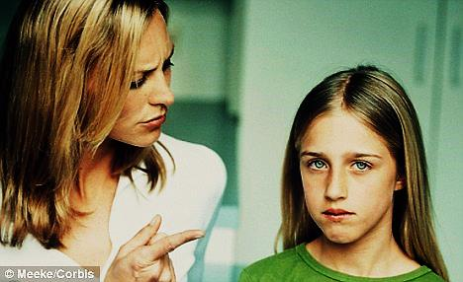
What if you know you will get into trouble if you admit to something you did wrong?
You might be tempted to:
You finally decide to:
Why?

Slide 14
What if you know you will get into trouble if you admit to something you did wrong?
You might be tempted to:
You finally decide to:
Why?
Proverbs 3:11-12
My child, do not reject the Lord's discipline, and don't get angry when he corrects you.
The Lord corrects those he loves,
just as parents correct
the child they delight in.

Slide 15

What is the Sinner‘s Prayer?
This is a prayer we can pray when we are ready to admit we are sinners and need Christ’s forgiveness.
It must be prayed with faith in our hearts and a readiness to have a life-changing encounter with Jesus Christ.

Slide 16
You Should Pray this Prayer If :
If you never have before
You have in the past, but you think you would mean it more today
You have been walking afar off and you want to come back
You want to set an example and show others how it is done
You just like to give your heart to Jesus again & again

Slide 17
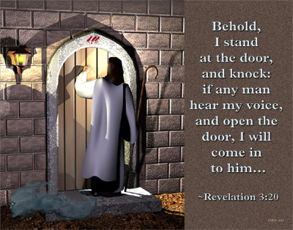

Slide 18

Dear Jesus,
I know I am a sinner & need your forgiveness.
I believe you died for my sins.
I now turn from sin.
Come into my heart I pray.
Do you want to meet Jesus as your savior right now?
Do you believe He died to save you from your sins & that He rose from the dead?
Do you believe that He is waiting to save you right now?

Slide 19


“But to all who believed him and accepted him, he gave the right to become children of God.” John 1:12

Slide 20



Slide 21


“If you declare with your mouth that Jesus is
Lord, and believe in your heart that God raised him from the dead, you
will be
saved.” Rom. 10:9
What did you learn today?
How does this lesson apply to our lives today?
What do you want to say about Jesus today?

Slide 22

“Draw near to God, and He will draw near to you…
…Cleanse your hands, you sinners, and make your hearts pure, you who are half-hearted towards God.” James 4:8 WNT

