Slide 2
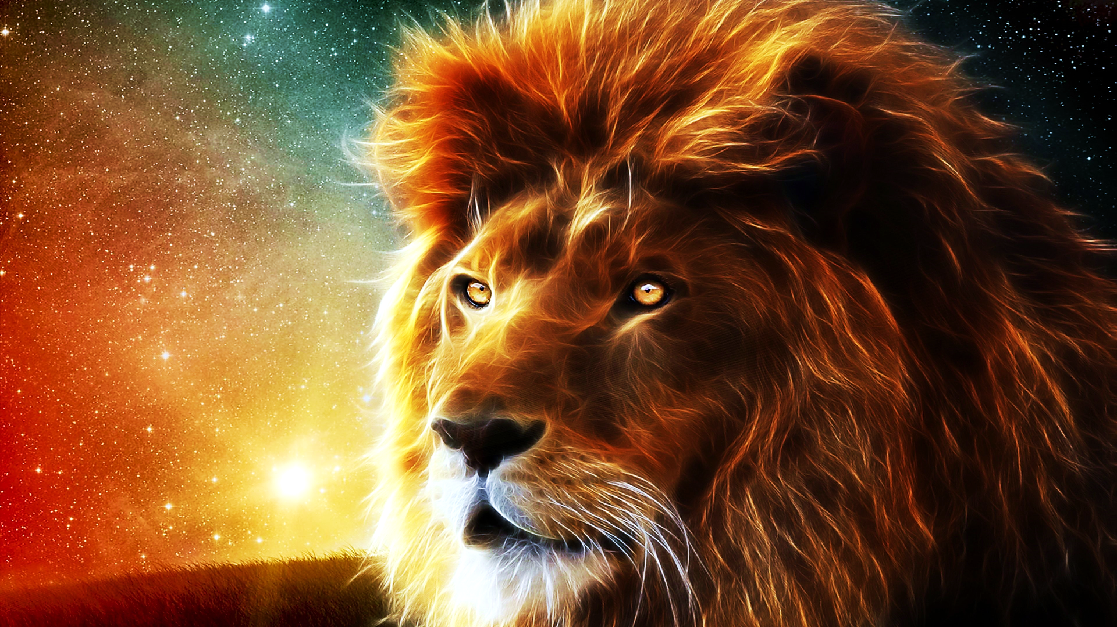
God’s Timetable
pt. 5
“Wise Men Still Fear Him.”

Slide 3
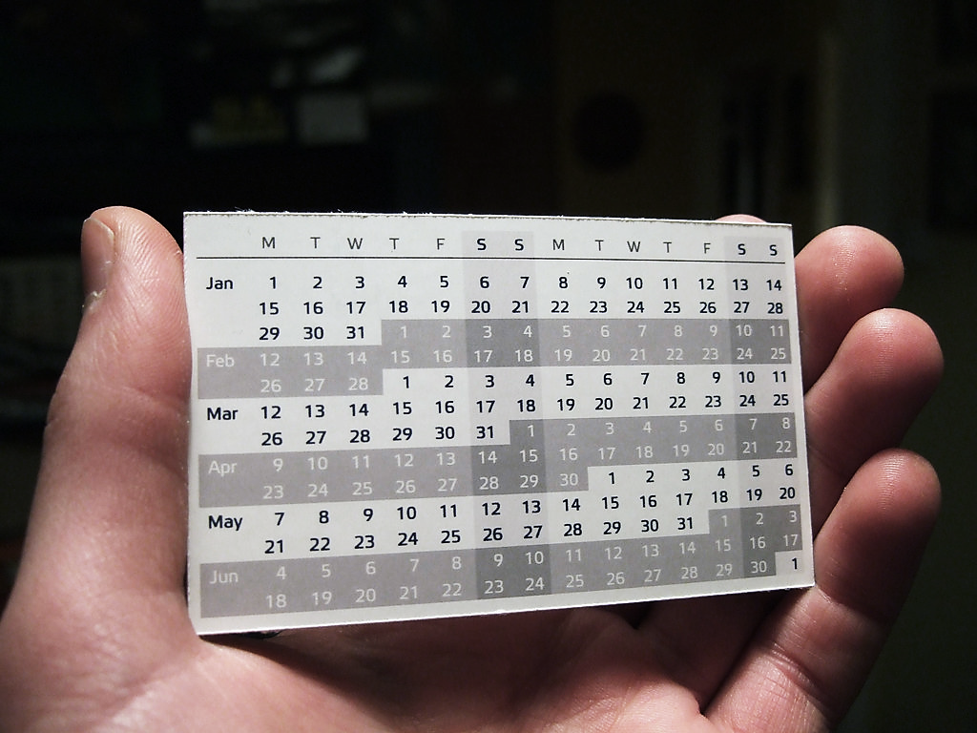
God’s Timetable Pt. 5

Slide 4
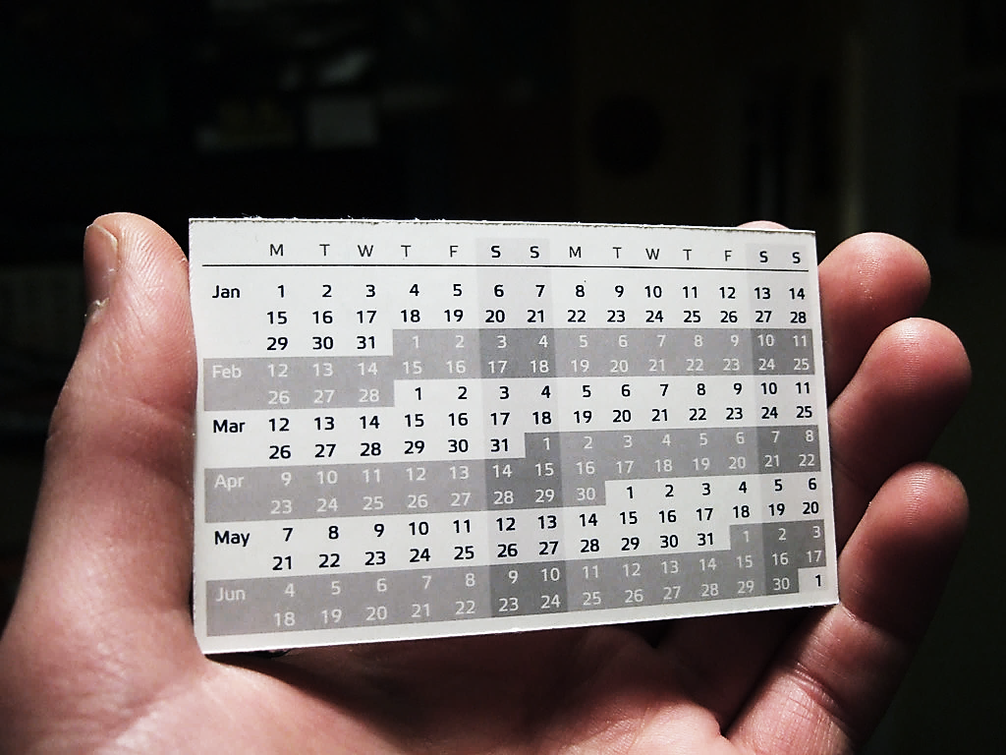
We learned that “In the beginning” means not only the beginning of time…
…it is also the beginning of God’s plan to save mankind.
And the beginning of God’s plan to glorify God’s Son—Jesus.
Today, we continue to talk about God’s Timetable.
This is part 5, entitled “Wise Men Still Fear Him.”

Slide 5
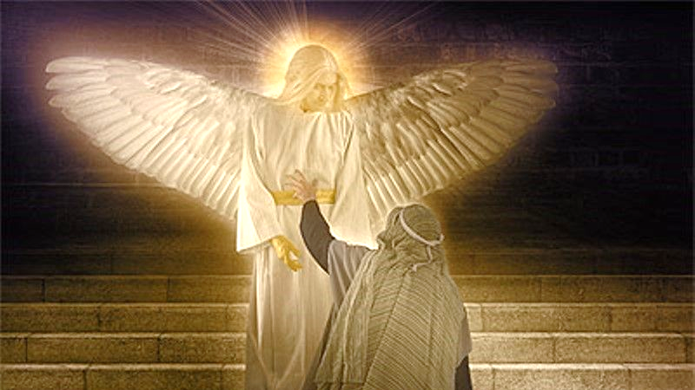
While Daniel was in prayer, the angel Gabriel came to tell Him exactly when the Messiah King Jesus would come.
Jesus was born late in history,
and yet, right on time.
The Heavenly Timetable is carefully planned.

Slide 6
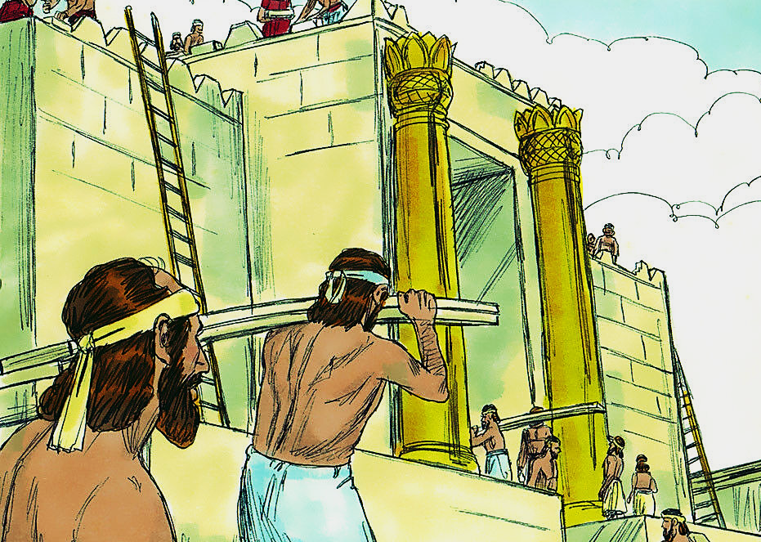
It all happened exactly as the angel said it would.
After the king of Persia gave the order to restore the Temple of the Lord, the work took 49 years to complete… just as the angel told Daniel.

Slide 7
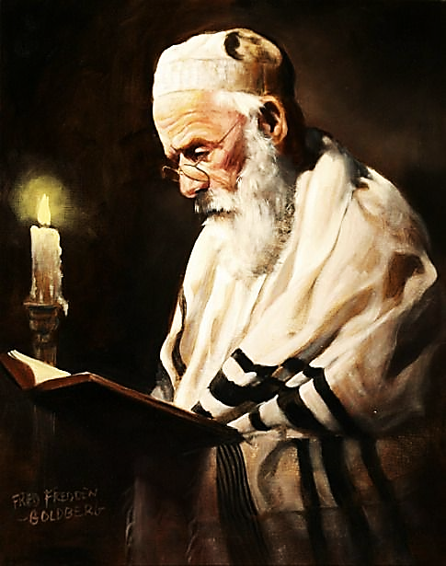
Then (as the angel had said) 434 years later, Jesus (The Messiah King) rode into Jerusalem on His way to be crucified.
Is it any wonder that people (who studied the scriptures) were expecting Him to come at the time he did?

Slide 8
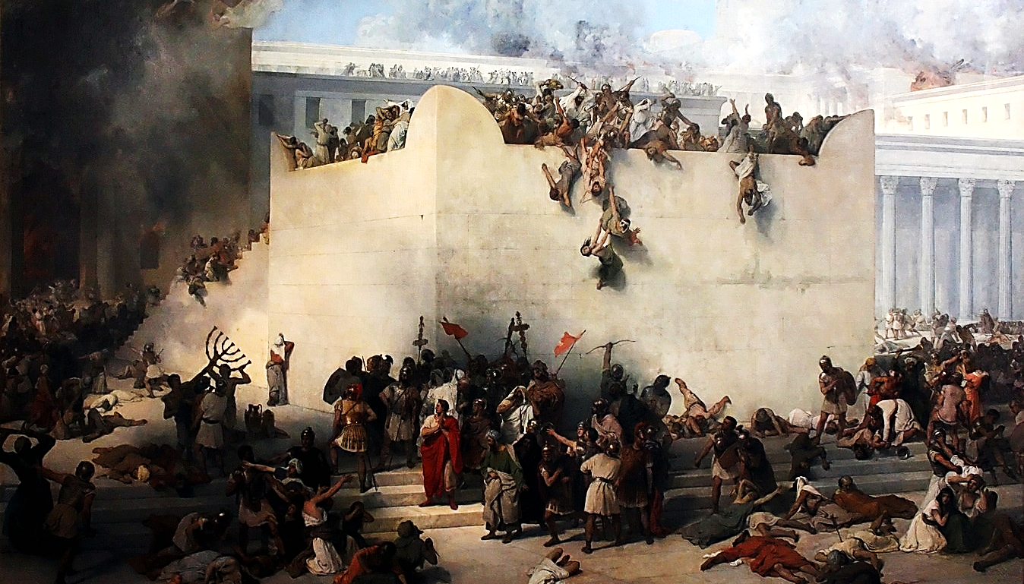
As the Angel said, the promised One would be killed, and Jerusalem would fall shortly after…
And in 70 AD it did!

Slide 9
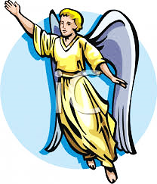
The angel prophesied that there would be 483 years from the Medo-Persian king’s decree to start rebuilding the temple to the final entry of Jesus’ into Jerusalem to be killed.

Slide 10
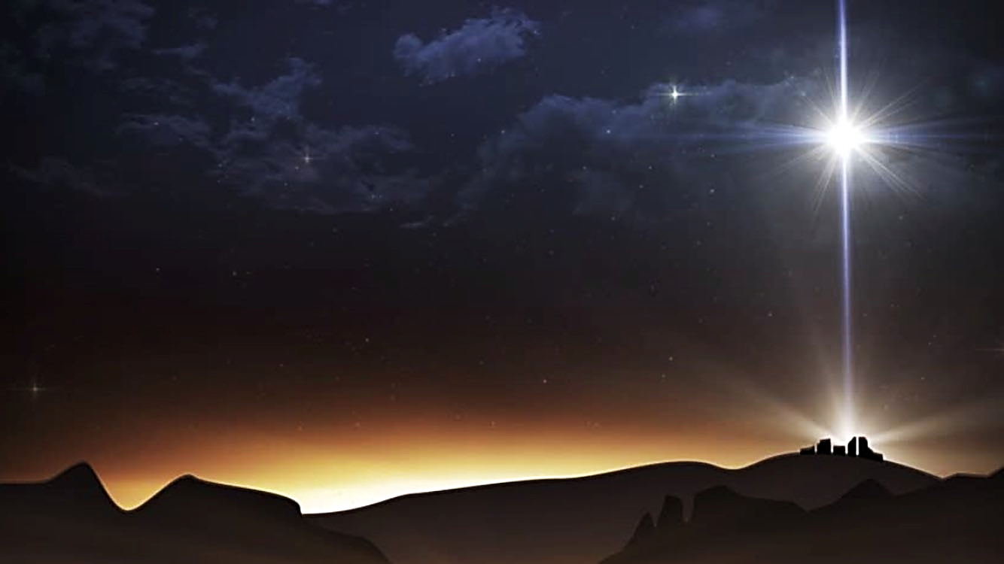
So, we see Jesus was born exactly on time.
An amazing event in the night sky would mark the exact moment that God’s clock would tick and begin Christ’s life as a human man on Earth.
At that moment, a special star would appear that would be either a blessing to the wise hearted or a warning to a world full of arrogant, rebellious souls.

Slide 11
This star appeared over Bethlehem in Israel and signaled to the whole world that The Great King of the Universe has been born.
It appeared over Israel the very moment Jesus was born and was a heavenly sign of both His birth and His great importance.

Slide 12
Tell the World… the Time has come…
The True King has Arrived!

Slide 13
The Star of Bethlehem would be a signal to Israel and to the world that the promised “Lion of Judah” was finally born.
This would be a powerful King that would rule the whole world.
Let’s Review Jacob’s prophecy over his son Judah.

Slide 14
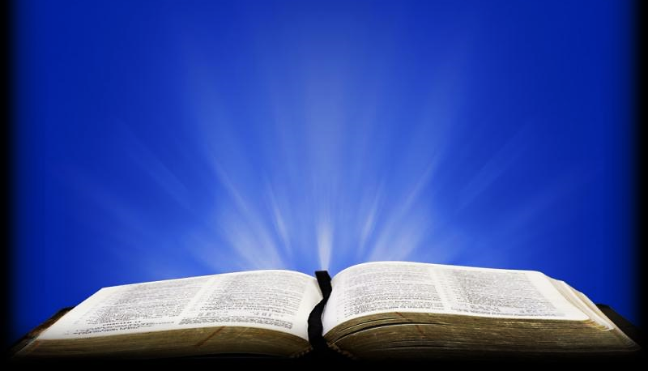
Genesis 49:8-10 GNT
“Judah, your brothers will praise you. You hold your enemies by the neck. Your brothers will bow down before you. Judah is like a lion, killing his victim and returning to his den, stretching out and lying down…

Slide 15
Genesis 49:8-10 GNT (cont.)
…No one dares disturb him. Judah will hold the royal scepter, and his descendants will always rule. Nations will bring him tribute and bow in obedience before him.”

Slide 16
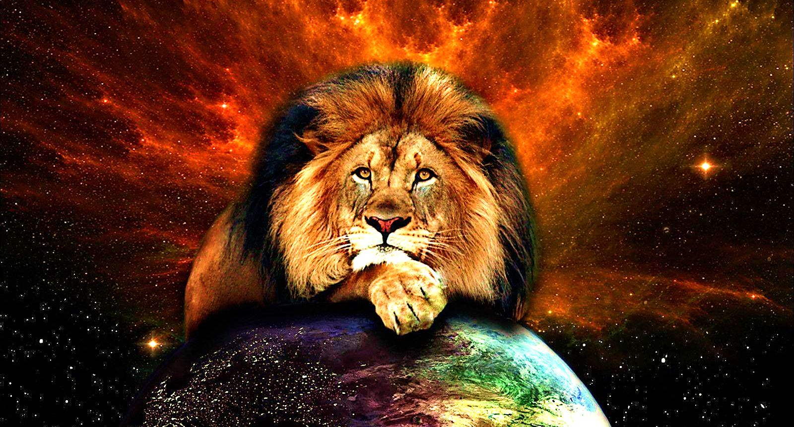
This Lion that comes from the tribe of Judah will be worshipped by His brothers—the Israelites.
And, very importantly, He will stand on the necks of all His enemies.

Slide 17
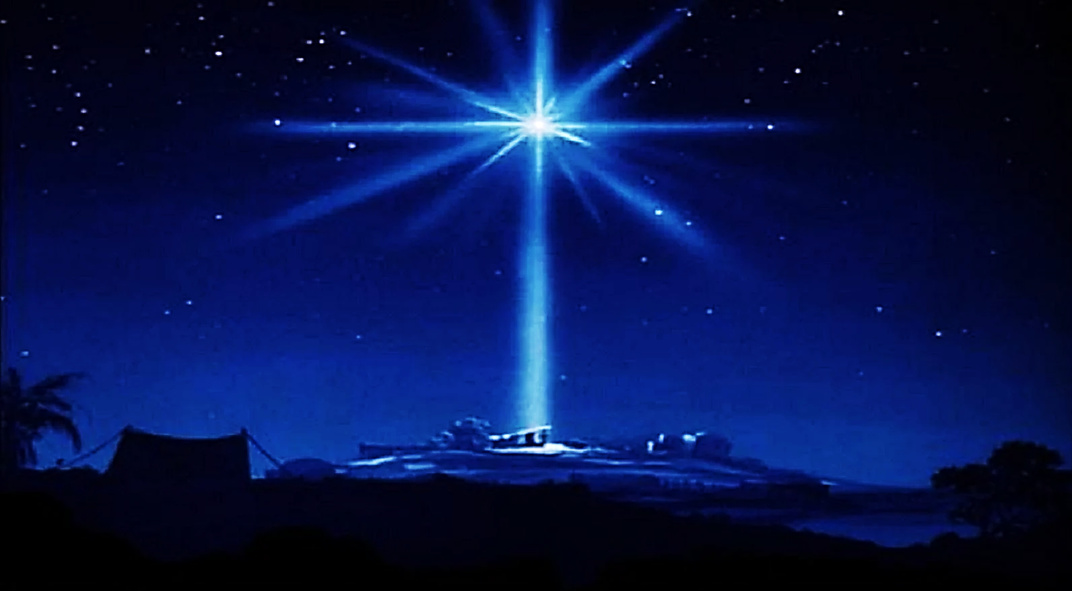
We talked about the lion, today we are going to talk about the Star.
It speaks of a King who is coming and who is to be greatly feared and revered…

Slide 18
…The Old Testament Prophets have been speaking of His coming for centuries:
The prophet Isaiah of the Old Testament calls Jesus a Great Light who Will come:

Slide 19
Isa 9:2 NASB
"The people who walk in darkness Will see a great light; Those who live in a dark land, The light will shine on them."

Slide 20
Then, as if to say, “And now… here He is!!!” Matthew quotes Isaiah’s prophecy, but with one big difference.
Isaiah spoke in future tense (He WILL come) and Matthew speaks in the past tense (He HAS come) because it had already happened at the birth of Jesus Christ.

Slide 21
Matt 4:16 NIV
"…the people living in darkness HAVE seen a great light; on those living in the land of the shadow of death a light HAS dawned."

Slide 22
Question #1:
How is living without Christ like living in the shadow of death and how is salvation like a dawning light?

Slide 23
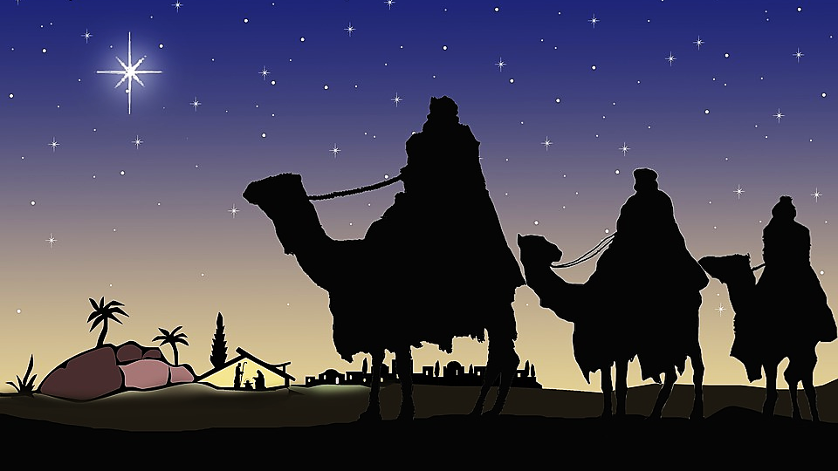
Around 1850 BC, Jacob told us about a lion who would be a King and hold the Royal Scepter.
Then, around 450 years later, a man named Balaam also prophesied about this coming king.

Slide 24
Then, in another 1300 years, Magi from the East, believing these old prophecies, traveled to Israel to see and pay homage and tribute to this King.

Slide 25
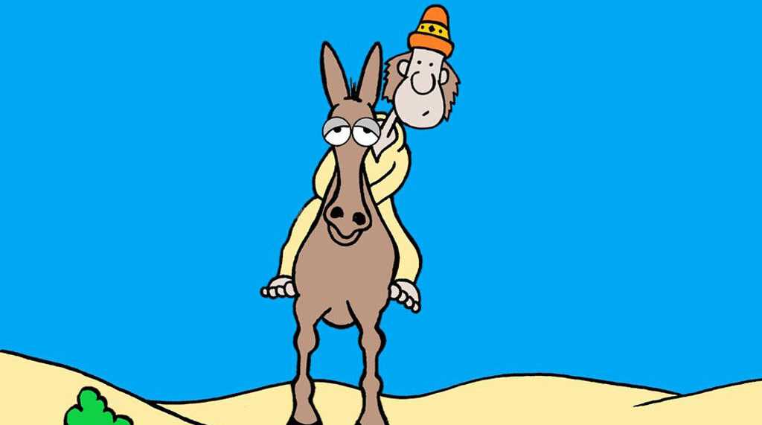
Let’s look at who Balaam was.
He was not a righteous man.
He was a very famous magician, seer, clairvoyant, astrologer, psychic, mystic (whatever you want to call it).

Slide 26
He is believed to be an ancient father of all such practices.
These are demonic practices which we refer to today as Eastern religion.
It is the attempt to exercise spiritual power without the Holy Spirit.

Slide 27
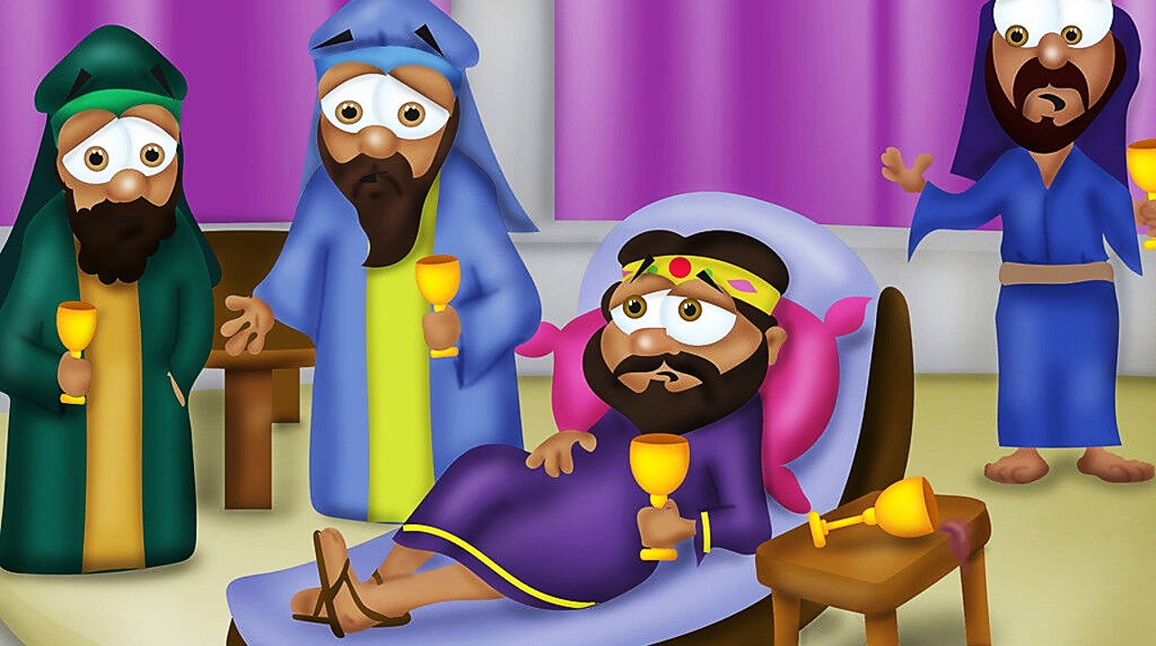
The false religions of this area of the world produced their own version of “prophets”
or “wise men”
(anyone they thought had psychic or fortune-telling powers).
These people (which they called Magi) were held in very high esteem.

Slide 28
They were part of the king’s court as his advisors and considered second only to the king himself.
They had the ear of the King and were very famous.

Slide 29
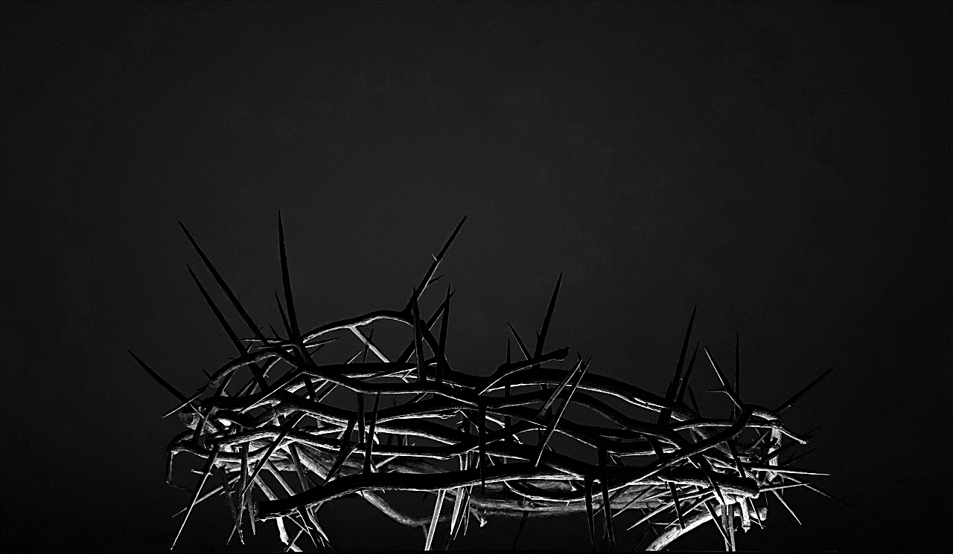
Now, let’s look at some prophecies about the promised Messiah King—Jesus.
But first, we need to understand a little history.
Balaam was from Mesopotamia.
This area was later known as Assyria.
It was around 500 miles from Israel.
To the Israelites, it was called, “The East.”

Slide 30
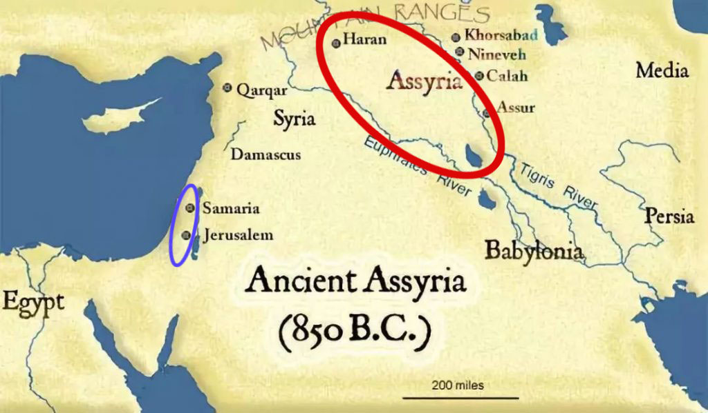

Slide 31
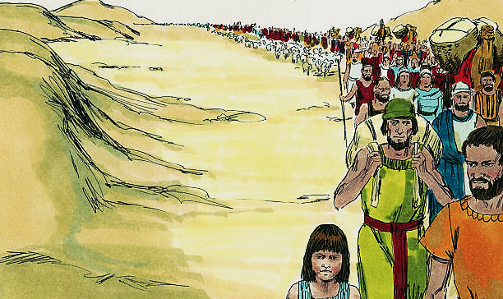
After Israel was established in their land, the Assyrians came and attacked the Northern part of Israel.
Whoever they didn’t kill, they took back to Assyria as their captives.

Slide 32
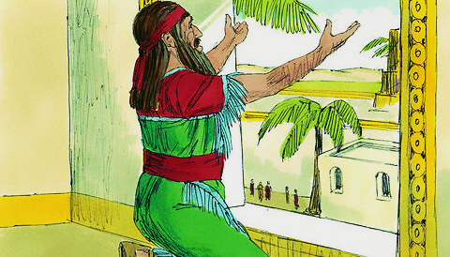
Then the Babylonians conquered the Assyrians and went down and captured the Southern half of Israel.
At this time, one of their captives was a boy named Daniel.

Slide 33
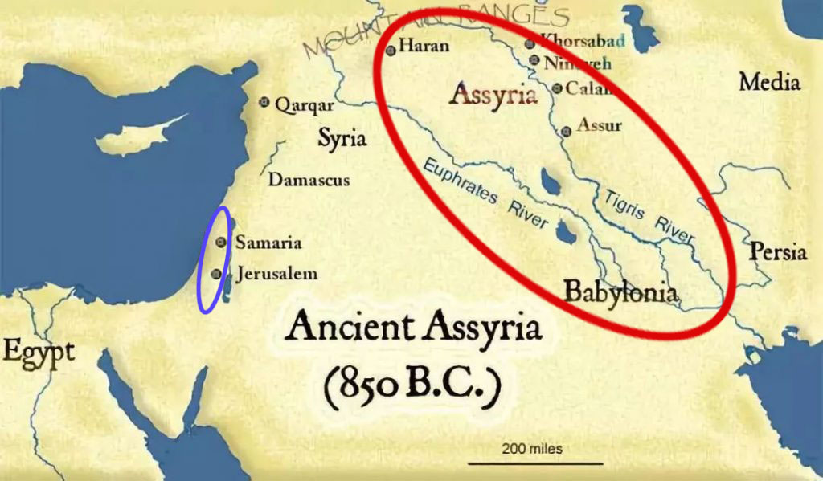

Slide 34
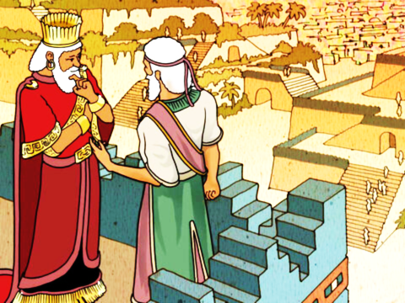
Then the Medes & Persians conquered the Babylonians.
When this happened, Daniel then became the captive of the Medo-Persians.

Slide 35
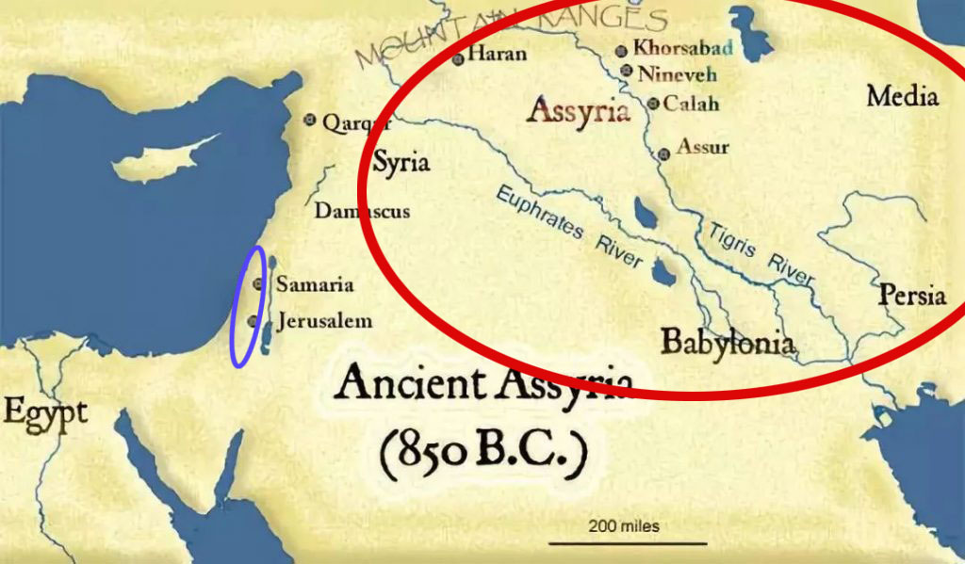

Slide 36
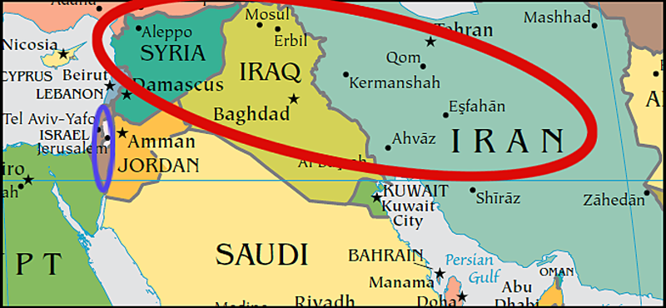
Today this area is divided again into the countries of Syria, Iraq & Iran.

Slide 37
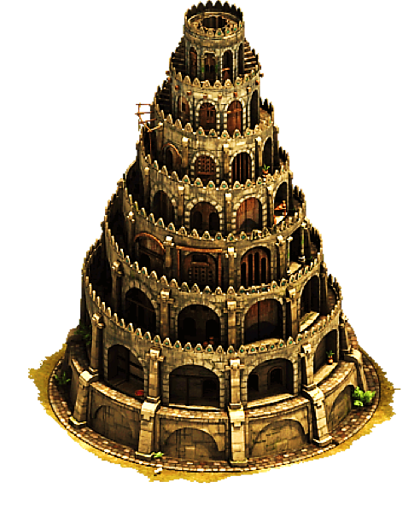
Throughout history, this area has been inhabited by nations that hate Israel and often try to destroy it.
This is the general area where the Tower of Babel was built as
people tried to substitute God
Worship with their own religion.
It is also the area from which
God called out Abraham and
sent him on a mission to
find the Promised Land.

Slide 38
Balaam is thought to be a forefather of the Magi that, years later, followed a star looking for the Christ.
Magi is the word from which we get the modern word, “magician.”
Balaam was the most famous and respected soothsayer of his time.
Even King Balak, in far away Moab had heard of Balaam’s so-called “psychic,” “fortune-telling” abilities.

Slide 39
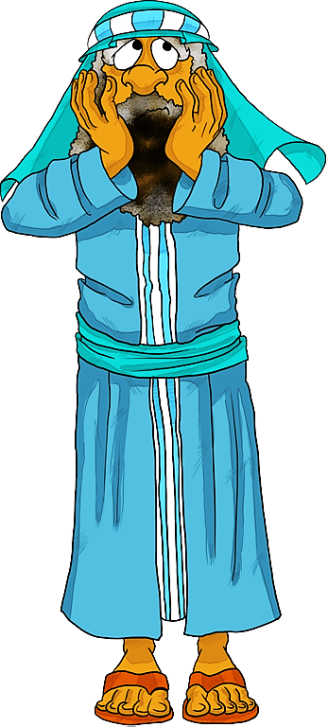
Balak had heard that the children of Israel, who had been wandering through the wilderness, were about to wander his way.
He was afraid because he knew God was with Israel in battle.
So, he sent a group of representatives to travel north-east to Balaam’s town and try to persuade him to come down and put a curse on Israel.

Slide 40
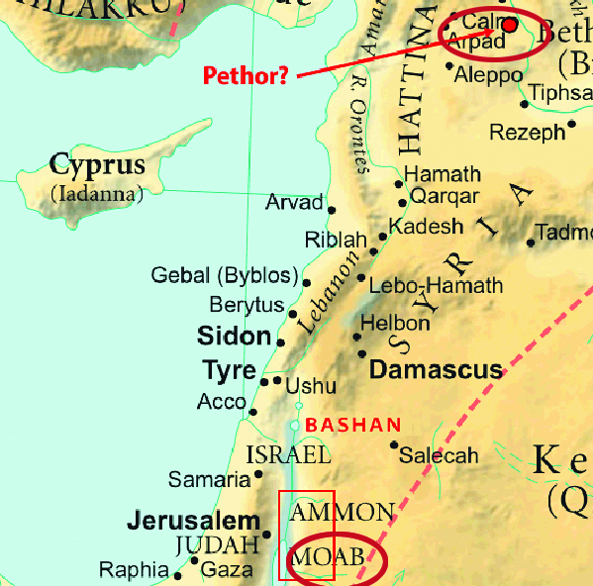
Balak (king of Moab) sent his ambassadors to bring Balaam down to Moab (approx.
500 miles).
But God told Balaam not to go to Moab with them.

Slide 41
So, they went all the way back to tell King Balak that Balaam wouldn’t come.

Slide 42
So, King Balak told them to go all the way back and offer to pay Balaam enough money to make him a very rich man.

Slide 43
Eventually, God
told Balaam to go ahead and go to Moab.
God told Balaam he must only say what God tells him to say.
So, Balaam made the trip on a donkey.
(Poor donkey ☹ )

Slide 44
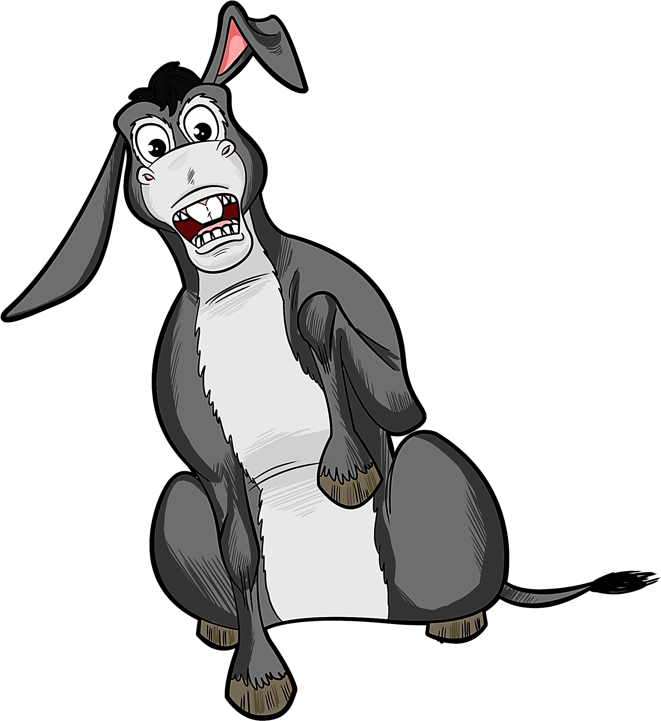
This is a case of an unlikely prophet helping an ungodly country.
How can an ungodly man be the voice of God?
No problem!
In this story, God showed us that even a tired, stick-beaten, road-weary donkey can speak for God (if God wills it).

Slide 45
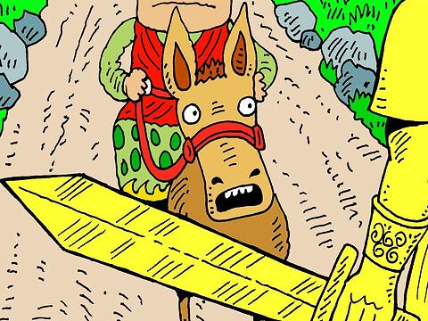
The donkey warned Balaam of the fierce angel blocking their path.
The angel reminded Balaam to only speak the Lord’s words.
Balaam tried three times to curse Israel, but God would only let him bless them.

Slide 46
Num 24:1 NIRV
"Balaam saw that the Lord was pleased to give his blessing to Israel. So, he didn’t try to use evil magic as he had done at other times.”

Slide 47
Question #2:
Why do you think Balaam chose not to use any form of divination this time to find the will of God?

Slide 48
Later, after being forbidden by God to curse the Israelites, Balaam gave Balak
an alternative way
to defeat them.
He told the king
of Moab to simply
tempt the Israelite
men with Moabite women and food
offered to idols.

Slide 49
Both of these things were forbidden, and
the Israelites soon
fell into sin.
Balaam said this
would make Israel vulnerable.
In Revelation, we
read that churches today are also
weakened this way.

Slide 50
Revelation 2:14 CEV
“I do have a few things against you. Some of you are following the teaching of Balaam. Long ago he told Balak to teach the people of Israel to eat food that had been offered to idols and to be immoral.”

Slide 51
Now, we will see that, when God sets His face to look upon Israel, it is always in love!
In times of judgement or blessing, He speaks of them with such loving tenderness.

Slide 52
We will see this in both Jesus’ lament and wicked Balaam’s prophecy.
This is because the Holy Ghost had come upon Balaam.
First, let’s listen to Jesus as He looks upon Israel knowing it is soon to be destroyed in 70 A.D.

Slide 53
Mat. 23:37 NCV
“Jerusalem, Jerusalem! You kill the prophets and stone to death those who are sent to you. Many times I wanted to gather your people as a hen gathers her chicks under her wings, but you did not let me.”

Slide 54
Question #3:
What can we learn from this verse about how God feels about sinners?

Slide 55
Now, let’s listen to Balaam as he looks upon Israel and prophesies over it.
You can hear that same tender-hearted love in his voice.

Slide 56
Num 24:1, 2-17, 19, 23 WEB
“…And Balaam lifted up his eyes, and he saw Israel abiding in his tents according to their tribes, and the spirit of God came upon him… How goodly are thy tents, O Jacob, and thy tabernacles, O Israel! ...

Slide 57
Num 24:2-17, 19, 23 WEB (cont.)
“…He shall pour the water out of his buckets, and his seed shall be in many waters, and his king shall be higher than Agag, and his kingdom shall be exalted…

Slide 58
Balaam tried to curse Israel, but God used him to prophecy a blessing over them.
God has a heart for Israel.

Slide 59
This blessing would be a continuation of Jacob’s earlier blessing over Judah.
Balaam’s version continued Jacob’s fortelling of the “Lion of Judah” plus he added the appearance of a special star.”

Slide 60
A Lion
A Star

Slide 61
It is a prophecy about a coming King who is to be greatly feared by the enemies of Israel, by all nations, and by every man.

Slide 62
Num 24:2-17,19, 23 WEB (cont.)
… He couched, he lay down as a lion, and as a great lion: who shall rouse him? …Blessed is he that blesseth thee, and cursed is he that curseth thee… there shall come a Star out of Jacob, and a Scepter shall rise out of Israel…

Slide 63
Question #4:
How do you think it effects your life choices when you believe that one day you will see Jesus face to face?

Slide 64
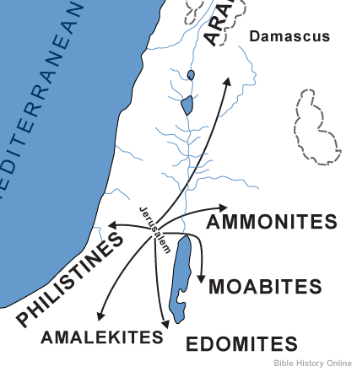
Notice some of the nations this ancient prophecy says the coming King will destroy.
But, more about them when we look at King Herod next time.

Slide 65
Num 24:2-17, 19, 23 WEB (cont.)
…and shall smite the corners of Moab… and Edom shall be a possession… Out of Jacob shall come he that shall have dominion and shall destroy him that remaineth of the city.’ He took up his parable, and said, “Alas, who shall live when God does this?”

Slide 66
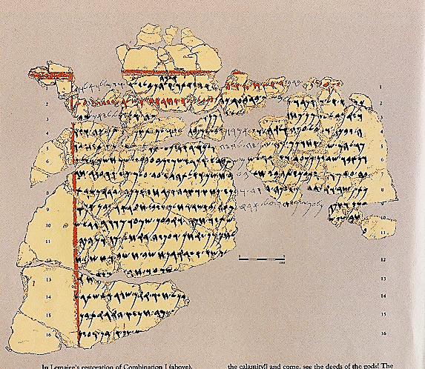
This ancient prophecy, has endured time and influenced the world for centuries.
As late as 1967, on an archeological dig in what now is called Jordan (but was once called Moab), they found fragments of a letter written in plaster.

Slide 67
In bold letters it read, “The prophet, Balaam, son of Beor.”
Could this have been the header on a letter that the ambassadors of Balak carried to Balaam?

Slide 68
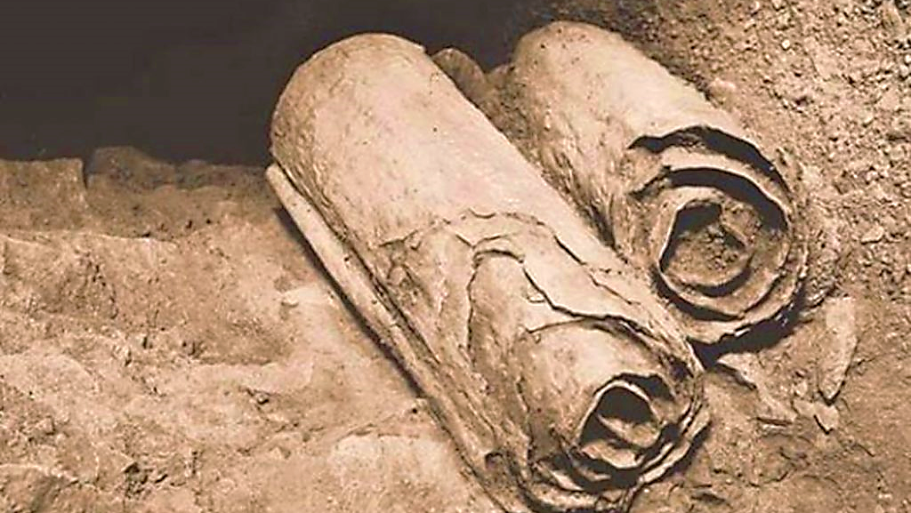
In 1946 / 1956 the Dead Sea Scrolls were discovered in a cave in what is now known as “The West Bank.”
In them, Balaam’s prophecies are discussed repeatedly with varying views of how to interpret them.

Slide 69
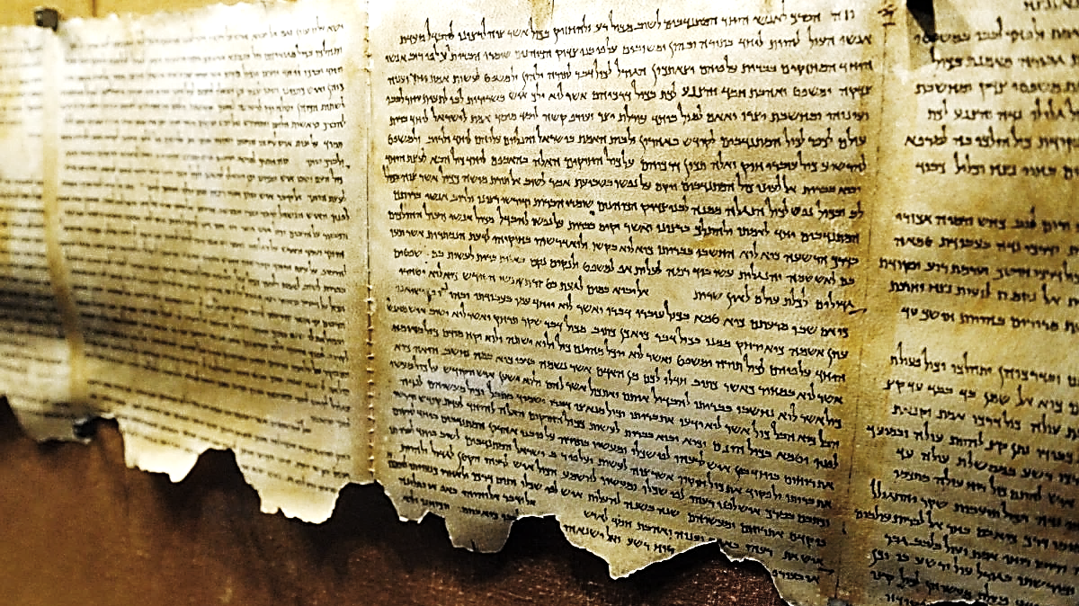
Surely, Balaam taught his peers that a great King was to be born to a tribe of Israel.
He advised them to look to the heavens to find that “new star” that would lead them to where the Christ would be born.

Slide 70
This understanding remained with the Magi community for 1300 years until the wonderous star actually did appear.

Slide 71
Balaam lived in Assyria, which was conquered by Babylon.
The Babylonians later conquered Southern Israel and took the boy named Daniel captive.
Then the Medes & Persians defeated Babylon and Daniel ended up in their custody.
Now God has a righteous boy living with Israel’s enemies.

Slide 72
With this boy in this key position, God was preparing the world outside of Israel to expect this great coming King.
The king of Babylon (Nebuchadnezzar) was so impressed with Daniel, he made him a ruler under him and put him in charge of all the magi in the Babylonian Empire!

Slide 73
Daniel would have taught them that their occult practices were evil.
He would also have verified the truths in Balaam’s prophecy about the coming Jewish King.

Slide 74
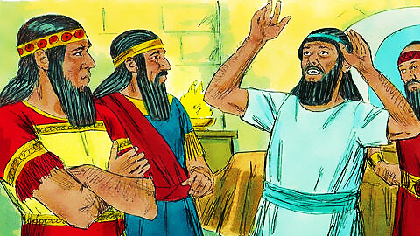
Daniel would have told them about his own visit with the angel Gabriel who told him there would be only 434 years from the rebuilding the Temple to the birth of this fearsome king.
They could easily count the days while they kept watch for this signal star.

Slide 75
It would be a star announcing the birth of a King from the Jewish tribe of Judah, a Lion who will destroy the enemies of Israel and rule the world.

Slide 76
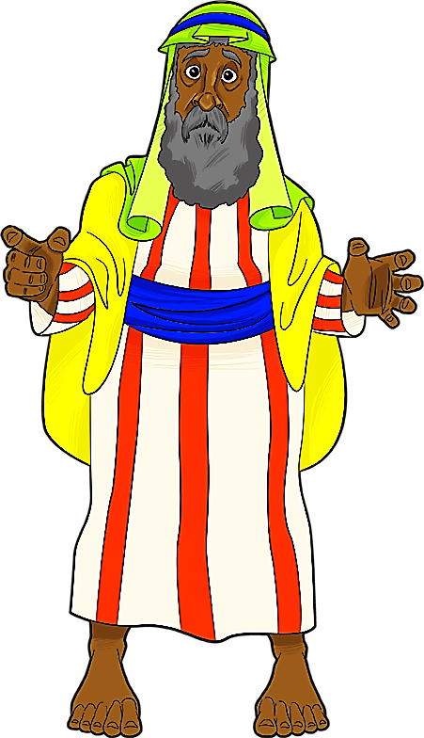
Imagine how these important men of the Kings court, these practitioners of the occult, these historic enemies of Israel must have felt as they counted the years, months and days till the birth of this prophesied King—
This “Lion of Judah!!”
This destroyer of all the Lord’s enemies!

Slide 77
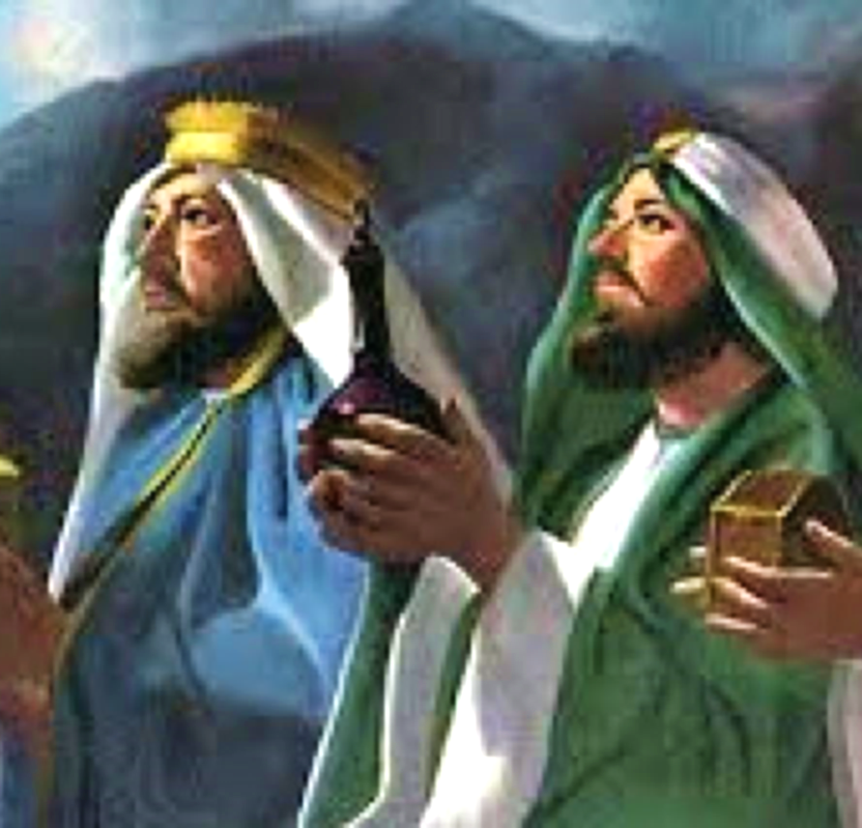
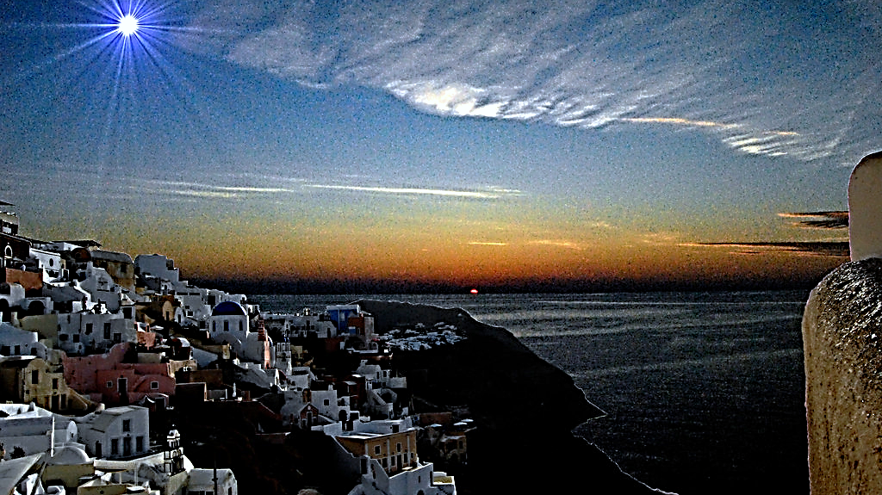
Yes, and we can imagine the feeling as they watched the sky for the tick of the clock, that would say, “It has begun, He is born.”
The appearing of His star said it all!!

Slide 78
Yet, as fearful as the lion is…
…as surely as He is the Lord who is worthy to righteously judge all sin…
…let’s return to the verse in the book of Revelation where the judgement seals need to be opened.
Notice who steps up when the call goes out for the worthy Lion of Judah.

Slide 79
Revelation 5:4-5 GNT
“…who could open the scroll and look inside it. I cried bitterly because no one could be found who was worthy to open the scroll or look inside it…”

Slide 80
Revelation 5:1-5 GNT (cont.)
…Then one of the elders said to me, “Don't cry. Look! The Lion from Judah's tribe, the great descendant of David, has won the victory, and he can break the seven seals and open the scroll.”

Slide 81
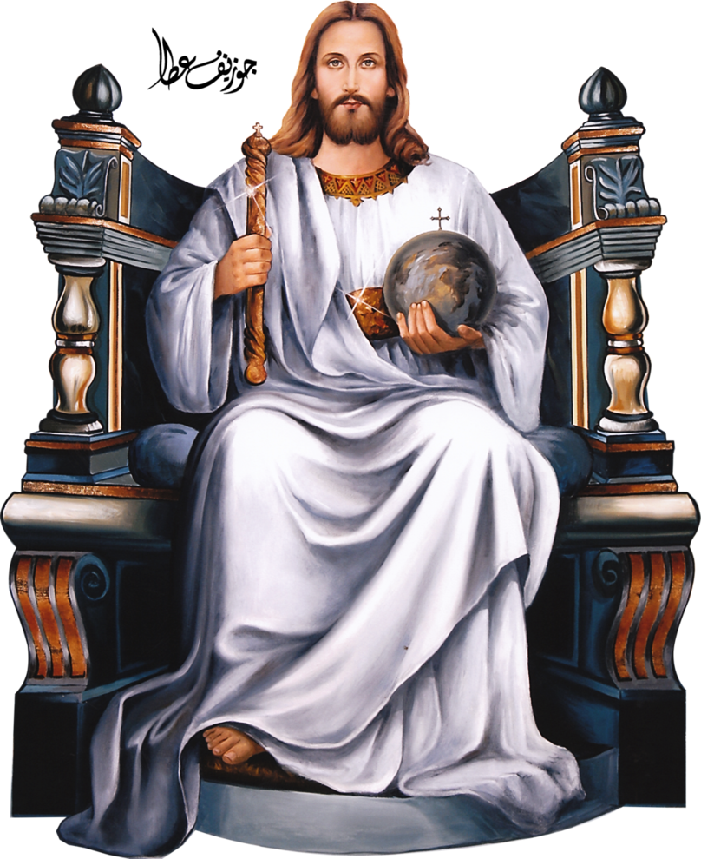
The Lion of Judah is called for—the one who is worthy to open the seven judgement seals.
But notice who is the one who actually steps up and does the job.

Slide 82
Revelation 5:1-5 GNT (cont.)
“Then I saw a Lamb standing in the center of the throne... The Lamb appeared to have been killed… The Lamb went and took the scroll… As he did so… the twenty-four elders fell down before the Lamb…

Slide 83
Revelation 5:1-5 GNT (cont.)
“…They sang a new song:
‘You are worthy to take the scroll and to break open its seals. For you were killed, and by your sacrificial death you bought for God people from every tribe, language, nation, and race…’”

Slide 84
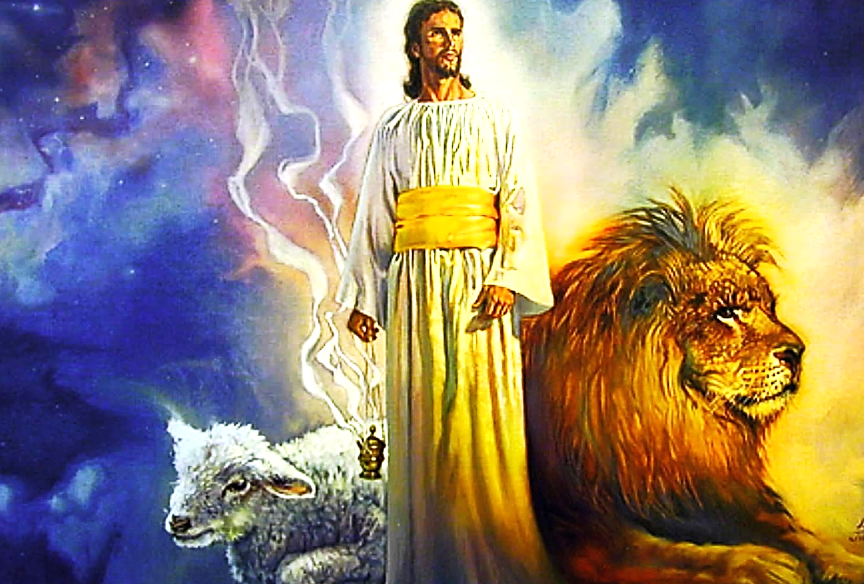
So, we see, the “Lion of Judah” and the slain “Lamb of God” are both Jesus.
He is the only one worthy to judge sin,
but He chose, rather,
to take our sin
upon Himself and let
that judgement
for our sin fall
on Him.

Slide 85
For this He will be eternally praised by all creatures in Heaven and Earth.

Slide 86
Question #5:
Why is Jesus the only One worthy to judge the world?

Slide 87
