Slide 1
God’s Timetable, pt. 3 –
Love is Patient

Slide 2
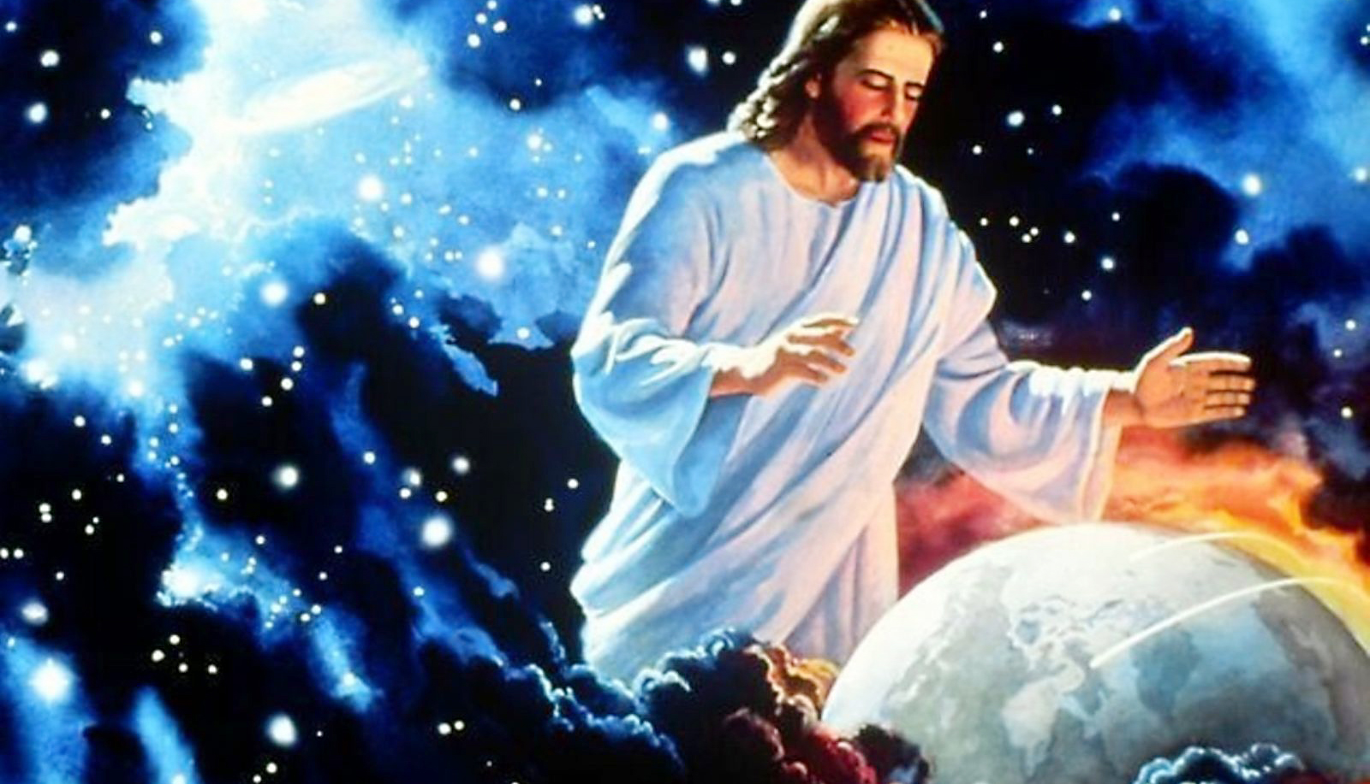
His Patience

Slide 3
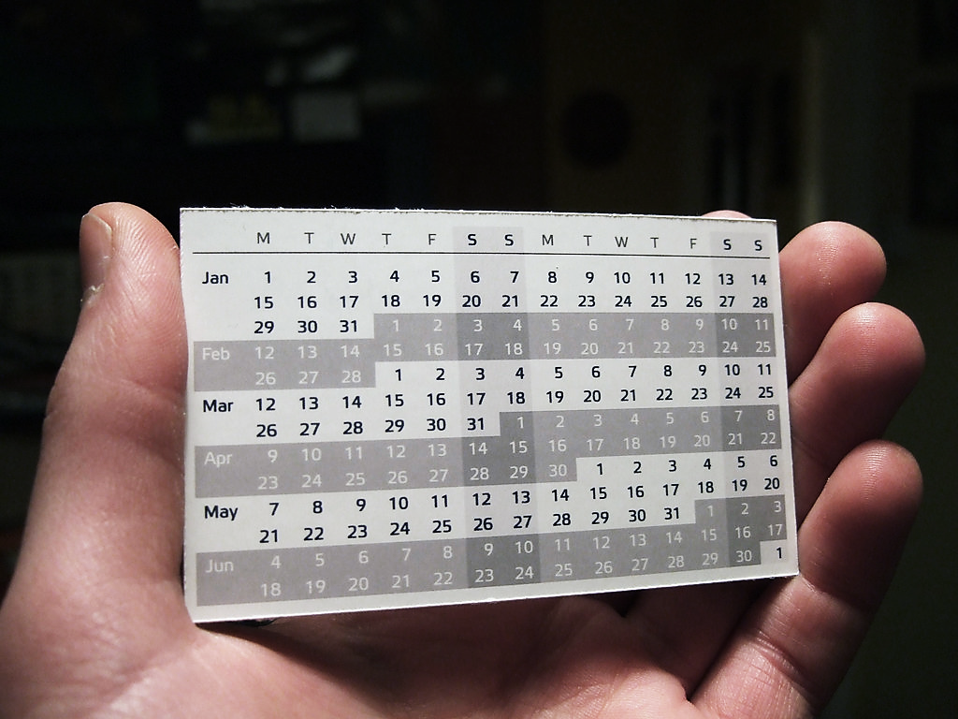
Today, we are continuing to talk about God’s Timetable – this is pt. 3 “His Patience.”

Slide 4
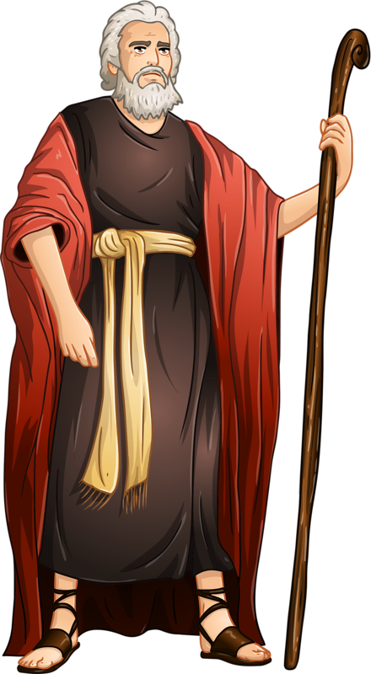
Our 7th “P” regarding why Jesus waited to near the end of God’s timetable is simply…
His PATIENCE.
“Love is patient.”
This is what God told Moses on Mount Sinai:

Slide 5
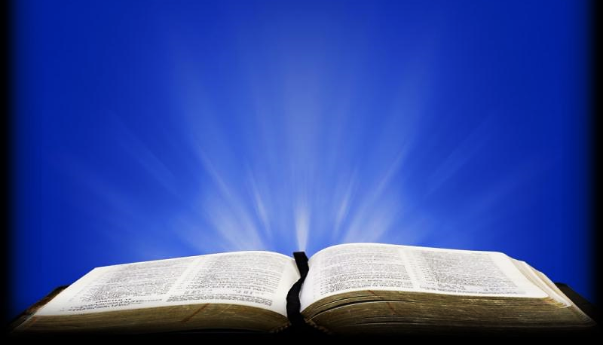
Exodus 34:6 ESV
“The Lord passed before him and proclaimed, ‘The Lord, the Lord, a God merciful and gracious, slow to anger, and abounding in steadfast love and faithfulness.’”

Slide 6
Because of His great Patience, He waits decades for people to repent of sin.
He is, by nature, a loving Savior.
God had promised that the descendants of Abraham would possess the Canaan land...
...but (He said) not yet, because in His patience,
He was still giving the Amorites time to repent.
This wouldn’t happen for four more generations.

Slide 7
Gen 15:16 GNV
“And in the fourth generation they shall come hither again: for the wickedness of the Amorites is not yet full.”

Slide 8
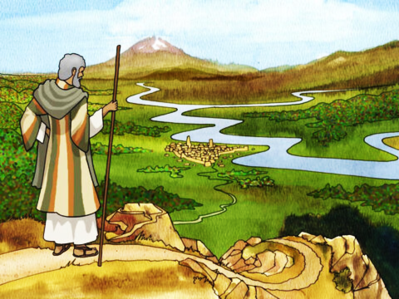
But eventually, after four generations, the Amorite’s cup of iniquity was full, and God gave Israel their promised land.
He was also patient with Israel.
Even though Israel had rebelled against Him over and over and over…

Slide 9
Numbers 14:18 ICB
“The Lord doesn’t become angry quickly. The Lord has great love. The Lord forgives sin and law breaking. He has great mercy. But the Lord does not forget to punish guilty people…”

Slide 10
1 Pet 2:9 TLB
“He isn’t really being slow about his promised return, even though it sometimes seems that way. But he is waiting, for the good reason that he is not willing that any should perish, and he is giving more time for sinners to repent.”

Slide 11
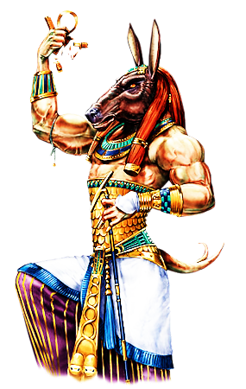
God was very patient with the people of Israel.
They had a repeating pattern of repentance and backsliding.
First, they would worship strange gods, then they would be slaves to some captor, then they would offer remorse and supplications, then God would raise up a deliverer, then they would sin again, be captured again, repent again, and so on and so on.

Slide 12
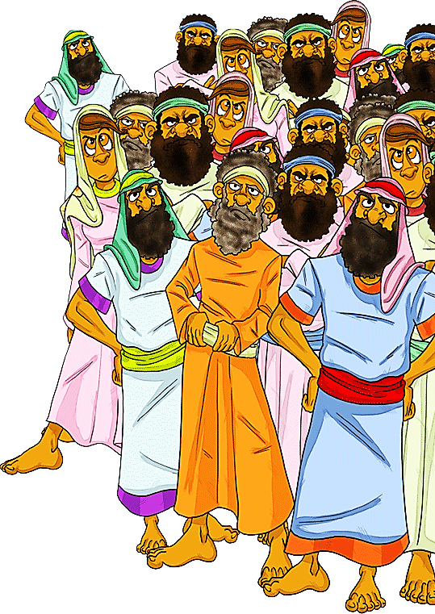
Their main problem was that they found the world around them so very attractive.
They were tired of God’s laws and wanted the freedom and fun that the heathen seemed to be having.
The last time we see this cycle take place is in the book of Nehemiah.
This book records the last events of Old Testament times.

Slide 13
Previously, the Babylonians had broken down the wall, destroyed the Temple and captured the Jews—
making them slaves for 70 years.
The Israelites had backslidden yet again. They were taken captive by various enemies approximately 44 times throughout history.
Then (after 70 years) Cyrus, the Persian King, defeated Babylon and issued a decree that declared that all the captive Jews were now free to return to their homeland.

Slide 14
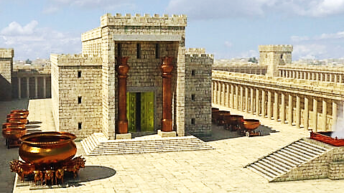
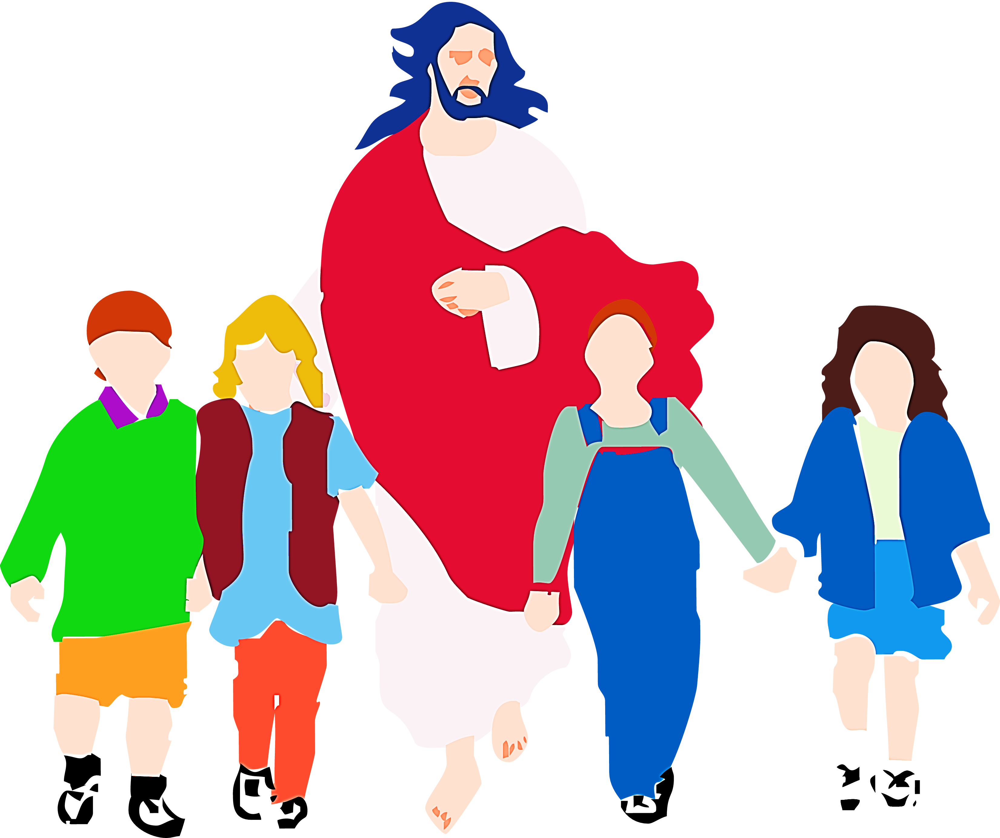
More than 50,000 Jews returned under a leader named Zerubbabel.
Under his leadership, they Rebuilt the Temple of the Lord.
The bible says: Believers are now the temple of the Lord.
Believers are the place where God dwells now.

Slide 15
1 Cor 6:19, 20 ERV
“You should know that your body is a temple for the Holy Spirit that you received from God and that lives in you. You don’t own yourselves. God paid a very high price to make you his. So honor God with your body.”

Slide 16
Question #1
Talk about different ways you can honor God with your body.

Slide 17
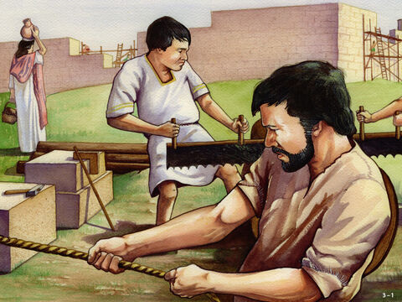
The Temple was rebuilt; however Jerusalem and the Temple were defenseless because her wall was still in ruins.
This was a tall, strong wall that kept the Temple of the Lord separate and safe from the Amorites and other surrounding hostile nations.

Slide 18
Without a strong wall, the temple had no protection from the world around it.
Jerusalem needed a strong wall to protect the Temple.

Slide 19
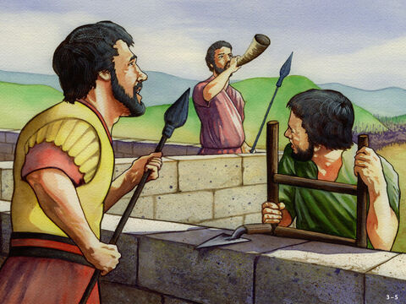
We too need strong spiritual walls around us.
We are His Temple today.
We need to be fortified against the evil all around us in this world.
Yes, we need to build strong spiritual walls.

Slide 20
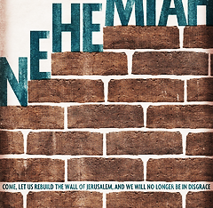
Nehemiah was in Persia working as a cup holder for it’s king when a visitor came from Israel.
He asked the
visitor about how
his brother Jews
were doing back in
Israel.

Slide 21
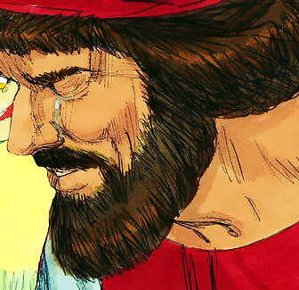
The news wasn’t
good, the wall was
in shambles. The
city was vulnerable.
When Nehemiah heard
about the walls, he wept, fasted and prayed.

Slide 22
Neh 1:2-4 ICV
“Hanani, one of my brothers, arrived with some men from Judah. I asked them about the Jews who had escaped, about those who had survived the Babylonian captivity, and about Jerusalem…

Slide 23
Neh 1:2-4 ICV (cont.)
…They told me, “The survivors of the captivity there in the province are living in great distress and shame. Furthermore, the Jerusalem wall remains broken down and its gates have been burned by fire…

Slide 24
Neh 1:2-4 ICV (cont.)
…When I heard this, I sat down and cried, mourning for a number of days while I fasted and prayed in the presence of the God of Heaven.”

Slide 25
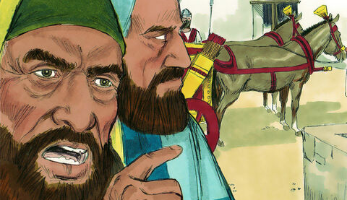
Then Nehemiah went to Jerusalem to rebuild the walls.
They were met with a lot of opposition from the surrounding heathen nations.
Especially from two guys named Tobiah and Sanballat.

Slide 26
Neh. 4:3 CEV
“Tobiah from Ammon was standing beside Sanballat and said, “Look at the wall they are building! Why, even a fox could knock over this pile of stones.”

Slide 27
Question #2
In what ways might an unbeliever make a believer feel foolish and vulnerable for trying to build a relationship with God? Why do you think they do this?

Slide 28
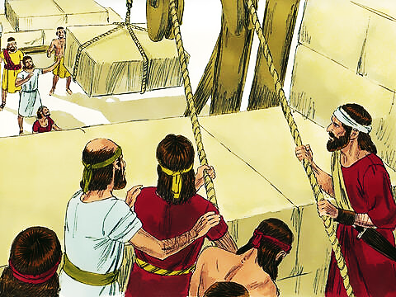
They did a lot more than mock. They plotted evil entrapments against both Nehemiah and the building of the wall.
Nevertheless, God was with Nehemiah and the wall was built.

Slide 29
Neh. 6:15, 16 CEV
“…the wall was completely rebuilt. It had taken fifty-two days. When our enemies in the surrounding nations learned that the work was finished, they felt helpless, because they knew that our God had helped us rebuild the wall.”

Slide 30
Question #3
Tobiah had mocked them and tried to make them feel weak and foolish. But all that changed when he saw how the Lord had helped the Israelites rebuild the wall. How might that apply to the mockers in our lives?

Slide 31
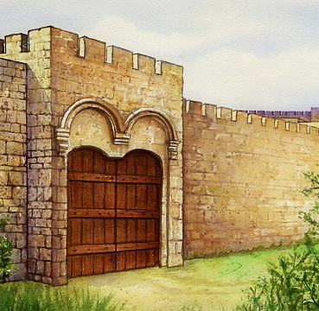
It was a miracle
that, even with all that opposition, they got the wall built in only 52 days.
Then the enemy
got discouraged because it was obvious that God was with Israel.

Slide 32
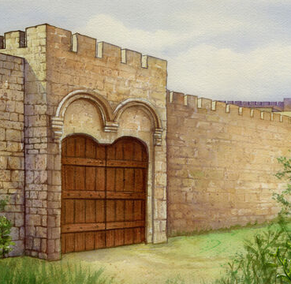
So, Nehemiah, feeling good about the situation, went back to his job as the King of Persia’s cupholder.
After a while he moved back to Israel—probably to retire.

Slide 33
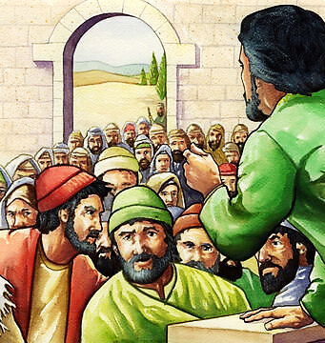
When he got back to Israel, he was horrified by what he saw—they were backslidden—again!
He realized that, although his secular work was done, it was still crucial that his spiritual work continue.

Slide 34
He found out that “When the cat’s away, the mice do play.”
He found that the people had compromised their faith in big ways.

Slide 35
In his absence, Tobiah, the Lord’s enemy, had even been given a cozy apartment right in the Lord’s
Holy Temple.
Too make things worse,
he was given the very
chamber intended for
the Lord’s sacrifices
and holy vessels.
They had cleared out all the tithes and offerings just to make room for Tobiah.

Slide 36
The Jews were
marrying the
heathen girls.
Compromise had
brought about an
unrighteous, but
seemingly peaceful
existence between
the people of God
and the heathen world
around them.
In other words, an unholy alliance.

Slide 37
Neh. 13:4-6 VOICE (cont.)
“…the priest named Eliashib took a large storeroom in the temple of God and gave it to Tobiah the Ammonite for his use. Eliashib was in charge of the storerooms, and Tobiah was a relative of his.

Slide 38
Neh. 13:4-6 VOICE (cont.)
“…Before he gave it to Tobiah, it had been used to store many different things for use in the temple: the grain offerings, the incense, the vessels…

Slide 39
Neh. 13:4-6 VOICE (cont.)
“…I was not in Jerusalem when Eliashib did this. It was the 32nd year of the reign of Artaxerxes, king of Persia, and I had returned to make a report to him. Later on, I asked his permission to return to Jerusalem.”

Slide 40
Tobiah was a relative of the High priest Eliashib. This could only have happened through inter-marrying between the two families. Now Tobiah had a seat at the family table.
And, whereas Nehemiah wouldn’t even let Tobiah enter through the wall into Jerusalem, Eliashib had actually built a cozy apartment for him right inside the Lord’s Temple.

Slide 41
Neh 13:7-9 VOICE
“When I arrived, I learned about the evil thing Eliashib had done by giving Tobiah a room in the courts of the temple of the True God, a place he wasn’t even allowed to enter because of his heritage…

Slide 42
Neh 13:7-9 VOICE (cont.)
“…I was livid. In my anger, I threw all of Tobiah’s property out of the room. Then I had them purify the rooms and restore what was supposed to be there—the sacred vessels, the grain offerings, and the incense.”

Slide 43
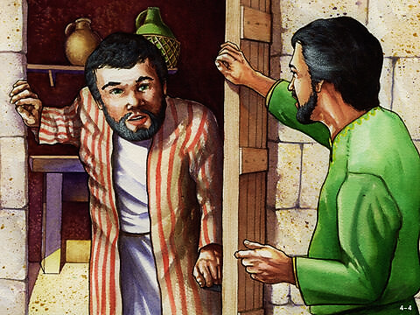
Eliashib was the priest who had been put in charge of the storerooms of the temple.
And yet, to Nehemiah’s horror, the high priest was allowing Tobiah (the Lord’s enemy) to set up an apartment there in the Temple chamber allocated for the storage of sacrifices and holy things.

Slide 44
He had allowed Tobiah to sweet talk him into providing him with a large room, formerly used to store the grain offerings, incense and temple articles.

Slide 45
2 Corinthians 6:14-18 MSG
“Don’t become partners with those who reject God. How can you make a partnership out of right and wrong? That’s not partnership; that’s war. Is light best friends with dark? Does Christ go strolling with the Devil? Do trust and mistrust hold hands? …

Slide 46
2 Corinthians 6:14-18 MSG (cont.)
“Who would think of setting up pagan idols in God’s holy Temple? But that is exactly what we are, each of us a temple in whom God lives. God himself put it this way: “I’ll live in them, move into them; I’ll be their God and they’ll be my people…

Slide 47
2 Corinthians 6:14-18 MSG (cont.)
“So, leave the corruption and compromise; leave it for good,” says God. “Don’t link up with those who will pollute you. I want you all for myself. I’ll be a Father to you; you’ll be sons and daughters to me.” The Word of the Master, God.”

Slide 48
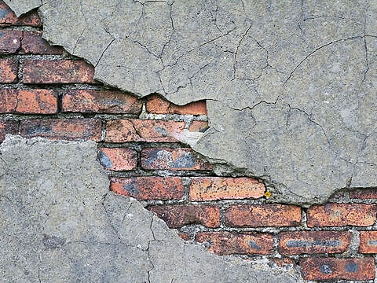
This is what it looks like when the walls of righteousness are not guarded.
The world starts creeping into our hearts (God’s Temple) just looking for a comfortable place to call home.
Perhaps we start telling more and more little white lies.
Or we toy with a little flirtation outside our marriage.
Or job promotions & work pals take the place of pleasing God.

Slide 49
Money becomes more and more enticing.
We are less ready to make sacrifices for God.
We begin feeling that time spent with God is a drudgery.
We relegate the ministry of the Word to others thinking it’s “someone else’s calling.”
Has the wall protecting our spiritual life been crushed by an enemy, or has it simply failed to stand?

Slide 50
Has such a believer been invaded?
--NO!--
This believer is entertaining a special guest—an old
familiar friend—his
Tobiah— “The World.”
He has prepared room
for Tobiah (the world)…
a special room that was
originally intended to
hold ONLY things
dedicated to God.

Slide 51
This room, in the Lord’s Temple, our bodies, is our heart.
There we store all our worship, love, affection, sacrifice and desire to serve the Lord.
This is the one and only thing for which the human heart was created.
He wants to occupy the whole space—our whole heart.

Slide 52
Deuteronomy 10:12 BSB
"And now, O Israel, what does the LORD your God ask of you but to fear the LORD your God by walking in all His ways, to love Him, to serve the LORD your God with all your heart and with all your soul,”

Slide 53
James 4:3-5 CEV
“You people aren’t faithful to God! Don’t you know that if you love the world, you are God’s enemies? And if you decide to be a friend of the world, you make yourself an enemy of God. Do you doubt the Scriptures that say, “God truly cares about the Spirit he has put in us?”

Slide 54
2 Kings 17:41 NCV
"So, these nations honored the Lord but also worshiped their idols, and their children and grandchildren still do as their ancestors did.”

Slide 55
Question #4:
What is the danger to our children and grandchildren if we model half-hearted devotion and love for God?

Slide 56
We must never get out our brooms and start sweeping away a little corner space for our worldly pleasures and pursuits.
To do that, we would have to remove some of our “loving God stuff” in order to make room for our “worldly Tobiah stuff.”
But Christians may ask, “Can’t we have just a little Tobiah stuff in God’s special chamber – a little space in our heart?

Slide 57
Rom 13:14 KJV
“But put ye on the Lord Jesus Christ, and make not provision for the flesh, to fulfil the lusts thereof.”

Slide 58
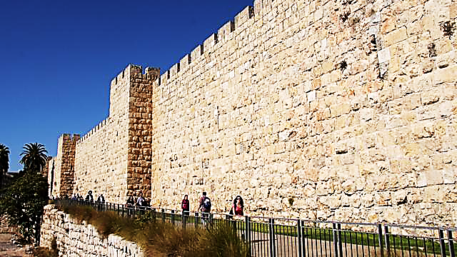
So, what is this spiritual wall that we are building tall and strong and protecting with all vigilance?
It is our personal relationship with God--this is our spiritual wall protecting our heart (our special chamber in God’s holy Temple).
Spiritual Wall, Tall, Strong and Protecting

Slide 59
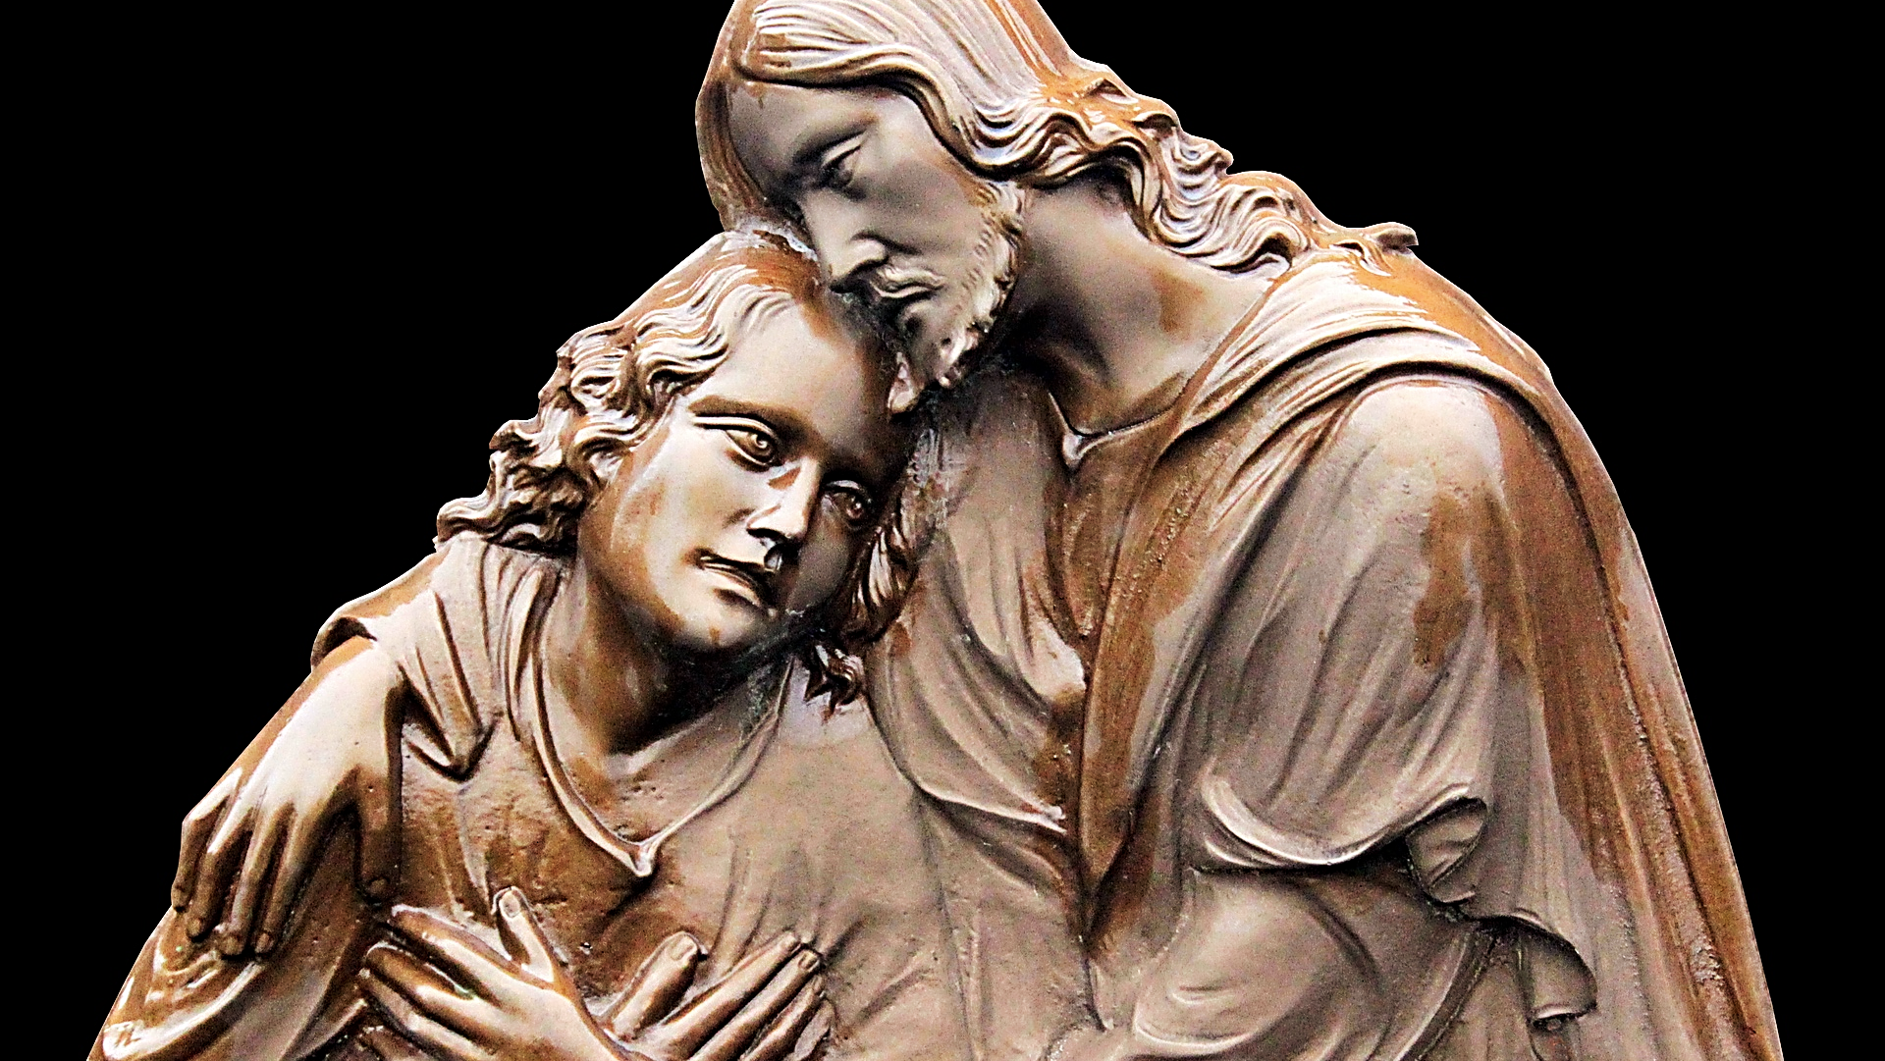
Relationship with God—the strongest
wall against our enemy--worldliness.

Slide 60
Psalm 144:1-3 TPT
“There is only one strong, safe, and secure place for me; it’s in God alone, and I love him! …He’s my shelter of love and my fortress of faith, who wraps himself around me as a secure shield…”

Slide 61
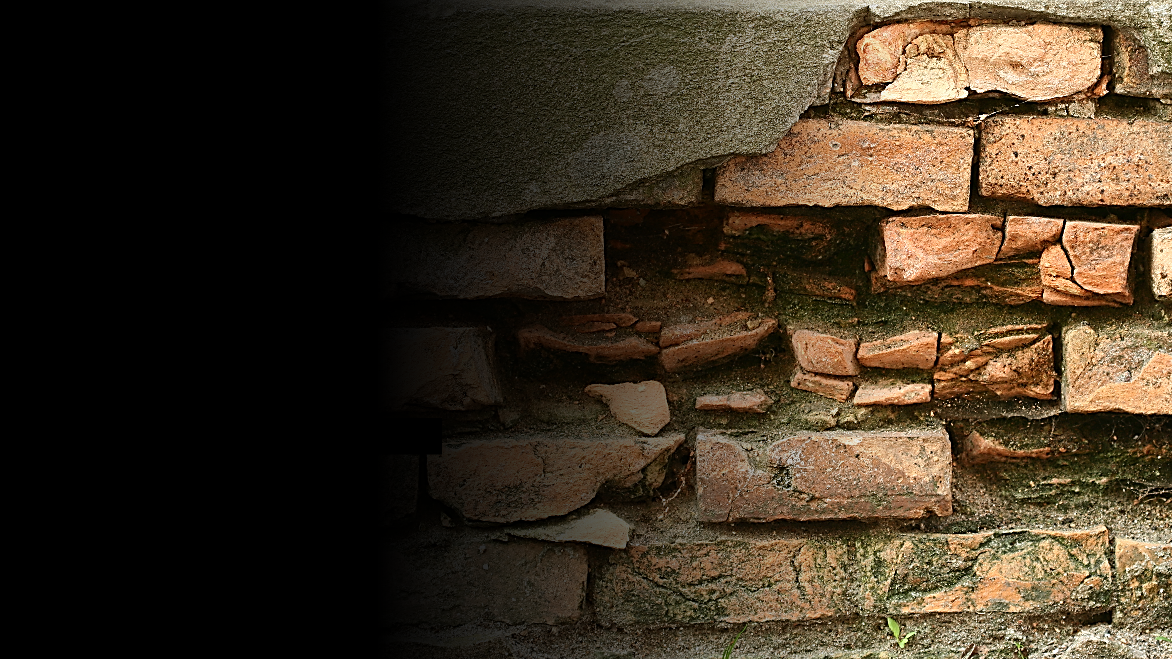
We must take it seriously.
A neglected wall
(or neglected relationship with God) will expose us to deadly hidden dangers.

Slide 62
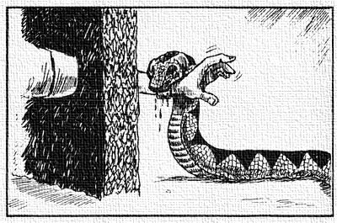
Ecclesiastes 10:8 CSB
“…one who breaks through a wall may be bitten by a snake.”

Slide 63
Question #5:
If we let our spiritual wall (our relationship with God) break down, what are some of the snakes (sins) that we might get bitten by?

Slide 64
God took His time in sending Jesus because He is patient and waits for people to be saved.
We have seen that:
God waited for the heathen nations to repent.
And He waited for Israel to turn to Him as a Nation and not continue to backslide.

Slide 65
Sadly, after God had waited more than 4,000 years the Jews proved that they were not ready to repent as a nation, at least not in a way that was true, lasting and deeply felt.

Slide 66
Ezekiel 33:11 ERV
“You must say to them, ‘The Lord God says: By my life, I swear that I don’t enjoy seeing people die—not even evil people! I don’t want them to die. I want them to come back to me…

Slide 67
Ezekiel 33:11 ERV (cont.)
…I want them to change their lives so that they can really live. So, come back to me! Stop doing bad things! Why must you die, family of Israel?’”

Slide 68
Remember, in our
last lesson, we
quoted Anna
Wintour, the editor
of Vogue magazine,
who said this about
fashion trends…
“It’s always about
timing. If it’s too
soon, no one
understands. If it’s too
late, everyone has forgotten.”

Slide 69
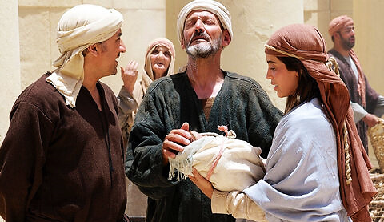
We talked about how Jesus and His mission were easily understood by the world when He did arrive because God had made the world ready, and many were eagerly waiting Him.

Slide 70
On the other hand, according to Anna Wintour, when a trend does reach public consciousness, and some are far too slow to adapt it—their opportunity to be considered “stylish” or “with it” is missed.
Hence the expression, “You are so last year” or even, “so last week.”

Slide 71
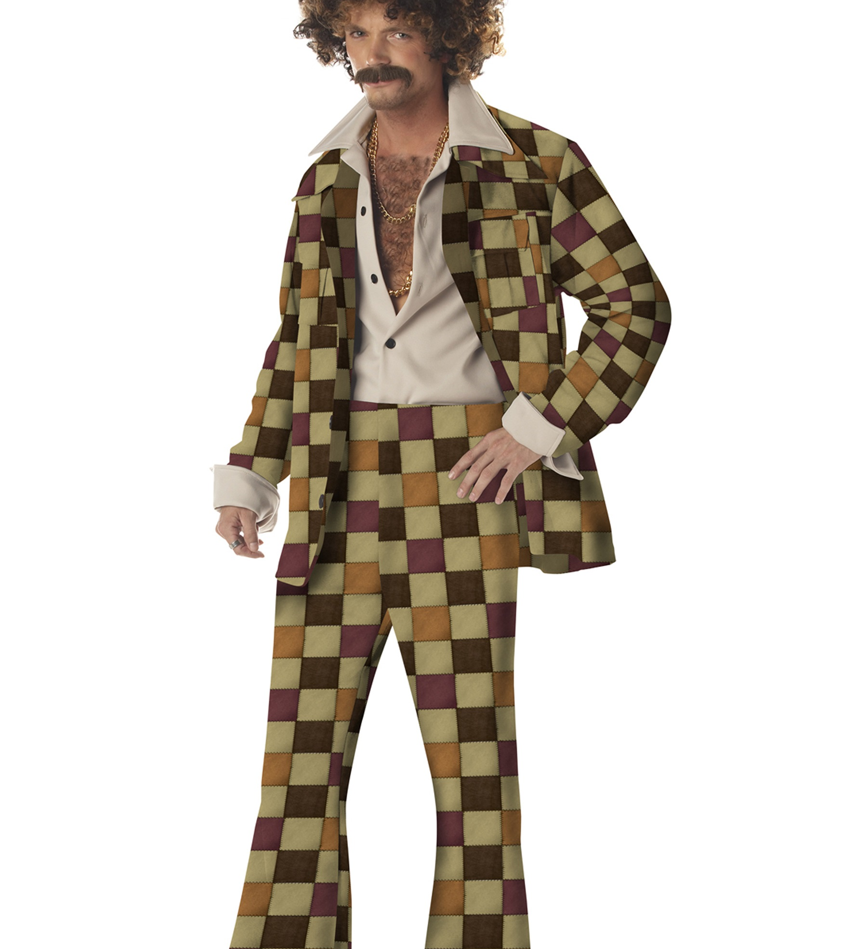
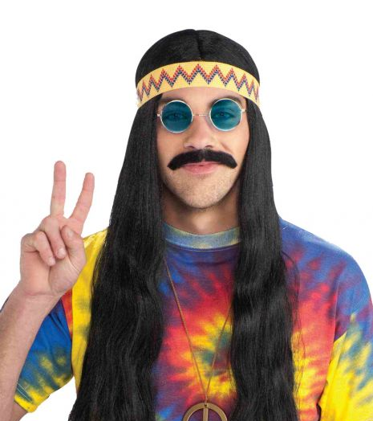
These guys missed the time for change.
These dudes are so 60 years ago!

Slide 72
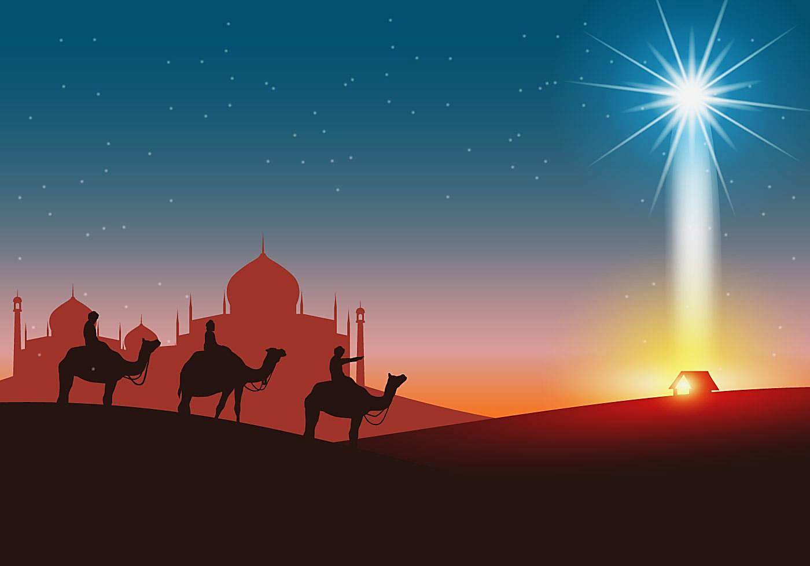
This is true for more that the fashion industry.
When it comes to the callings and gifts of God, we can miss them, and they can pass us by.
Near the end of God’s plan, Jesus came to earth, to Israel, to a people who had forsaken Him.

Slide 73
He was giving them another chance.
Will they embrace this amazing
opportunity to repent and glorify the
promised Messiah who is now
in their midst?

Slide 74
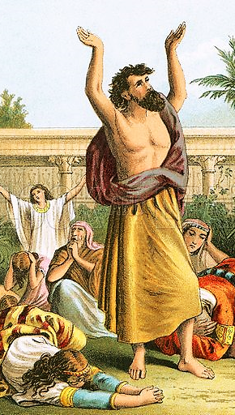
This was a time when the Jews should have recognized and welcomed their promised Savior.
Israel should have fasted, prayed and mourned in sackcloth and ashes for their national sins.
But that didn’t happen.
They hated Him, they plotted against him just like Tobiah had plotted against Nehemiah.
They chose Barabbas, the thief & crucified Jesus, the Savior.

Slide 75
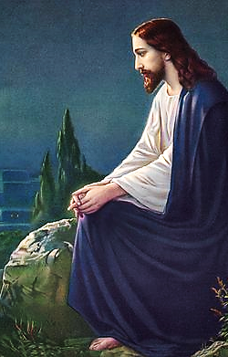
Nevertheless, just before they crucified Him, He went up on a hill to gaze upon them.
To pray and mourn for them because, having missed their opportunity for national repentance, they were about to be destroyed by conquerors yet again.
In 70 AD, the Romans would destroy Jerusalem, burn down the Temple (again), and scatter the people (again).

Slide 76
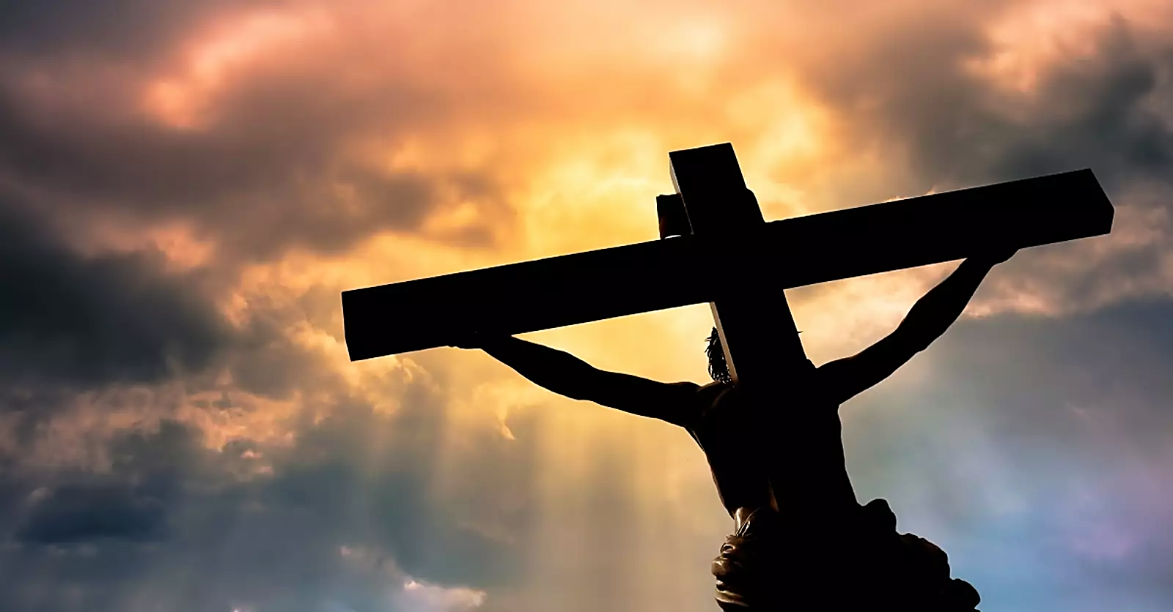
Jesus knew that His coming to earth was nearly Israel’s last chance for national repentance, but foolishly they had missed their time.
A final time will come when Jesus returns in His glory to deliver Israel from the armies of the anti-christ.
On that day, they will look on him who they have pierced, and they will mourn.
And there will be national repentance, salvation and reconciliation with their God.

Slide 77
At that time, they will repent,
but not now, not yet.
Soon, within a generation’s time, in 70 AD, they would suffer, having missed Him, the expected one, their Messiah.
Because of this, Jesus mourned for them.

Slide 78
Luke 13:34, 35 GNT
“Jerusalem, Jerusalem! You kill the prophets; you stone the messengers God has sent you! How many times I wanted to put my arms around all your people, just as a hen gathers her chicks under her wings, but you would not let me!...

Slide 79
Luke 13:34, 35 GNT (cont.)
…And so your Temple will be abandoned. I assure you that you will not see me until the time comes when you say, ‘God bless him who comes in the name of the Lord.’”

Slide 80
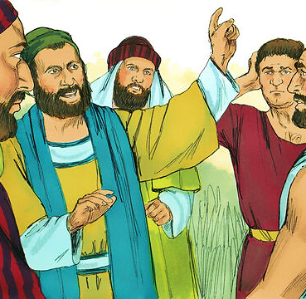
Till then, God has
turned His
attention to the
Gentiles as well as
any individual Jews
who receive Jesus
by faith.
After trying to preach
salvation through
Jesus to his fellow
Jews, Paul explains this transition—this major
shift in God’s plan.

Slide 81
Acts 28:26-27 BSB
“For this people’s heart has grown callous; they hardly hear with their ears, and they have closed their eyes. Otherwise, they might see with their eyes, hear with their ears, understand with their hearts, and turn, and I would heal them.’…

Slide 82
Acts 28:26-27 BSB
…Be advised, therefore, that God’s salvation has been sent to the Gentiles, and they will listen!”

Slide 83
“It’s always about timing. If it’s too soon, no one understands. If it’s too late, everyone’s forgotten.”
Jesus came right on time and God used our 7 “P” words to prepare the world for His first coming.
That is: His People, His Place, His Professor, His Prophets, His Pictures, His Pages and His Patience.

Slide 84
Even the heathen world was ready for Him.
They understood that there is a righteous God and Israel was anticipating a coming Savior.
Jesus stepped onto a world that was ripe for Him.
He had waited patiently with all long-suffering for both the ancient heathen nations and Israel to repent.
He was right on time.
In fashion terms, Jesus was
the “in thing!” that year.
He was in-season—Christmas season!

Slide 85
Israel missed her opportunity.
They failed to embrace Jesus.
They failed to exalt their Messiah.
They were prideful & stubbornly slow to get on-board with God’s plan.
Now God’s work has moved to the Gentiles (for now).

Slide 86
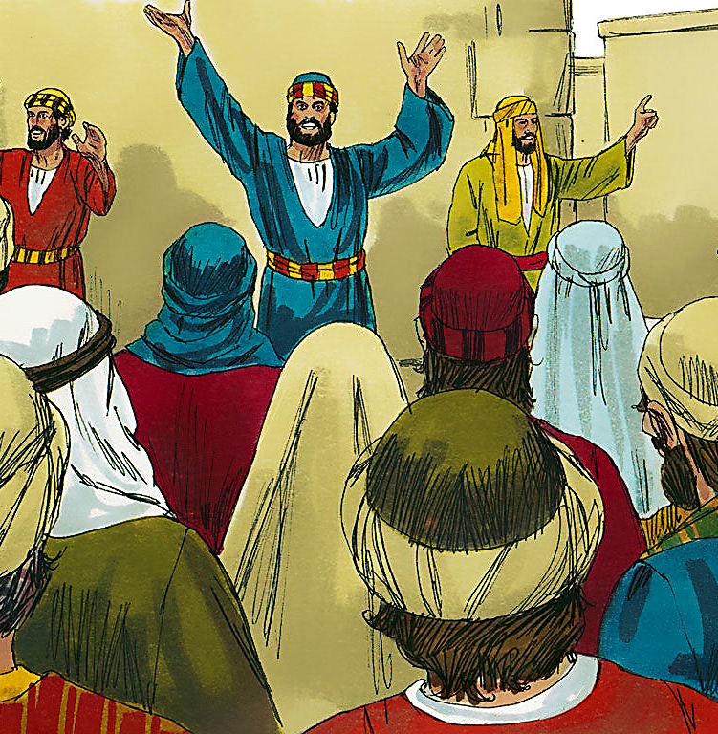
God waited patiently for the ancient heathen nations to repent.
And He waited for Israel.
He then came to reveal Himself to Israel, but they
missed Him.
Now, He is sending His messengers to the Gentiles.

Slide 87
He is still waiting for as many of them that will, to come to Him.
This is His Bride.
This is the church He is bringing into His Kingdom before He comes again.

Slide 88
2 Peter 3:9 ERV
“He isn’t really being slow about his promised return, even though it sometimes seems that way. But he is waiting, for the good reason that he is not willing that any should perish, and he is giving more time for sinners to repent.”

Slide 89
After the events in Nehemiah, the Word of God was silent for 400 years.
No more prophets, no more bible stories, no more Psalms of worship, no more recorded history—nothing.

Slide 90
Nothing, that is, but a 400-year-old promise.
You see, there was, in Nehemiah’s day, a certain prophet named Malachi.
He wrote the last book of the Old Testament.
Here is one of the last things he wrote:

Slide 91
Malachi 4 ISV
“But I will send Elijah the prophet to you. He will come before that great and terrible day of the Lord’s judging.”

Slide 92
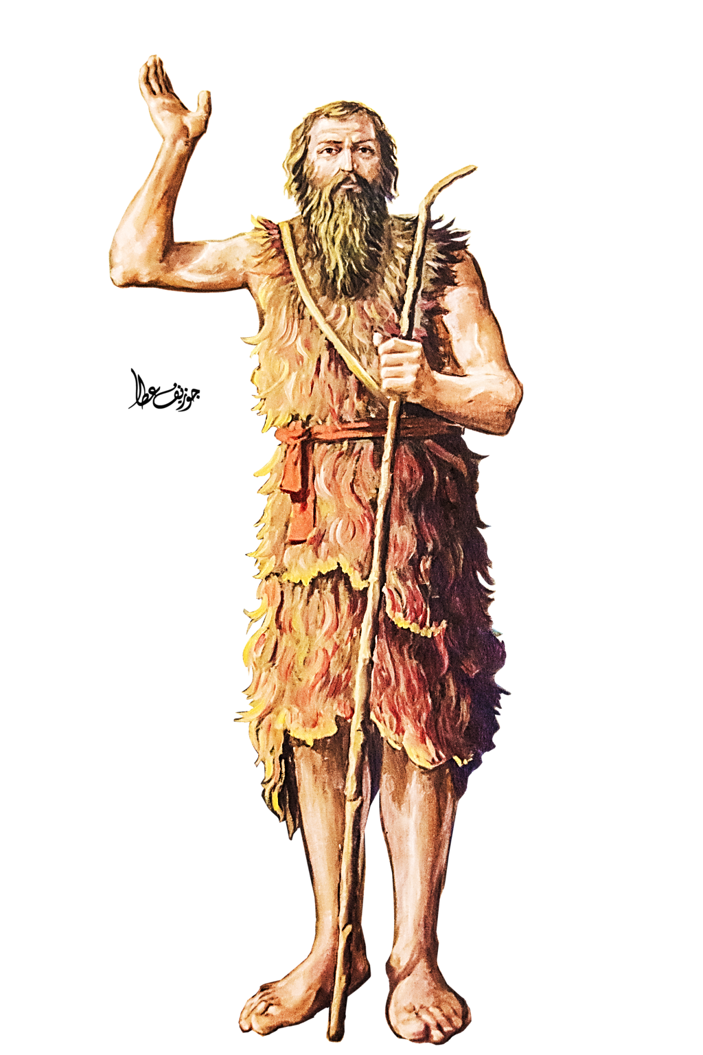
Before the final judgement, God planned to send a prophet like Elijah.
This man would be John the Baptist, and he would come after 400 yrs. of silence.
John would introduce Jesus to the world.
When He comes, will He find a righteous Israel eager to celebrate His coming?
Or, after the long 400 yr. silence, will he find the likes of “Tobiah” (or worldliness) comfortably sprawled in God’s Holy Temple?
Did the mice play while the cat was away?

