Slide 1
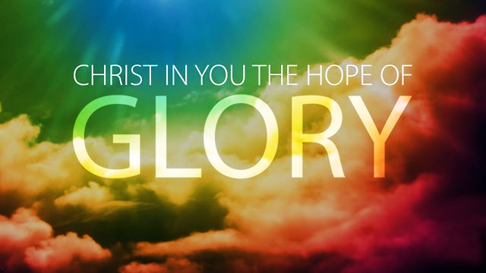

Slide 2
If you would like to watch the video of this live service, click here: https://campaignkerusso.org/?p=8675
We would love to know more about the people who download our lessons & sermons. We invite you to email us & let us know where & how you use them.
info@ckusa.org

Slide 3
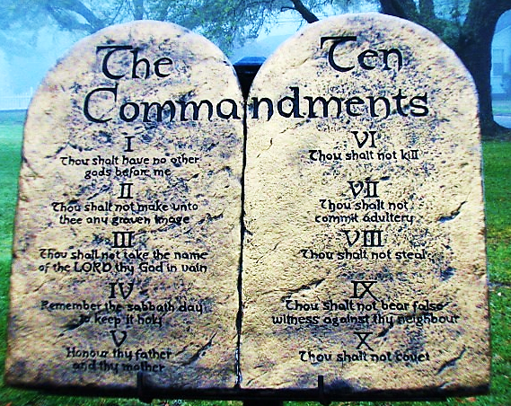
The Ten Commandments come from God, but they are very hard for us to do!
Let’s read them and think about whether we have ever broken any of God’s laws.

Slide 5
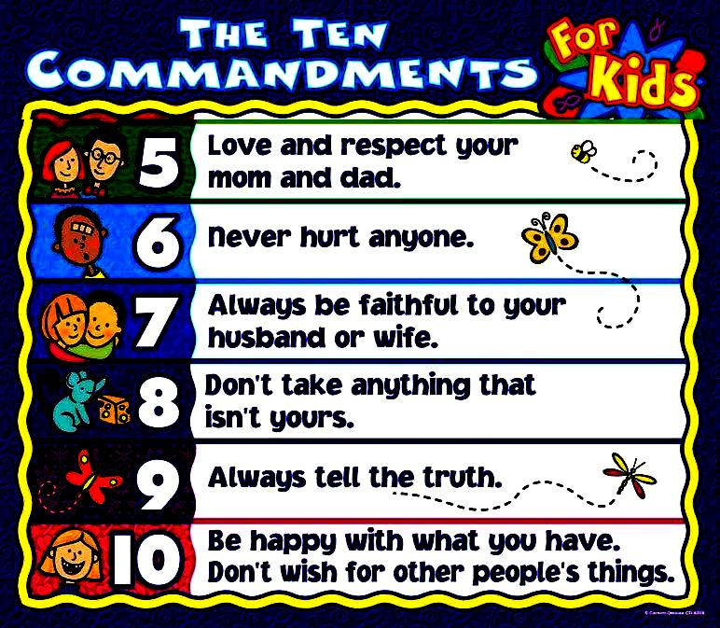

Slide 6
This man is hanging from a chain that has nine perfectly good golden links & just one broken one.
Do you think it will hold him?
Is he safe for a while?
Is he safe forever?
Why not?
The Bible says:
“If you obey every law except one, you are still guilty of breaking them all.” James 2:10 (CEV)
The truth is, none of us are safe.
We have all broken commandments.
The punishment for breaking God’s law is death and Hell.

Slide 7
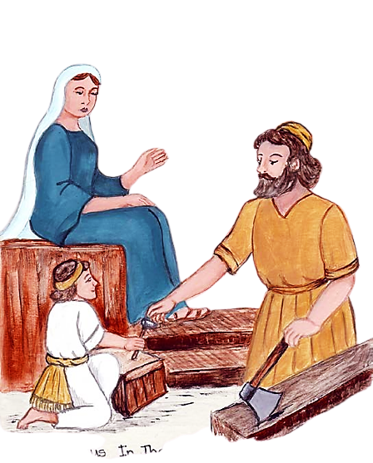
When Jesus was on Earth, He was a perfect baby, & a perfect boy, & a perfect man.
He never did anything wrong.
It was natural for Him to obey the laws because He wrote them a long time go.
They describe Him, who He was and is & will always be.
He lives the law because He is the law.

Slide 8
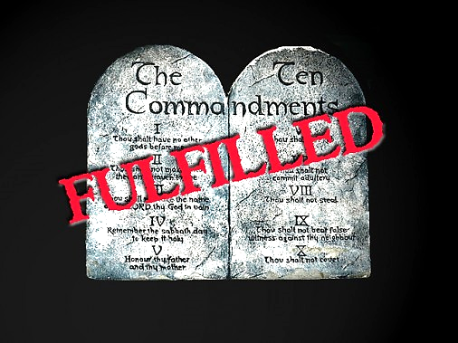
Jesus fulfilled every letter of the law.
If you have invited Him to come into your heart, that is where He now lives.
The perfect record of your heart-guest counts as your perfect record too.
You get credit for His goodness.

Slide 9
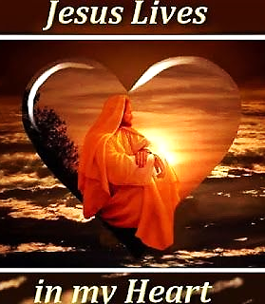
Not only do you get full credit for His perfect record…
Because He lives in your heart, you are changing—becoming more like Him.
Soon, when you’re tempted to break a law, you will find that your new Christ-heart no longer wants to sin.

Slide 10
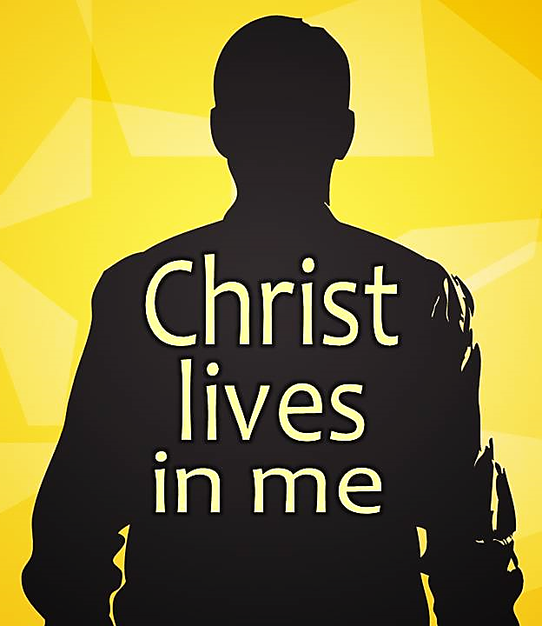
Colossians 1:27 (GW)
“God wanted his people throughout the world to know the glorious riches of this mystery—which is Christ living in you, giving you the hope of glory.”

Slide 11
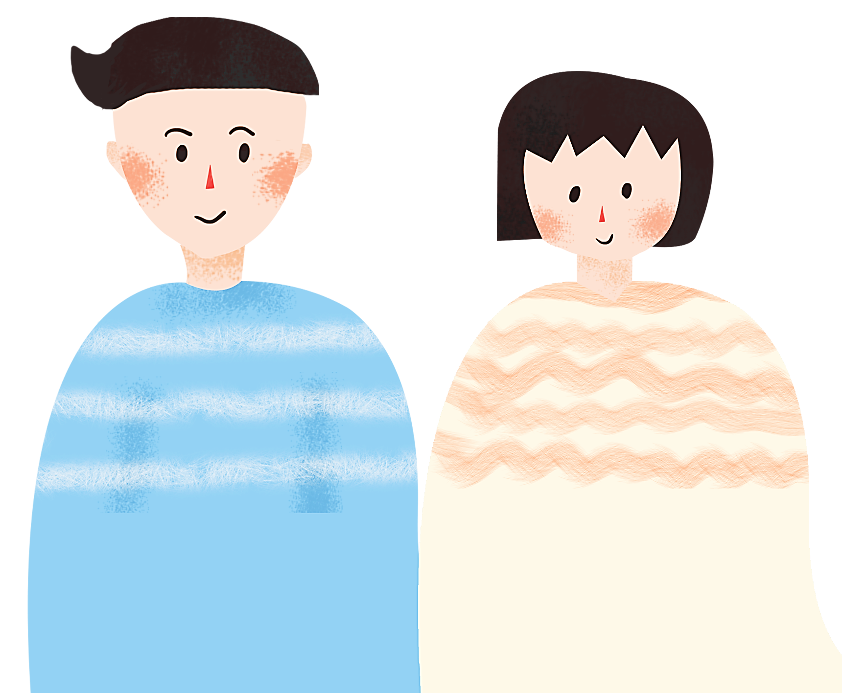
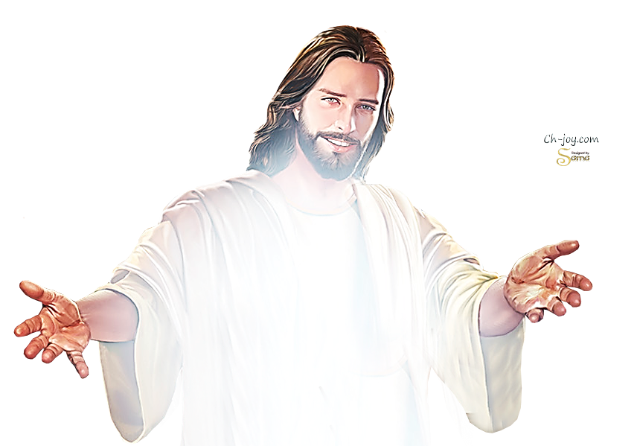
“Christ in you…
…the hope of glory.”

Slide 12
Describe someone who disobeys this 1st commandment.
What are some things they might say?
What are some things they might do?
How do we become this person?

Slide 13
Describe someone who obeys this 1st commandment.
What are some things they might say?
What are some things they might do?
How do we become this person?

Slide 14
“Christ in you…
…the hope of glory.”

Slide 15
Describe someone who disobeys this 2nd commandment.
What are some things they might say?
What are some things they might do?
How do we become this person?

Slide 16
Describe someone who obeys this 2nd commandment.
What are some things they might say?
What are some things they might do?
How do we become this person?

Slide 17
“Christ in you…
…the hope of glory.”

Slide 18
Describe someone who disobeys this 3nd commandment.
What are some things they might say?
What are some things they might do?
How do we become this person?

Slide 19
Describe someone who obeys this 3nd commandment.
What are some things they might say?
What are some things they might do?
How do we become this person?

Slide 20
“Christ in you…
…the hope of glory.”

Slide 21
Describe someone who disobeys this 4th commandment.
What are some things they might say?
What are some things they might do?
How do we become this person?

Slide 22
Describe someone who obeys this 4th commandment.
What are some things they might say?
What are some things they might do?
How do we become this person?

Slide 23
“Christ in you…
…the hope of glory.”

Slide 24
Describe someone who disobeys this 5th commandment.
What are some things they might say?
What are some things they might do?
How do we become this person?

Slide 25
Describe someone who obeys this 5th commandment.
What are some things they might say?
What are some things they might do?
How do we become this person?

Slide 26
“Christ in you…
…the hope of glory.”

Slide 27
Describe someone who disobeys this 6th commandment.
What are some things they might say?
What are some things they might do?
How do we become this person?

Slide 28
Describe someone who obeys this 6th commandment.
What are some things they might say?
What are some things they might do?
How do we become this person?

Slide 29
“Christ in you…
…the hope of glory.”

Slide 30
Describe someone who disobeys this 7th commandment.
What are some things they might say?
What are some things they might do?
How do we become this person?

Slide 31
Describe someone who obeys this 7th commandment.
What are some things they might say?
What are some things they might do?
How do we become this person?

Slide 32
“Christ in you…
…the hope of glory.”

Slide 33
Describe someone who disobeys this 8th commandment.
What are some things they might say?
What are some things they might do?
How do we become this person?

Slide 34
Describe someone who obeys this 8th commandment.
What are some things they might say?
What are some things they might do?
How do we become this person?

Slide 35
“Christ in you…
…the hope of glory.”

Slide 36
Describe someone who disobeys this 9th commandment.
What are some things they might say?
What are some things they might do?
How do we become this person?

Slide 37
Describe someone who obeys this 9th commandment.
What are some things they might say?
What are some things they might do?
How do we become this person?

Slide 38
“Christ in you…
…the hope of glory.”

Slide 39
Describe someone who disobeys this 10th commandment.
What are some things they might say?
What are some things they might do?
How do we become this person?

Slide 40
Describe someone who obeys this 10th commandment.
What are some things they might say?
What are some things they might do?
How do we become this person?

Slide 41
“Christ in you…
…the hope of glory.”

Slide 42
Suggested Next Slide - Song:
“I Know Who Holds Tomorrow”
Click or Ctrl Click Here:
http://www.youtube.com/watch?v=sxwMQVEJdec

Slide 43
Is Jesus
Speaking to You?
“They said to each other, ‘Did not our hearts burn within us while he talked to us on the road, while he opened to us the Scriptures?’”
John Wesley Said:
“…the preacher was describing the change which God works in the heart through faith in Christ and I felt my heart strangely warmed.”
Jesus makes His presence Known by a small voice!

Slide 44
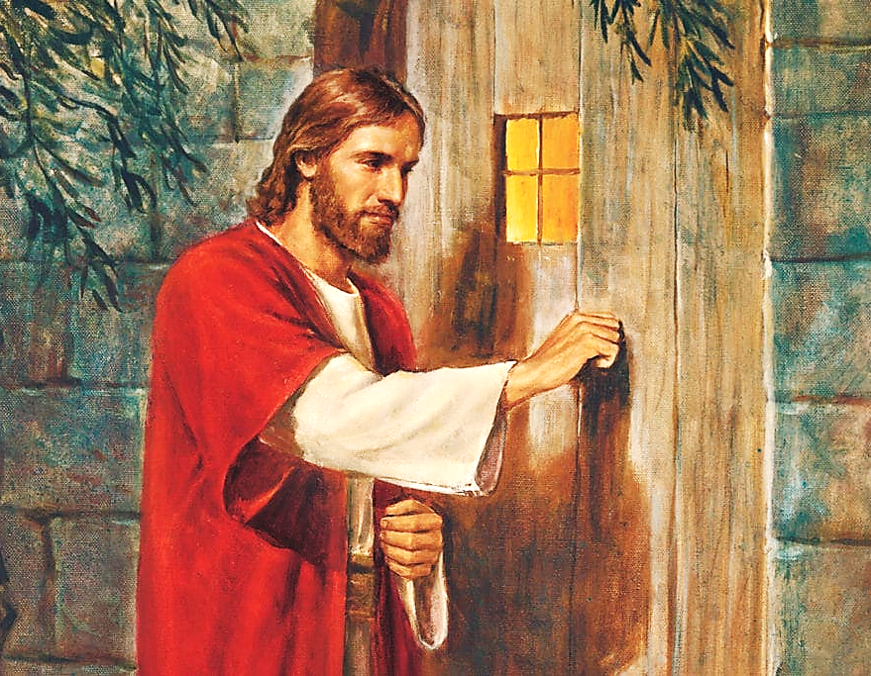

Slide 45
What is the Sinner‘s Prayer?
This is a prayer we can pray when we are ready to admit we are sinners and need Christ’s forgiveness.
It must be prayed with faith in our hearts and a readiness to have a life-changing encounter with Jesus Christ.

Slide 46
“Draw near to God, and He will draw
near to you…”
…Cleanse your hands, you sinners, and make your hearts pure, you who are half-hearted towards God.”
James 4:8 WNT

Slide 47
A prayer of faith → Pray this prayer if :
If you never have before
You have in the past, but you think it would mean more today.
You have been walking afar off and you want to come back.
You want to set an example & show others how it is done.
You just like to give your heart to Jesus again & again.
Saving Faith is a Leap of Trust in Jesus.

Slide 48
Dear Jesus,
I know I am a sinner and I need your forgiveness.
I believe you died for my sins.
I now turn from sin.
Come into my heart I pray.
Please wash away my sin.
Do you want to meet Jesus as your savior right now?
Do you believe He died to save you from your sins & that He rose from the dead?
Do you believe that He is waiting to save you right now?

Slide 49
“But some people did accept him. They believed in him, and he gave them the right to become children of God.” John 1:12

Slide 51
We Declare Our Faith Publicly Because Jesus Declared His LOVE Publicly
“If you stand before others and are willing to say you believe in me, then I will tell my Father in heaven that you belong to me.” Mat 10:32

Slide 52
“If you openly say, ‘Jesus is Lord’ and believe in your heart that God rfrom death, you aised him will be saved.”
Rom. 10:9
What did you learn today?
What have you been thinking about God lately?
What do you want to tell others about Jesus?

Slide 53
Close in Prayer

