Slide 1
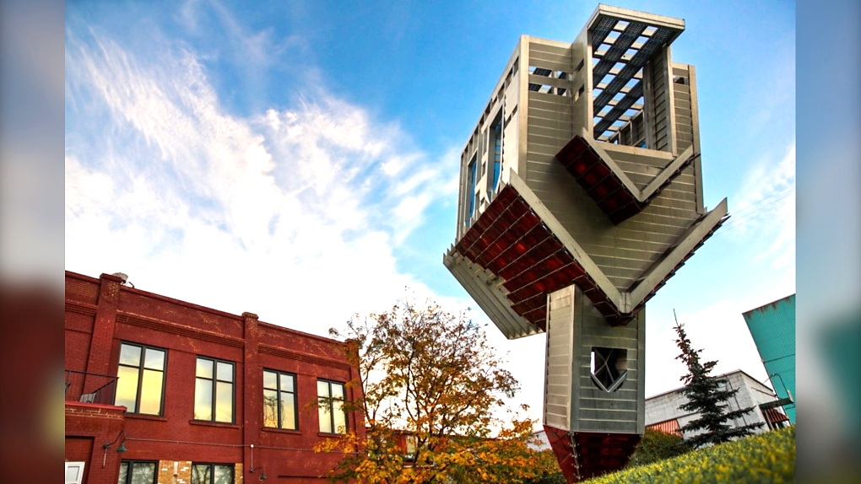
Jesus Lives in
an Upside-down House
A Different Kind
Of Kingdom

Slide 2
If you would like to watch the video of this live service, click here:
https://campaignkerusso.org/?p=21585
We would love to know more about the people who download our lessons & sermons. We invite you to email us & let us know where & how you use them.
info@ckusa.org

Slide 3
Suggested Next Slide - Song:
“1 Peter 5:5b -
Humble Yourselves”
A Memory Verse Song
Click or Ctrl Click Here:
https://youtu.be/ZtWvaD1m-wA

Slide 4
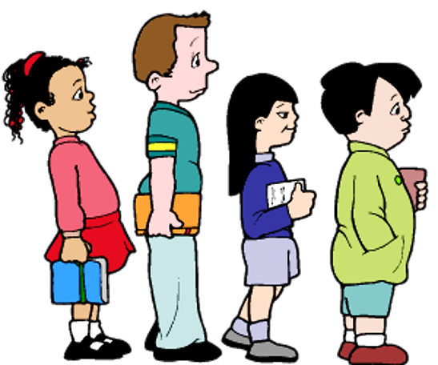
Imagine a teacher tells her students to line up for candy & whoever is first in line will get 2 pieces.
What do you think would happen?

Slide 5
Then she gives the first boy 2 the pieces.
She gives the second & third child 3 pieces each.
Then, she gives the last girl 5 pieces… WHAT!?!

Slide 6
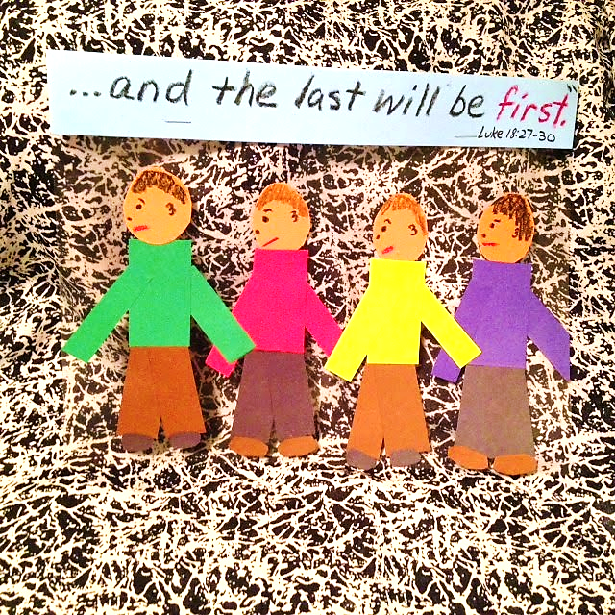
Then the kids remembered what Jesus had said:
“Many who are first now will be last in the future. And many who are last now will be first in the future.”
Mat. 19:30 (ICB)

Slide 7
What do you think the children learned about Jesus and being humble?

Slide 8
A modern trend of hanging Christmas trees upside-down has its roots in the middle ages.
To teach German pagans about the trinity, a missionary used the triangle shape of an upside-down evergreen.

Slide 9
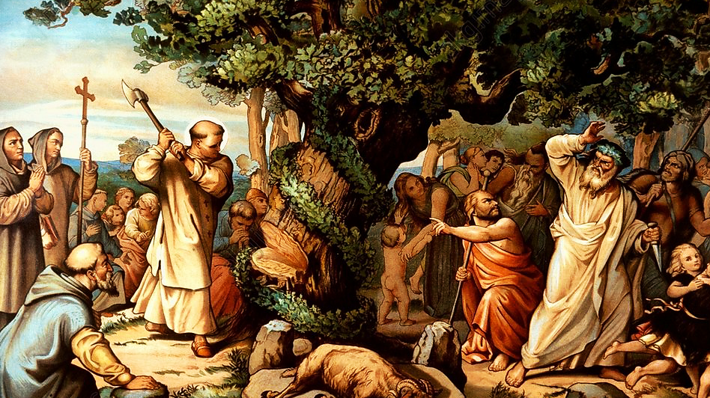
According to legend, a missionary named Boniface came upon pagans worshiping the false god “Thor” by sacrificing their children to him beneath Thor’s so-called “holy” oak.
He stopped the ritual, the story is told, by taking a hatchet to the trunk of the tree and inviting “Thor” (if he was truly real) to strike him dead.
Nothing happened—people were shocked!

Slide 10
They say this happened on Christmas Eve.
He then took a small evergreen tree, held it upside down to show the triangle shape.

Slide 11
He used the three corners of the tree as an object lesson to explain to them the Trinity…
The Father
The Son—Jesus &
The Holy Spirit.
Many believed and, as a reminder, began to bring evergreen trees into their homes every Christmas.

Slide 12
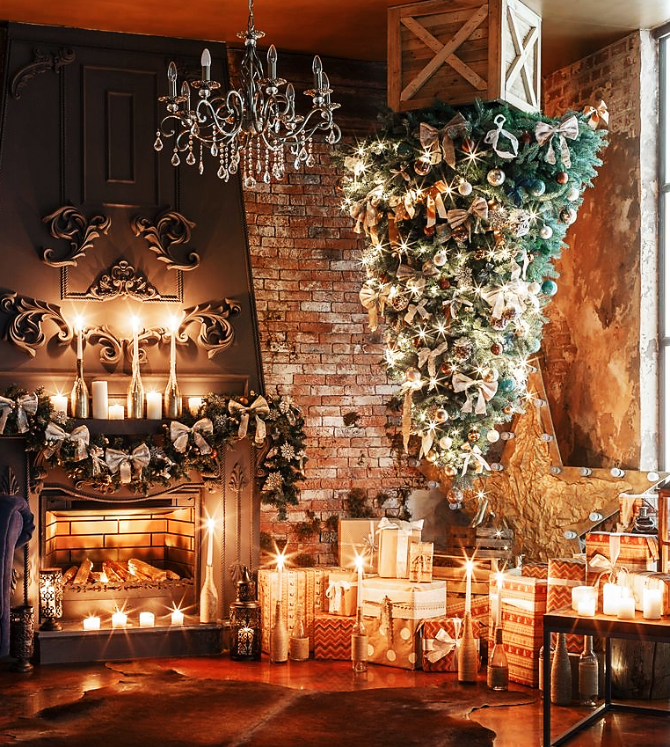
To this day, it is customary in parts of Germany to hang the Christmas tree upside down.
It has also become popular in many other countries.
Today, we will compare the upside-down tree with the Kingdom of God.

Slide 13
Actually, it’s quite appropriate for something that represents Jesus Christ and His entrance into this world to be displayed upside-down.
In every way, His kingdom and the World’s are exact opposites.

Slide 14
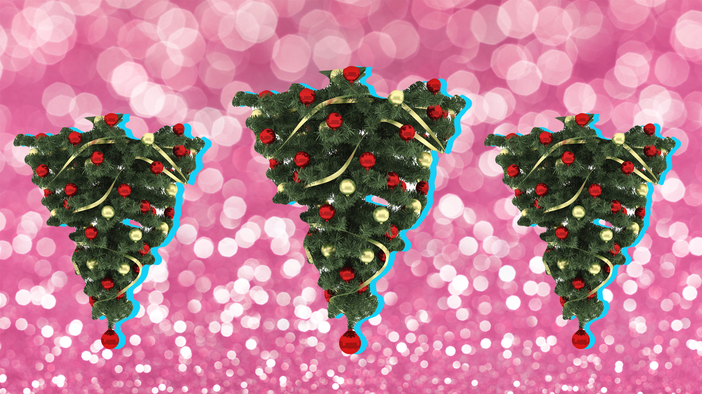
What is up? What is down?

Slide 15
What is first? What is Last?

Slide 16
Which has the greatest reward?

Slide 17
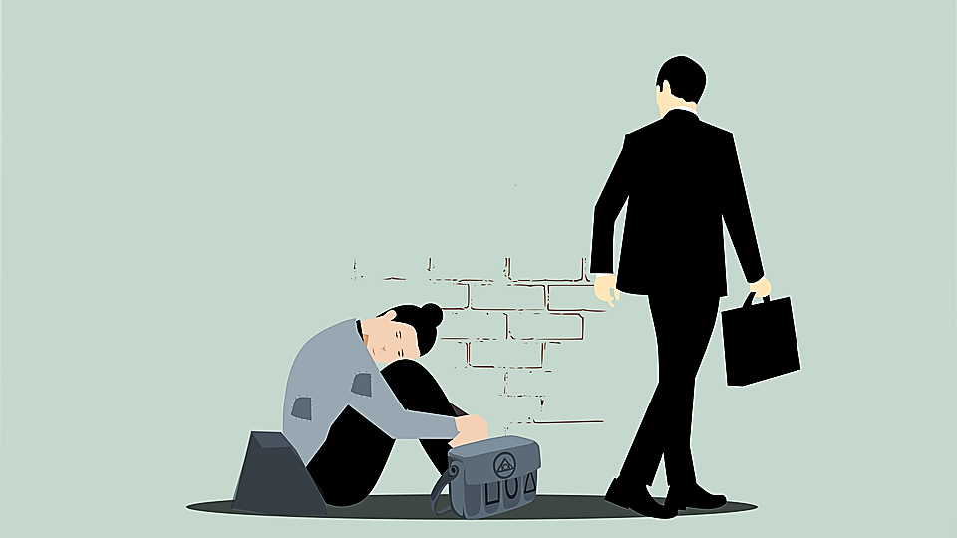
Which is good and which is bad?
You can’t always tell by appearances.

Slide 18
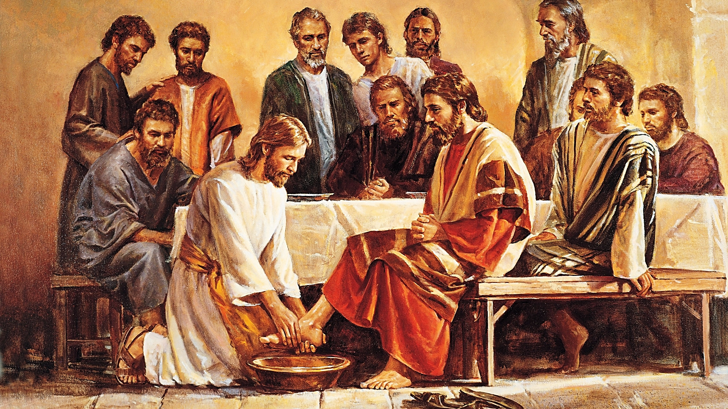
Which man is greatest in God’s kingdom?

Slide 19
1 Corinthians 1:26-27 (CEV)
“My dear friends, remember what you were when God chose you. The people of this world didn't think that many of you were wise. Only a few of you were in places of power, and not many of you came from important families. But God chose the foolish things of this world to put the wise to shame. He chose the weak things of this world to put the powerful to shame.”

Slide 20
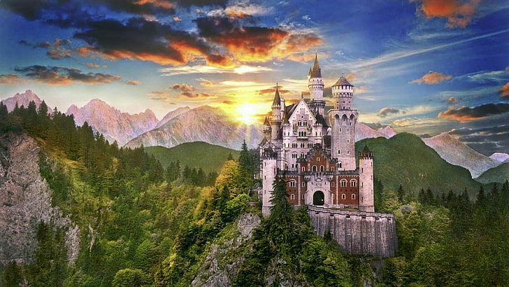
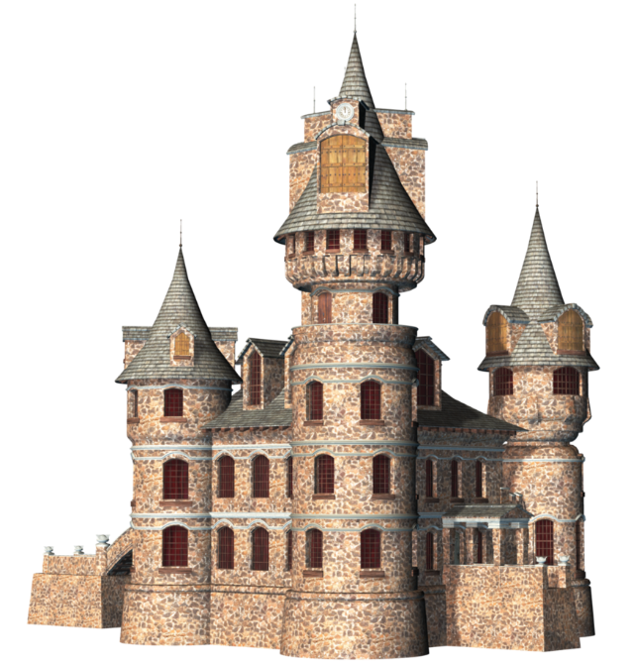
We are looking at two
completely different kingdoms.
Everything that is first in one is last in the other.
Everything that is right in one is wrong in the other.

Slide 21
These two kingdoms have two completely different sets of laws.
Down is Up
Up is Up

Slide 22
For Example, the world says:
“Look deep within yourself to find your inner strength.”
But the Word says:
“Let us look only to Jesus. He is the one who began our faith, and he makes our faith perfect…” Heb. 12:1 (ICB)
Even the phrase “self-improvement” is erroneous worldly kingdom thinking.

Slide 23
More Worldly Thinking:
“To thine oneself be true.”
(No, to Christ be true.)
“Be all that you can be.”
(No, be less of you and more of Christ.)
“Visualize what you want, and it will happen.”
(No, obey what God wants of you.) Etc., Etc., Etc.

Slide 24
It was said of Jesus’ disciples:
“These men, who have turned the world upside down, have come here also.” Acts 17:6
They didn’t literally turn the world upside-down; they turned the world’s thinking, culture and values on its head.
“What is truth?”

Slide 25
Suggested Next Slide - Video:
“The Upside-Down House”
Click or Ctrl Click Here:
https://youtu.be/OMjlQ-MLHbo

Slide 26
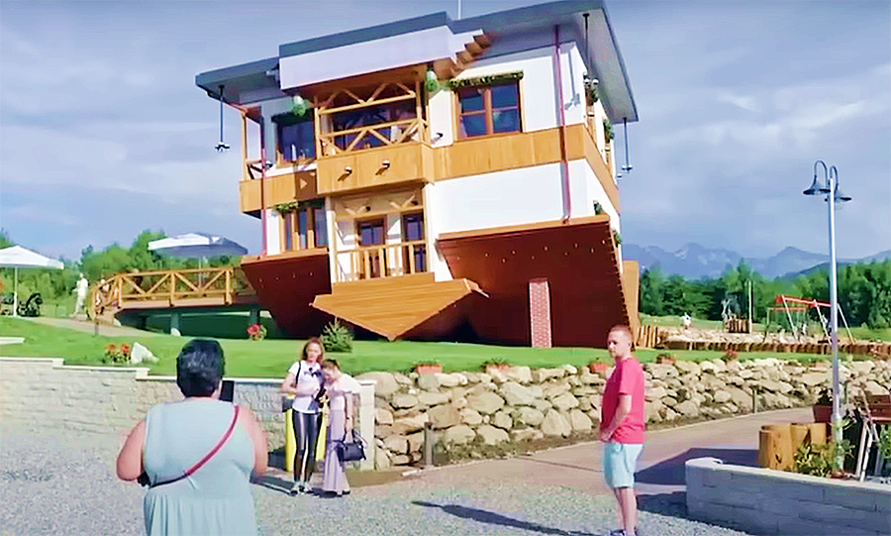
In contrast to this world’s ways, our Savior Jesus, might be said to live in an upside-down house!
Like inside this tourist attraction, He does everything just the opposite of the way the world does things.

Slide 27
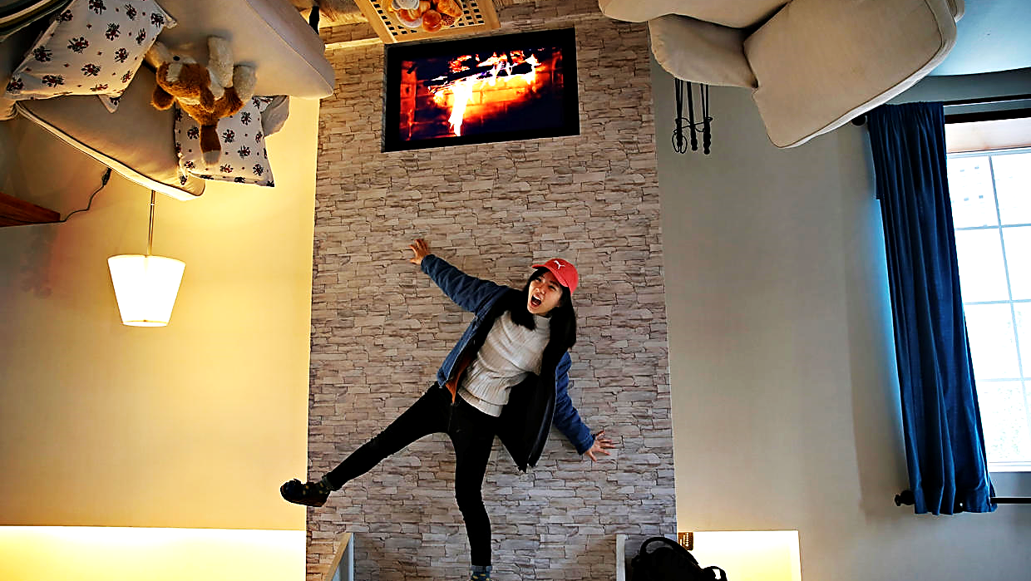
It’s enough to make the new believer a bit dizzy while trying to navigate the higher laws of God’s Heavenly Kingdom.
Okay Lord, “Thy Kingdom Come, Thy will be done.”
Compared to worldly values, Jesus’ Kingdom is quite like the Upside-Down House.
Up is down,
first is last & master is servant.

Slide 28
1 Corinthians 2:10-14 (CEV)
“God's Spirit has shown you everything. His Spirit finds out everything, even what is deep in the mind of God. You are the only one who knows what is in your own mind, and God's Spirit is the only one who knows what is in God's mind. But God has given us his Spirit. This is why we don't think the same way that the people of this world think…”.

Slide 29
.

Slide 30
John 18:36 (ESV)
“Jesus answered, ‘My kingdom is not of this world. If my kingdom were of this world, my servants would have been fighting, that I might not be delivered over to the Jews. But my kingdom is not from the world.’”

Slide 31
When the Greeks conquered Judea, they replaced all the Hebrew books
with Greek language books.
Even now, when the Russians occupied parts of Ukraine, they replaced their books.
Satan (and the world he controls) have replaced Heavenly Kingdom thinking with worldly kingdom thinking.
Our minds are filled with it.

Slide 32
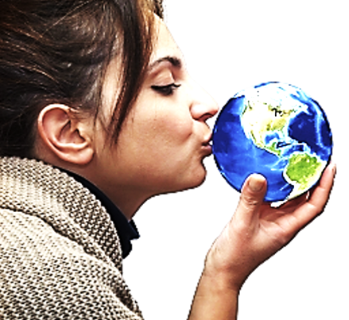
“Don’t you realize that friendship with the world makes you
an enemy of God?
I say it again: If
you want to be a
friend of the
world, you make
yourself an enemy
of God.”
James 4:4 (NLT)

Slide 33
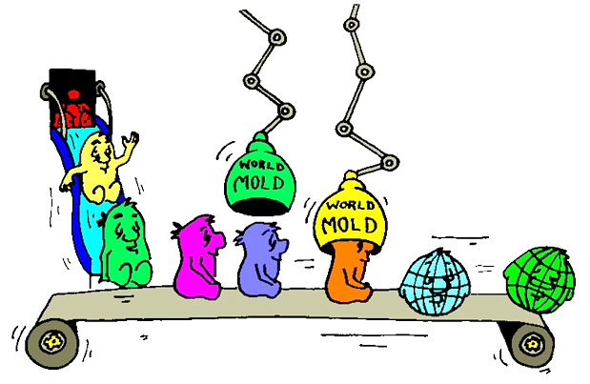
“Do not be conformed to this world, but be transformed…”
Rom.12:2

Slide 34
Romans. 12:2 (AMP)
“And do not be conformed to this world [any longer with its superficial values and customs], but be transformed and progressively changed [as you mature spiritually] by the renewing of your mind [focusing on godly values and ethical attitudes], so that you may prove [for yourselves] what the will of God is, that which is good and acceptable and perfect [in His plan and purpose for you].”

Slide 35
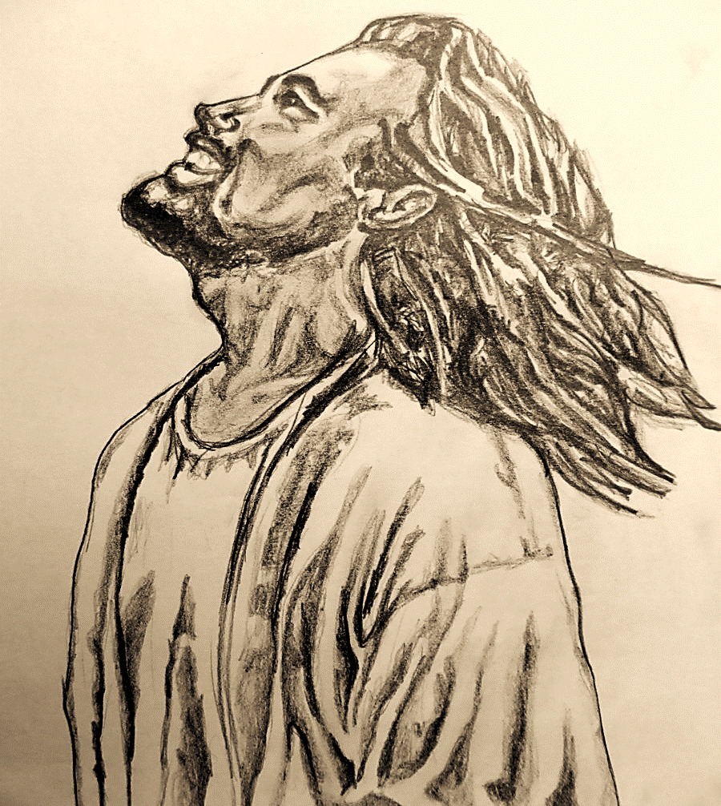
The first thing Jesus taught us to ask of the Father in Heaven (even before our own needs and requests) is..
“Our Father… May your Kingdom come soon. May your will be done on earth, as it is in heaven.” Matt. 6:10 (NLT)
The first thing Jesus wants us to pray for is that God’s Kingdom (His values & His Truth) will replace the world’s evil teachings and ways.

Slide 36
Colossians 3:1-2 (MSG)
“So if you’re serious about living this new resurrection life with Christ, act like it. Pursue the things over which Christ presides. Don’t shuffle along, eyes to the ground, absorbed with the things right in front of you. Look up and be alert to what is going on around Christ—that’s where the action is. See things from his perspective.”

Slide 37
How To Live in an Upside-down Kingdom

Slide 38
The next slide is a link to an excellent 6 min. animation of Jesus explaining His Kingdom as he washes the disciples' feet.

Slide 39
Suggested Next Slide: Video
“Servants Are Better than Masters” Download Here:
https://youtu.be/fmtAMUuFfkk

Slide 40
Last is Better than First

Slide 41
Mark 2:17 (NIV)
“It is not the healthy who need a doctor, but the sick. I have not come to call the righteous, but sinners.”

Slide 42
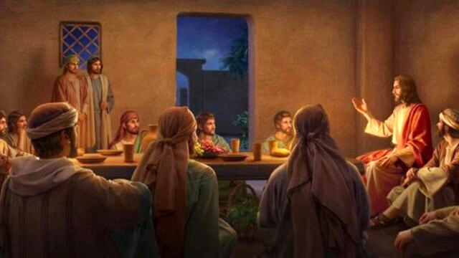
The Lowest Seat is Better than the Highest

Slide 43
Luke 14:7-11 (NLT)
“When Jesus noticed that all who had come to the dinner were trying to sit in the seats of honor near the head of the table, he gave them this advice:
When you are invited to a wedding feast, don’t sit in the seat of honor. What if someone who is more distinguished than you has also been invited? …

Slide 44
Luke 14:7-11 (NLT) cont.
…The host will come and say, ‘Give this person your seat.’ Then you will be embarrassed, and you will have to take whatever seat is left at the foot of the table! Instead, take the lowest place at the foot of the table…

Slide 45
Luke 14:7-11 (NLT) cont.
…Then when your host sees you, he will come and say, ‘Friend, we have a better place for you!’ Then you will be honored in front of all the other guests.
For those who exalt themselves will be humbled, and those who humble themselves will be exalted.”

Slide 46
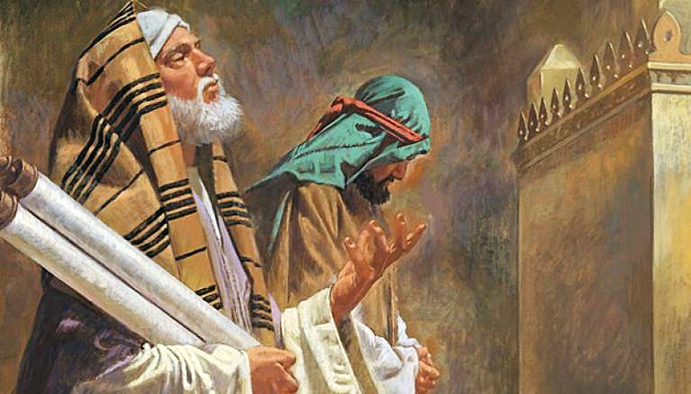
Heartfelt Repentance is Better than Self Righteousness

Slide 47
Luke 18:9-14 (NIV)
“To some who were confident of their own righteousness and looked down on everyone else, Jesus told this parable: “Two men went up to the temple to pray, one a Pharisee and the other a tax collector. The Pharisee stood by himself and prayed: ‘God, I thank you that I am not like other people—robbers, evildoers, adulterers—or even like this tax collector…

Slide 48
Luke 18:9-14 (NIV) cont.
…I fast twice a week and give a tenth of all I get.’ “But the tax collector stood at a distance. He would not even look up to heaven, but beat his breast and said, ‘God, have mercy on me, a sinner.’ “I tell you that this man, rather than the other, went home justified before God. For all those who exalt themselves will be humbled, and those who humble themselves will be exalted.”

Slide 49
Psalm. 138:6 (NIV)
“Though the LORD is on high, he looks upon the lowly, but the proud he knows from afar.”
Psalm 138:6 (NIV)
“Humble yourselves before the Lord, and he will lift you up.”
1 Peter 5:6 (NIV)
“Humble yourselves, therefore, under the mighty hand of God so that at the proper time he may exalt you.”

Slide 50
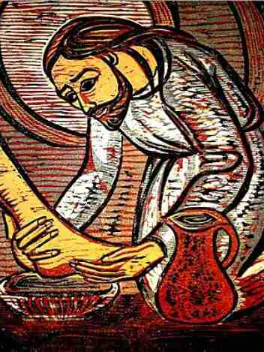
Our King is Humble
Born a human, He slept in an animal food trough
Never owned a home
Rode into Jerusalem on a borrowed donkey
Washed His disciple’s feet
Allowed Himself to be arrested

Slide 51
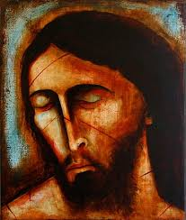
Our King is Humble
Allowed Himself to be whipped & crucified
“I offered my back to those who beat me, my cheeks to those who pulled out my beard; I did not hide my face from mocking and spitting.” Isa.50:5 (NIV)

Slide 52
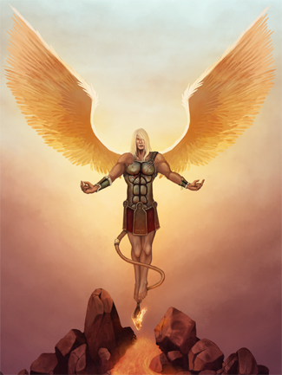
Pride is Brought Low
“O shining star, son of the morning!
You have been thrown down to the earth,
For you said to yourself,
‘I will ascend to heaven and set my throne above God’s stars…
Instead, you will be brought down to the place of the dead…” Isaiah 14:12-15 (NLT)

Slide 53
Humility is Exalted
“Although he was in the form of God and equal with God,
he did not take advantage of this equality. Instead, he emptied himself by taking on the form of a servant, by becoming like other humans,
by having a human appearance. He humbled himself by becoming obedient to the point of death, death on a cross…

Slide 54
Humility is Exalted cont.
…This is why God has given him an exceptional honor—
the name honored above all other names—so that at the name of Jesus everyone in heaven, on earth, and in the world below will kneel and confess that Jesus Christ is Lord to the glory of God the Father.” Philippians 2:6-11 (GW)
The Father exalted
His humble Son.

Slide 55
These two kingdoms have two completely different sets of laws.
God
World

Slide 56
The next slide is a link to a very beautiful, 2 min. non-vocal presentation entitled, “This was no Ordinary King.”

Slide 57
Suggested Next Slide - Video:
“This Was No Ordinary King” Download Here:
https://youtu.be/lJLxaVDdZh0

Slide 58
Suggested Next Slide - Song:
“The Servant King” Download Here:
https://youtu.be/DwIukabdw3E

Slide 59
Suggested Next Slide - Song:
“Humble Me”
Click or Ctrl Click Here:
https://youtu.be/TH1CQ5qUF4Q

Slide 60
Is Jesus
Speaking to You?
“They said to each other, ‘Did not our hearts burn within us while he talked to us on the road, while he opened to us the Scriptures?’”
John Wesley Said:
“…the preacher was describing the change which God works in the heart through faith in Christ and I felt my heart strangely warmed.”
Jesus makes His presence Known by a small voice!

Slide 61
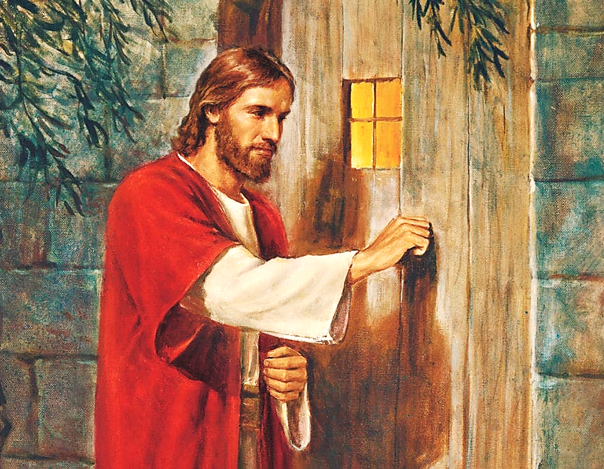

Slide 62
What is the Sinner‘s Prayer?
This is a prayer we can pray when we are ready to admit we are sinners and need Christ’s forgiveness.
It must be prayed with faith in our hearts and a readiness to have a life-changing encounter with Jesus Christ.

Slide 63
“Draw near to God, and He will draw
near to you…”
…Cleanse your hands, you sinners, and make your hearts pure, you who are half-hearted towards God.”
James 4:8 WNT

Slide 64
A prayer of faith → Pray this prayer if :
If you never have before
You have in the past, but you think it would mean more today.
You have been walking afar off and you want to come back.
You want to set an example & show others how it is done.
You just like to give your heart to Jesus again & again.
Saving Faith is a Leap of Trust in Jesus.

Slide 65
Dear Jesus,
I know I am a sinner and I need your forgiveness.
I believe you died for my sins.
I now turn from sin.
Come into my heart I pray.
Please wash away my sin.
Do you want to meet Jesus as your savior right now?
Do you believe He died to save you from your sins & that He rose from the dead?
Do you believe that He is waiting to save you right now?

Slide 66
“But some people did accept him. They believed in him, and he gave them the right to become children of God.” John 1:12

Slide 68
We Declare Our Faith Publicly Because Jesus Declared His LOVE Publicly
“If you stand before others and are willing to say you believe in me, then I will tell my Father in heaven that you belong to me.” Mat 10:32

Slide 69
“If you openly say, ‘Jesus is Lord’ and believe in your heart that God rfrom death, you aised him will be saved.”
Rom. 10:9
What did you learn today?
What have you been thinking about God lately?
What do you want to tell others about Jesus?

Slide 70
Close in Prayer

