Slide 1
Forgiveness: God’s Required Course:

Slide 2
Note: Any videos in this presentation will only play online. After you download the slideshow, you will need to also download the videos from YouTube & add them back into your PowerPoint.
We present these messages at Bee Creek Park in College Station, TX. If you would like to watch the video of the service with this message, click here:
http://campaignkerusso.org/?p=11452
We would love to know more about the people who download our lessons & sermons. We invite you to email us & let us know where & how you use them.
info@ckbrazos.org

Slide 3
Next Slide - Song:
Forgiveness →
Download Here:
http://youtu.be/xfkhqpl81NA

Slide 4
Forgiveness: God’s Required Course:

Slide 5
Next Slide - Video:
Peter Asks Jesus →
Download Here:
http://youtu.be/uErRFFpgK4w

Slide 6
Forgiveness: God’s Required Course:

Slide 7
Next Slide - Video:
The Unmerciful Servant→
Download Here:
http://youtu.be/TtabXcm1Ap0

Slide 8
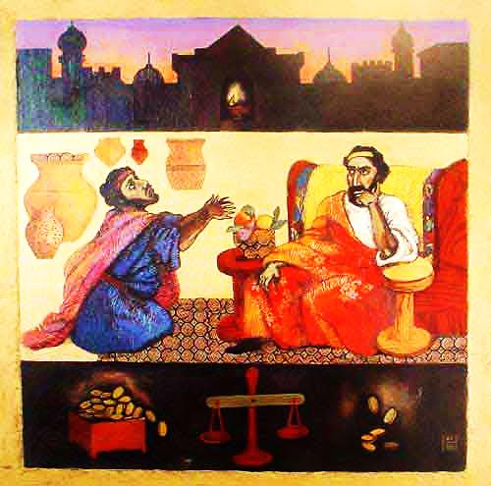
The Servant and His Forgiving Master

Slide 9
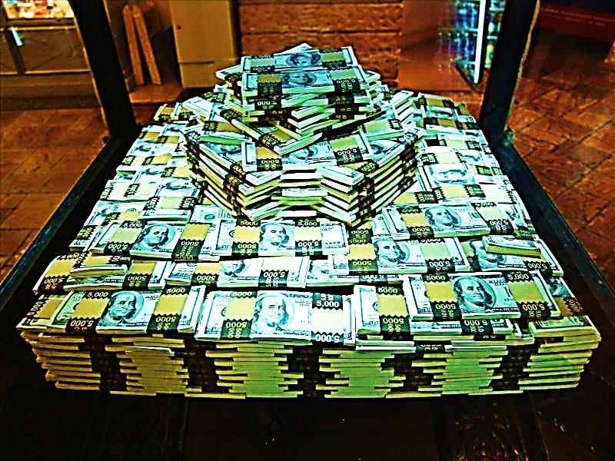
Millions of Dollars

Slide 10
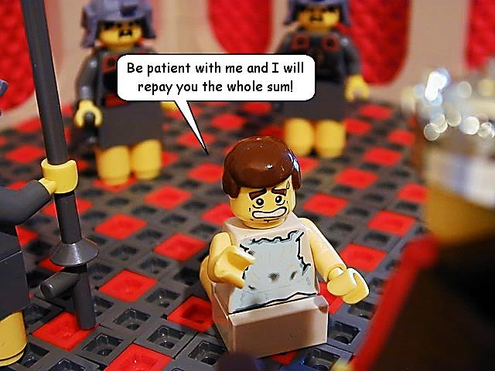

Slide 12
Please be patient and I will pay the whole sum.
Pay me now or else!

Slide 13
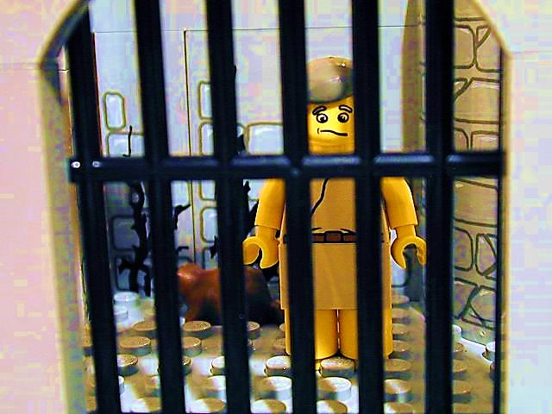
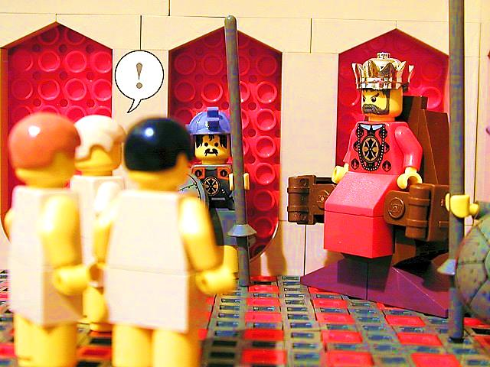
Master, Did you hear what happened?

Slide 14
“This is how your heavenly Father will treat each of you unless you forgive your brother from your heart!

Slide 15
Forgiveness: God’s Required Course:

Slide 16
Forgiveness Quiz!
a. Are you forgiving when you say, “I forgive you, but I will not forget what you did”?
a.
b.
c.
d.
e.
f.
g.

Slide 17
Forgiveness Quiz!
a. Are you forgiving when you say, “I forgive you, but I will not forget what you did”?
a. No
b.
c.
d.
e.
f.
g.

Slide 18
Forgiveness Quiz!
b. Are you forgiving when you are happy that something unfortunate has happened to someone who was unkind to you?
a. No
b.
c.
d.
e.
f.
g.

Slide 19
Forgiveness Quiz!
b. Are you forgiving when you are happy that something unfortunate has happened to someone who was unkind to you?
a. No
b. No
c.
d.
e.
f.
g.

Slide 20
Forgiveness Quiz!
c. Are you forgiving when your brother or sister hits you and you don’t get mad?
a. No
b. No
c.
d.
e.
f.
g.

Slide 21
Forgiveness Quiz!
c. Are you forgiving when your brother or sister hits you and you don’t get mad?
a. No
b. No
c. Yes
d.
e.
f.
g.

Slide 22
Forgiveness Quiz!
d. Are you forgiving when you want to get even with someone who has been unkind to you?
a. No
b. No
c. Yes
d.
e.
f.
g.

Slide 23
Forgiveness Quiz!
d. Are you forgiving when you want to get even with someone who has been unkind to you?
a. No
b. No
c. Yes
d. No
e.
f.
g.

Slide 24
Forgiveness Quiz!
e. Are you forgiving when you stop talking to someone who has been unkind to you?
a. No
b. No
c. Yes
d. No
e.
f.
g.

Slide 25
Forgiveness Quiz!
e. Are you forgiving when you stop talking to someone who has been unkind to you?
a. No
b. No
c. Yes
d. No
e. No
f.
g.

Slide 26
Forgiveness Quiz!
f. Are you forgiving when you stand up for someone who has been unkind to you?
a. No
b. No
c. Yes
d. No
e. No
f.
g.

Slide 27
Forgiveness Quiz!
f. Are you forgiving when you stand up for someone who has been unkind to you?
a. No
b. No
c. Yes
d. No
e. No
f. Yes
g.

Slide 28
Forgiveness Quiz!
g. Are you forgiving when you speak unkindly about the person you think has been unkind to you?
a. No
b. No
c. Yes
d. No
e. No
f. Yes
g.

Slide 29
Forgiveness Quiz!
g. Are you forgiving when you speak unkindly about the person you think has been unkind to you?
a. No
b. No
c. Yes
d. No
e. No
f. Yes
g. No

Slide 30
Next Slide - Song:
70 X 7 →
Download Here:
http://youtu.be/vUGXtfsEzeU

Slide 31
Is Jesus Speaking to You?
“They said to each other, ‘Did not our hearts burn within us while he talked to us on the road, while he opened to us the Scriptures?’”
John Wesley Said:
“…the preacher was describing the change which God works in the heart through faith in Christ and I felt my heart strangely warmed.”
Jesus makes His presence Known by a small voice!

Slide 33
What is the Sinner‘s Prayer?
This is a prayer we can pray when we are ready to admit we are sinners and need Christ’s forgiveness.
It must be prayed with faith in our hearts and a readiness to have a life-changing encounter with Jesus Christ.

Slide 34
A prayer of faith → Pray this prayer if :
If you never have before
You have in the past, but you think it would mean more today
You have been walking afar off and you want to come back
You want to set an example & show others how it is done
You just like to give your heart to Jesus again & again
Faith

Slide 35
We Declare Our Faith Publicly Because Jesus Declared His LOVE Publicly
“If you stand before others and are willing to say you believe in me, then I will tell my Father in heaven that you belong to me.” Mat 10:32

Slide 36
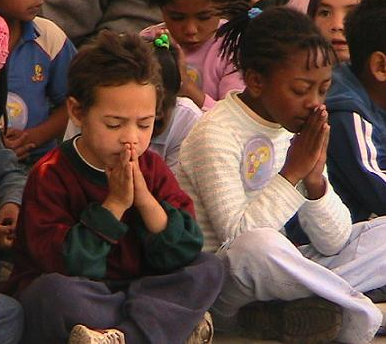
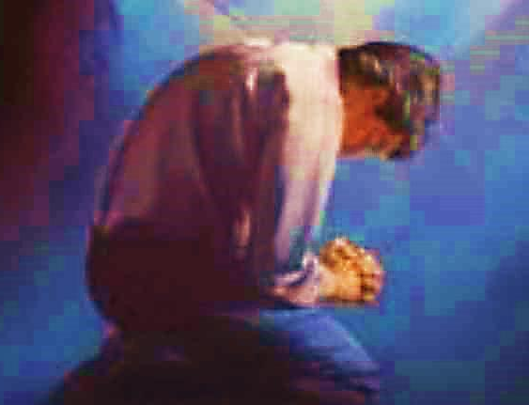
Important Questions
Do you want to know Jesus as your Savior right now?
Do you believe He died to save you from your sins & that He rose from the dead?
Do you believe that He is here, waiting to save you right now?

Slide 37
The Prayer of a Sinner Turning to Jesus
Dear Jesus, I know that I have sinned against You and that my sins separate me from You.
I am truly sorry.
Right now, I turn away from my sinful past .
Please forgive me, and help me to keep from sin.
I believe You died for my sins.
I Believe You rose from the dead, you are alive, and you hear this prayer from my heart.
I invite You Jesus to be both my Savior and the Lord of my life.
I want You to rule my life from now on.

Slide 38
“But some people did accept him. They believed in him, and he gave them the right to become children of God.”
John 1:12

Slide 40
“If you openly say, ‘Jesus is Lord’ and believe in your heart that God raised him from death, you will be saved.”
Rom. 10:9
What did you learn today?
What is the meaning of the name-tag?
What have you been thinking about God lately?
What do you want to tell the world about Jesus?

Slide 41
“Draw near to God, and He will draw near to you…
Altar Time
…Cleanse your hands, you sinners, and make your hearts pure, you who are half-hearted towards God.” James 4:8 WNT

Slide 42
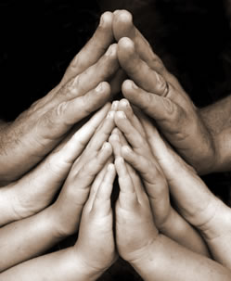
Close in Prayer

Slide 43
Note: Any videos in this presentation will only play online. After you download the slideshow, you will need to also download the videos from YouTube & add them back into your PowerPoint.
We present these messages at Bee Creek Park in College Station, TX. If you would like to watch the video of the service with this message, click here:
http://campaignkerusso.org/?p=11452
We would love to know more about the people who download our lessons & sermons. We invite you to email us & let us know where & how you use them.
info@ckbrazos.org

Slide 44
Welcome to Aggieland Faith Family Style Worship

Slide 45
CURRENT SCHEDULE: See www.Aggielandfaith.org
Three Sunday Services
First Sunday Service:
Basics – 15-20 min.
Includes – Snacks, Crafts, Prizes & Bible
We are going through the New Testament
Second Sunday Service:
Middle Level – 20-30 min.
Includes – Snacks, Prizes & Bible
We are going through the Old Testament
Third Sunday Service:
Advanced – 30-40 min.
Includes – Snacks, Prizes & Bible
We are studying the Tabernacle

Slide 46
Would You Like Prayer or Bible Study at Your House?
Personal Prayer: We can come to your home & pray with you, or you can email us when you need prayer.
Home Bible Study: We will come to your home & hold a bible study for you & your friends.
Bible Party: We will hold a Kid’s Bible Party: You provide the food & kids - we will do the bible fun & stories.

Slide 47
Would You Like Visitation?
We will visit a friend, loved one in the hospital or in prison to pray for them & share Christ with them.
Contact: info@aggielandfaith.org

Slide 48
www.aggielandfaith.org
Go here to see pictures & videos
Go here to subscribe to e-mails about changes & cancellations

Slide 49
Note: Any videos in this presentation will only play online. After you download the slideshow, you will need to also download the videos from YouTube & add them back into your PowerPoint.
We present these messages at Bee Creek Park in College Station, TX. If you would like to watch the video of the service with this message, click here:
http://campaignkerusso.org/?p=11452
We would love to know more about the people who download our lessons & sermons. We invite you to email us & let us know where & how you use them.
info@ckbrazos.org

