Slide 1
Guard Your Heart: The Cain & Abel Story

Slide 2
If you would like to watch the video of this live service, click here:
http://campaignkerusso.org/?p=6826
We would love to know more about the people who download our lessons & sermons. We invite you to email us & let us know where & how you use them.
info@ckusa.org

Slide 3
Where did God get the animal skins to cover Adam & Eve’s nakedness?
An animal must have been sacrificed.

Slide 4
There has always been only one way to have our sins covered & get right with God… …have FAITH in the Blood of the Lamb of God to cover your sin.

Slide 5
People wondered who this Lamb would be and how He would take away the sin of the world.
John the Baptist pointed right at Jesus and said “Behold the Lamb of God.”

Slide 7
Until Jesus was born and died on the cross, the animal sacrifices served as a visual promise of our coming savior. God wanted people to sacrifice the lamb and think about the Lamb of God (Jesus) who would come someday.

Slide 8
What Can Wash Away Our Sin?
Nothing but the BLOOD of Jesus!

Slide 9
God Accepted Abel’s Offering

Slide 10
Which brother brought the right kind of offering to the Lord?

Slide 11
Abel Believed in the Promised Savior
“By an act of FAITH, Abel brought a better sacrifice to God than Cain. It was what he believed, not what he brought, that made the difference…Heb. 11:4

Slide 12
What was wrong with Cain’s Offering?

Slide 13
Our Own Good Works Cannot Save Us
← I Do My Homework
← I Clean My Room
← I Know all the Answers
I Go to Church →
I Give to
the Poor →

Slide 14
"The Pharisee stood up and prayed about himself. 'God, I thank you that I am not like other people,' he said. 'I am not like robbers or those who do other evil things... I am not even like this tax collector.”

Slide 15
"But the tax collector…
…would not even look up to heaven. He beat his chest and said, 'God, have mercy on me. I am a sinner.' "I tell you, the tax
collector went home accepted by God. But not the Pharisee. Everyone who lifts himself up will be brought down. And anyone who is brought down will be lifted up."

Slide 16
God is Not Impressed with Our Good Works!
“Salvation is not a reward for the good things we have done, so none of us can boast about it.”Eph. 2:9
“All of us have become like something unclean, and all our righteous acts are like a polluted garment” Isaiah 64:6

Slide 17
God spoke to Cain & gave him a chance to change his choice of offering. He could switch to a lamb… But, Cain didn’t want to!

Slide 18
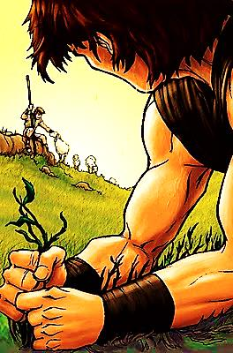
God gave Cain a Chance to Repent: Change His Offering
But Cain chose
to be angry

Slide 19
God Give Us Times of Choice

Slide 20
We Can Choose God or Sin

Slide 21
People Think a Little Sin is Harmless

Slide 22
Sin is Stronger than We Think
“Do what is right. Then you will be accepted. If you don't do what is right, sin is waiting at your door to grab you. It longs to have you. But you must rule over it." Genesis 4:7
Deal with it Before It Changes You

Slide 23
When Bad Thoughts are Allowed In → Bad Actions Always Come Out

Slide 24
“For from your heart come the evil ideas which lead you to kill, commit adultery… to rob, lie, and slander others.” Mat.15:19

Slide 25
Cain’s Unguarded Heart:
Lets in Unbelief & Pride
Resulting Action:
An Unacceptable Offering
God Offers Chance to Repent…
Cain Will not Repent
“Above all else, guard your heart, for everything you do flows from it.” Prov. 4:23

Slide 26
Cain’s Unguarded Heart Again:
Jealousy & Anger
Resulting Action:
Murdered his Brother
God Offers Another Chance to Repent…
Cain Will not Repent
“Above all else, guard your heart, for everything you do flows from it.” Prov. 4:23

Slide 27
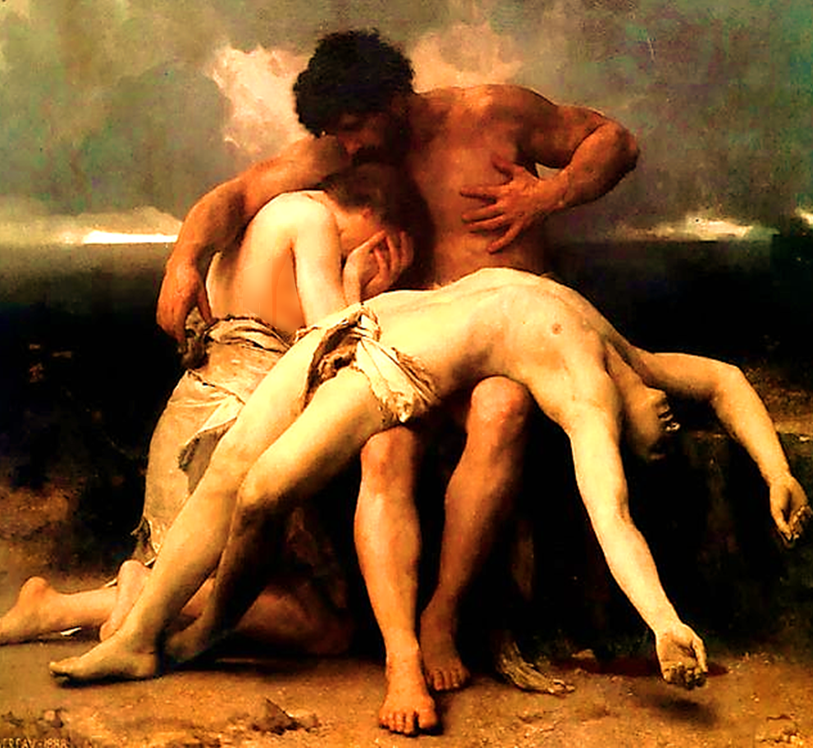
Cain Made the Wrong Choice… He Invited Sin In
Once in, it grew bigger and bigger – sin always does:
1] Pride →
2] Unbelief →
3] Jealousy →
4] Murder →

Slide 28
“We must not be like Cain, who belonged to the evil one and killed his brother. And why did he kill him? Because Cain had been doing what was evil, and his brother had been doing what was right” 1 John 3:12

Slide 29
Watch Out for Jealousy – Don’t Let it in Our Heart’s Door
“Love is patient and kind. Love is not jealous, it does not brag, and it is not proud.” 1 Cor. 13:4
“Don't be selfish; don't live to make a good impression on others. Be humble, thinking of others as better than yourself.” Phil. 2:3

Slide 30
Separation from God (the ultimate end of sin)
“It's your sins that have cut you off from God. Because of your sins, he has turned away and will not listen anymore.”
Isa. 59:2

Slide 31
Is Jesus
Speaking to You?
“They said to each other, ‘Did not our hearts burn within us while he talked to us on the road, while he opened to us the Scriptures?’”
John Wesley Said:
“…the preacher was describing the change which God works in the heart through faith in Christ and I felt my heart strangely warmed.”
Jesus makes His presence Known by a small voice!

Slide 32
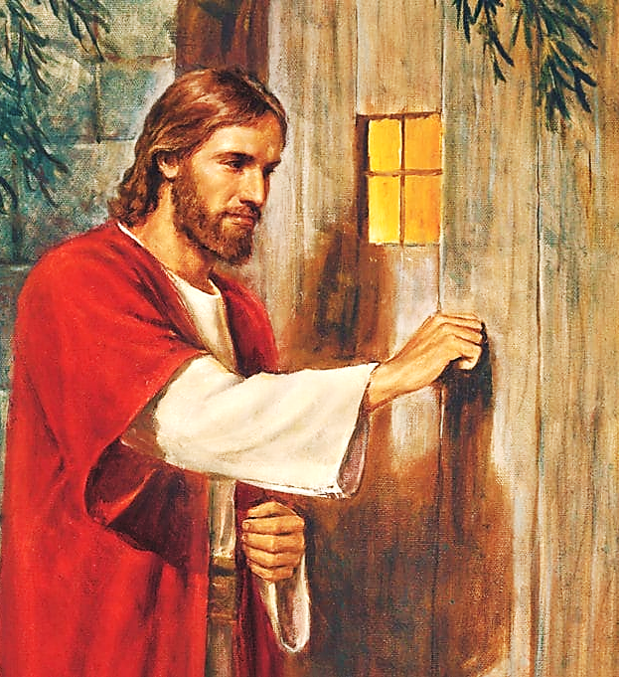

Slide 33
What is the Sinner‘s Prayer?
This is a prayer we can pray when we are ready to admit we are sinners and need Christ’s forgiveness.
It must be prayed with faith in our hearts and a readiness to have a life-changing encounter with Jesus Christ.

Slide 34
“Draw near to God, and He will draw
near to you…”
…Cleanse your hands, you sinners, and make your hearts pure, you who are half-hearted towards God.”
James 4:8 WNT

Slide 35
A prayer of faith → Pray this prayer if :
If you never have before
You have in the past, but you think it would mean more today.
You have been walking afar off and you want to come back.
You want to set an example & show others how it is done.
You just like to give your heart to Jesus again & again.
Saving Faith is a Leap of Trust in Jesus.

Slide 36
Dear Jesus,
I know I am a sinner and I need your forgiveness.
I believe you died for my sins.
I now turn from sin.
Come into my heart I pray.
Please wash away my sin.
Do you want to meet Jesus as your savior right now?
Do you believe He died to save you from your sins & that He rose from the dead?
Do you believe that He is waiting to save you right now?

Slide 37
“But some people did accept him. They believed in him, and he gave them the right to become children of God.” John 1:12

Slide 39
We Declare Our Faith Publicly Because Jesus Declared His LOVE Publicly
“If you stand before others and are willing to say you believe in me, then I will tell my Father in heaven that you belong to me.” Mat 10:32

Slide 40
“If you declare with your mouth, “Jesus is Lord,” and believe in your heart that God raised him from the dead, you will be saved.
Rom. 10:9
What did you learn today?
What have you been thinking about God lately?
What do you want to tell others about Jesus?

Slide 41
Close in Prayer

