Slide 1
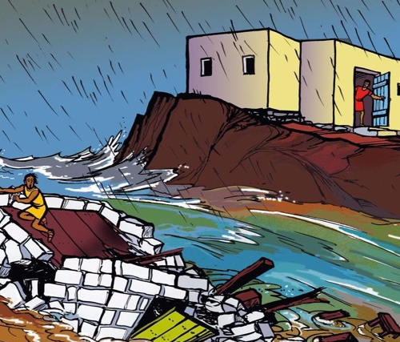
The Wise & Foolish Home Builder

Slide 2
If you would like to watch the video of this live service, click here: https://campaignkerusso.org/?p=22101
We would love to know more about the people who download our lessons & sermons. We invite you to email us & let us know where & how you use them.
info@ckusa.org

Slide 3
Suggested Next Slide - Song:
“The Wise Man Built His House Upon a Rock”
Click or Ctrl Click Here:
https://youtu.be/lTuPa_1QC9c

Slide 4
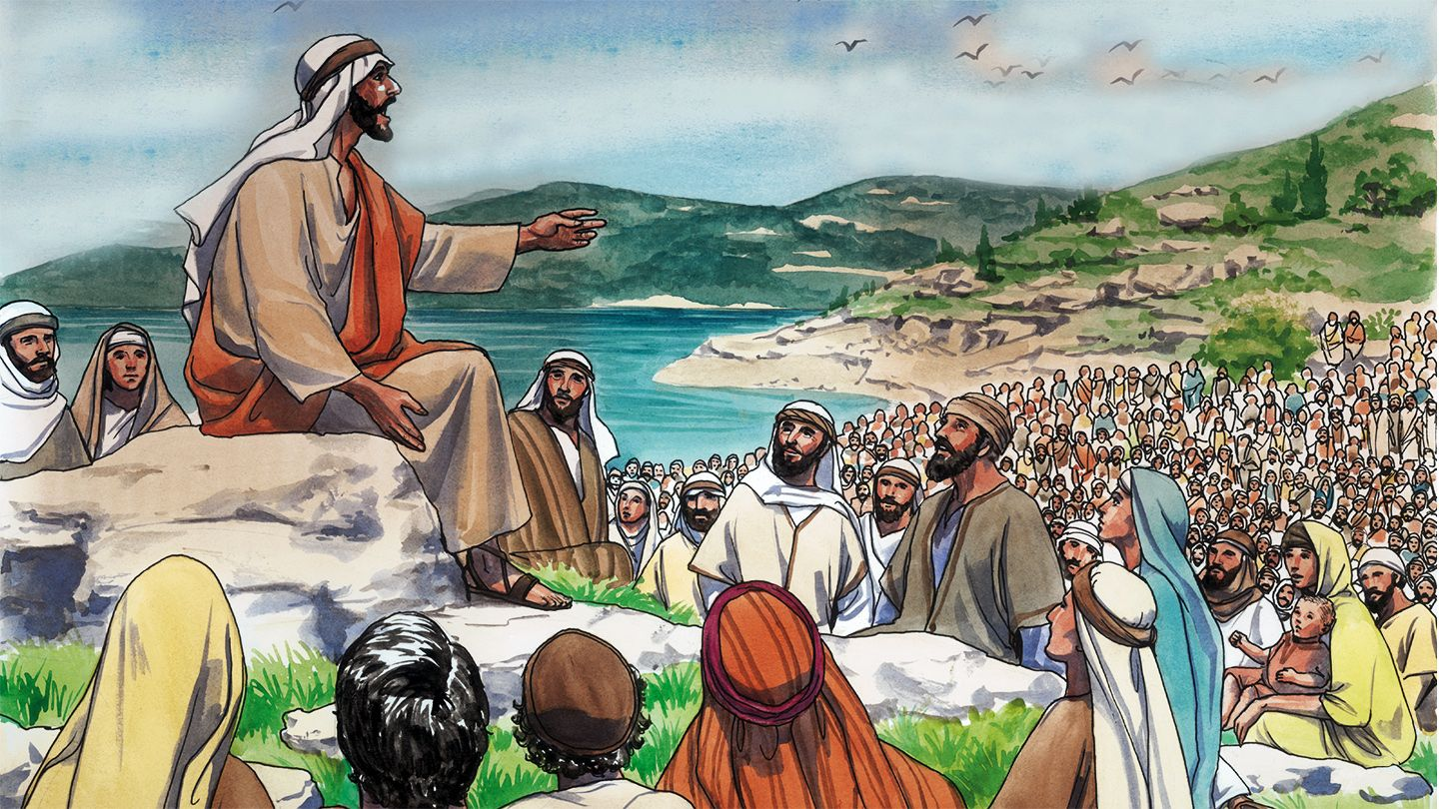
Jesus wanted us to learn how to live wisely so He told a story about two different house builders… one was wise and the other was foolish.

Slide 5
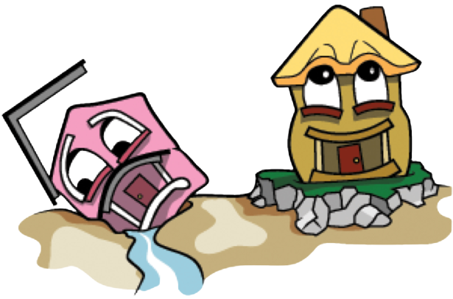
The Other Was Foolish
One Was Wise…

Slide 6
Matthew 7:24-25
“Everyone who hears these things I say and obeys them is like a wise man. The wise man built his house on rock. It rained hard and the water rose. The winds blew and hit that house. But the house did not fall, because the house was built on rock.”

Slide 7
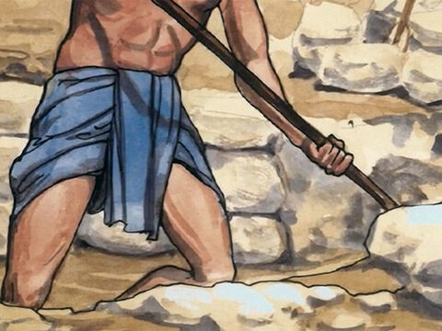
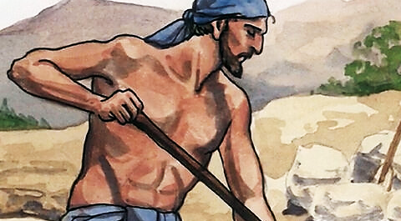
Question:
What did the wise builder do?

Slide 8
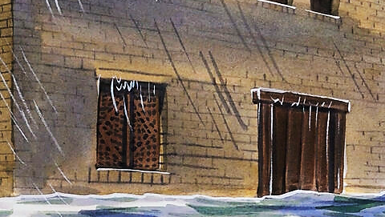
Question: When the rains came, what happened to the wise builder’s house?
It stood firm!!

Slide 9
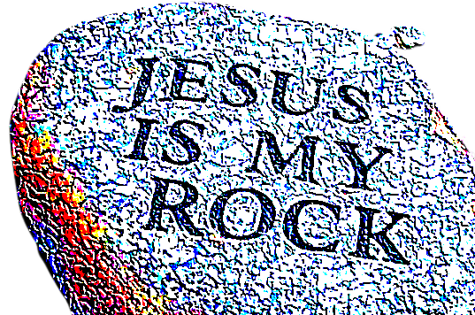
Building our lives (like building a house) must be on solid rock or we will face sure destruction.
What happened to the wise man’s house when the rains came?
Jesus is our ROCK.

Slide 10
Isaiah 26:4 NIV
“Trust in the LORD forever, for the LORD, the LORD himself, is the Rock eternal.”

Slide 11
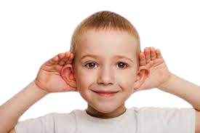
Question:
What is one way Jesus said we can build our lives on HIM—THE ROCK?

Slide 12
Matthew 7:24-25
“Everyone who HEARS these things I say…”

Slide 13
Answer:
We must hear His words.
He also said we must obey His words.

Slide 14
Matthew 7:24-25
“Everyone who hears these things I say and OBEYS them…”

Slide 15
Here are some ways
we can obey Jesus’ words after we hear them…

Slide 16
First, we must fall in love with His Words.
To really obey His teachings we must fall crazy in love with Jesus—the teacher.

Slide 17
Psalm 119:97 ICB
“How I love your teachings! I think about them all day long.”

Slide 18
We need to respect & obey parents,
teachers, etc. .

Slide 19
Colossians 3:20 NIV
“Children, obey your parents in everything, for this pleases the Lord.”

Slide 20
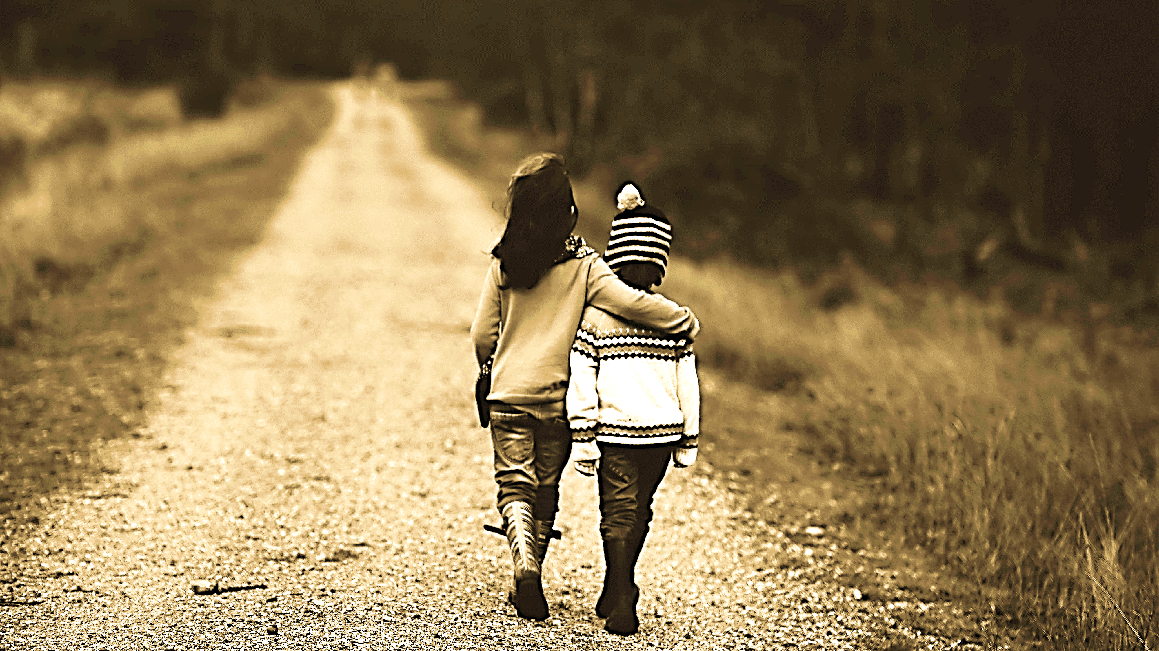
Show kindness.
Love others like Jesus loves them.

Slide 21
Colossians 3:12CEV
“God loves you and has chosen you as his own special people. So be gentle, kind, humble, meek, and patient.”

Slide 22
Be giving.

Slide 23
Hebrews 13:16 GW
“Don’t forget to do good things for others and to share what you have with them. These are the kinds of sacrifices that please God.”

Slide 24
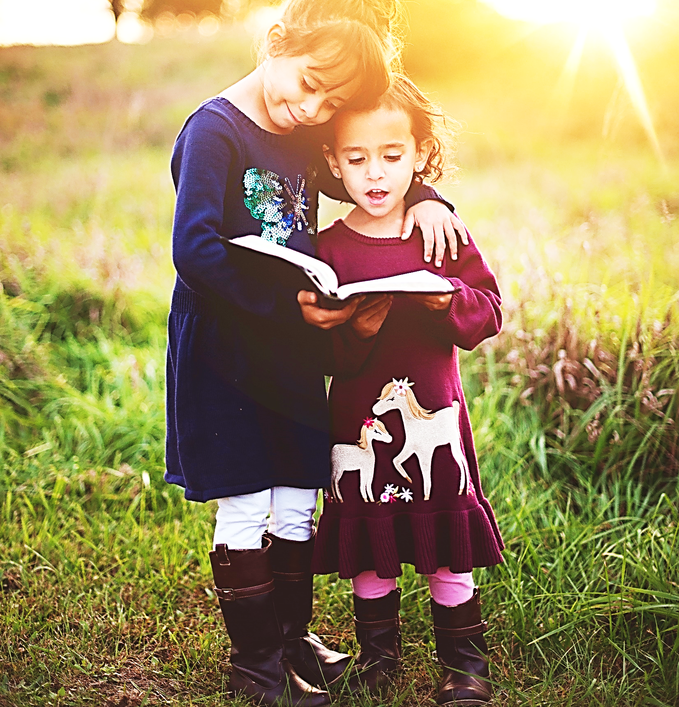
Share the Good News of Jesus with people who don’t know Him yet.

Slide 25
Mark 16:15 GW
“Then Jesus said to them, “So wherever you go in the world, tell everyone the Good News.”
Mark 5:19 ERV
…“Go home to your family and friends. Tell them about all that the Lord did for you. Tell them how the Lord was good to you.”

Slide 26
Forgive

Slide 27
Ephesians 4:32 KJV
“And be ye kind one to another, tenderhearted, forgiving one another, even as God for Christ's sake hath forgiven you.”

Slide 28
Always tell the truth…
even when you’re afraid to.

Slide 29
Proverbs 12:17 TLB
“A good man is known by his truthfulness; a false man by deceit and lies.”

Slide 30
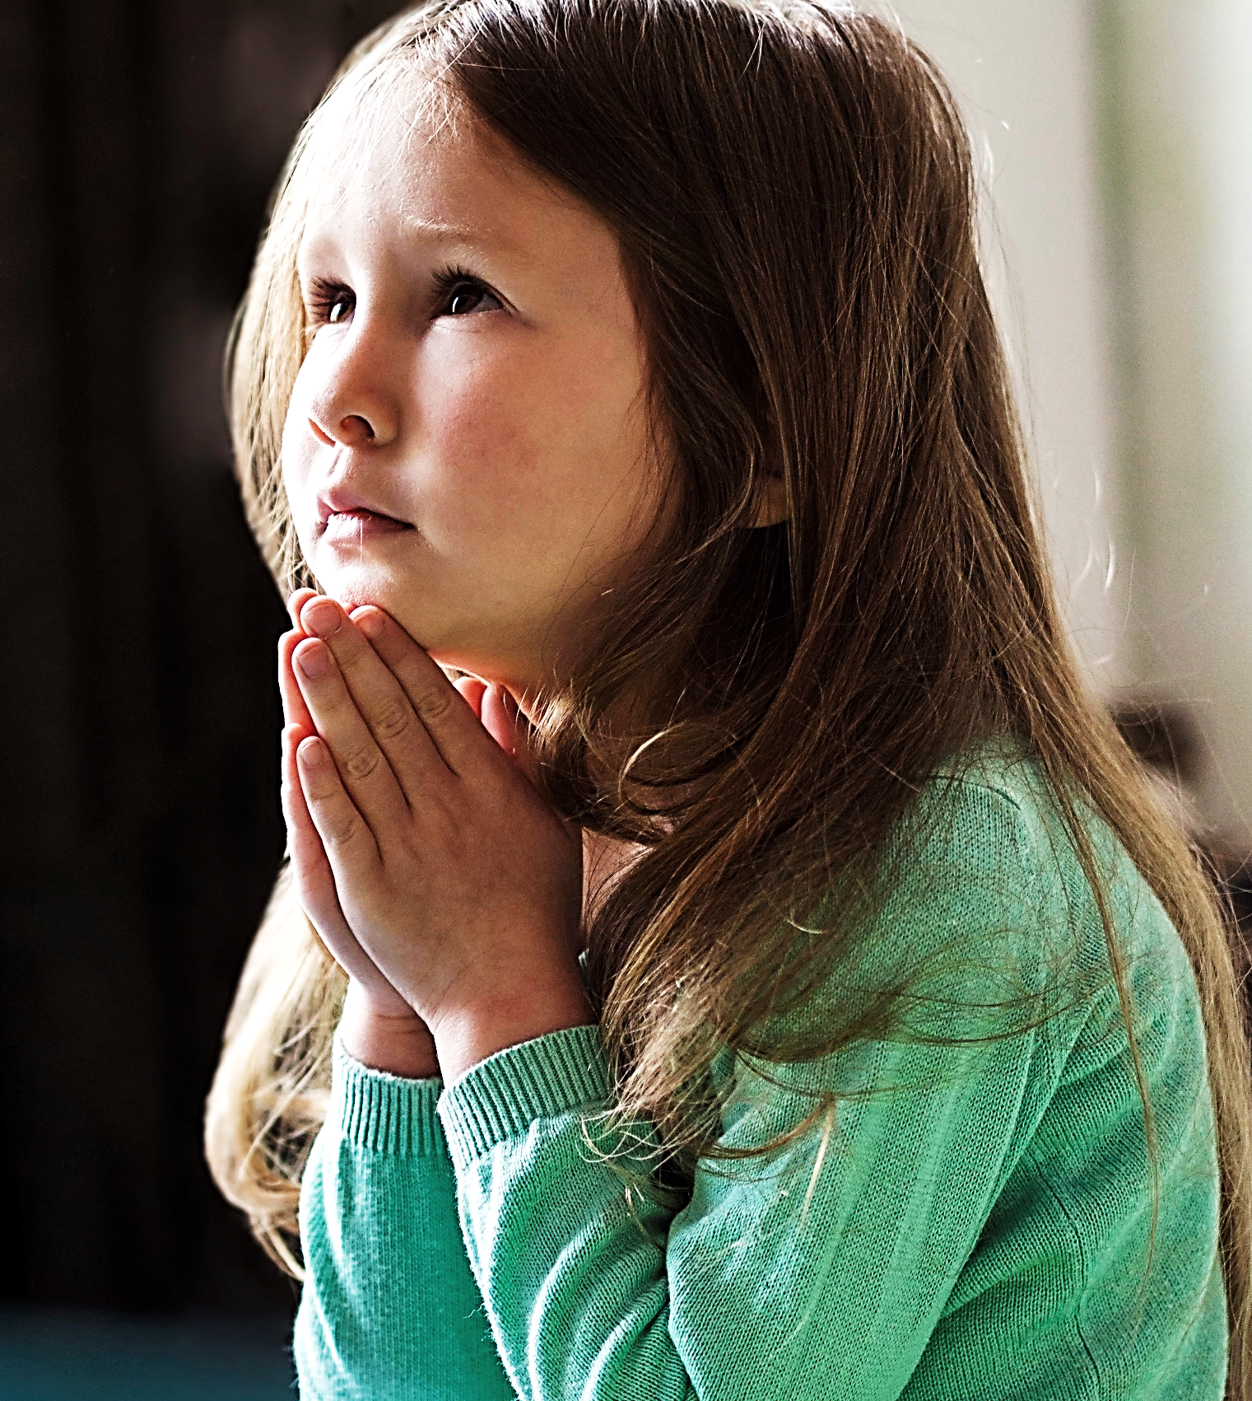
Pray, pray, pray,
every day,
all the time,
with all your heart!!!!

Slide 31
Ephesians 6:18 TLB
“Pray all the time. Ask God for anything in line with the Holy Spirit’s wishes. Plead with him, reminding him of your needs, and keep praying earnestly for all Christians everywhere.”

Slide 32
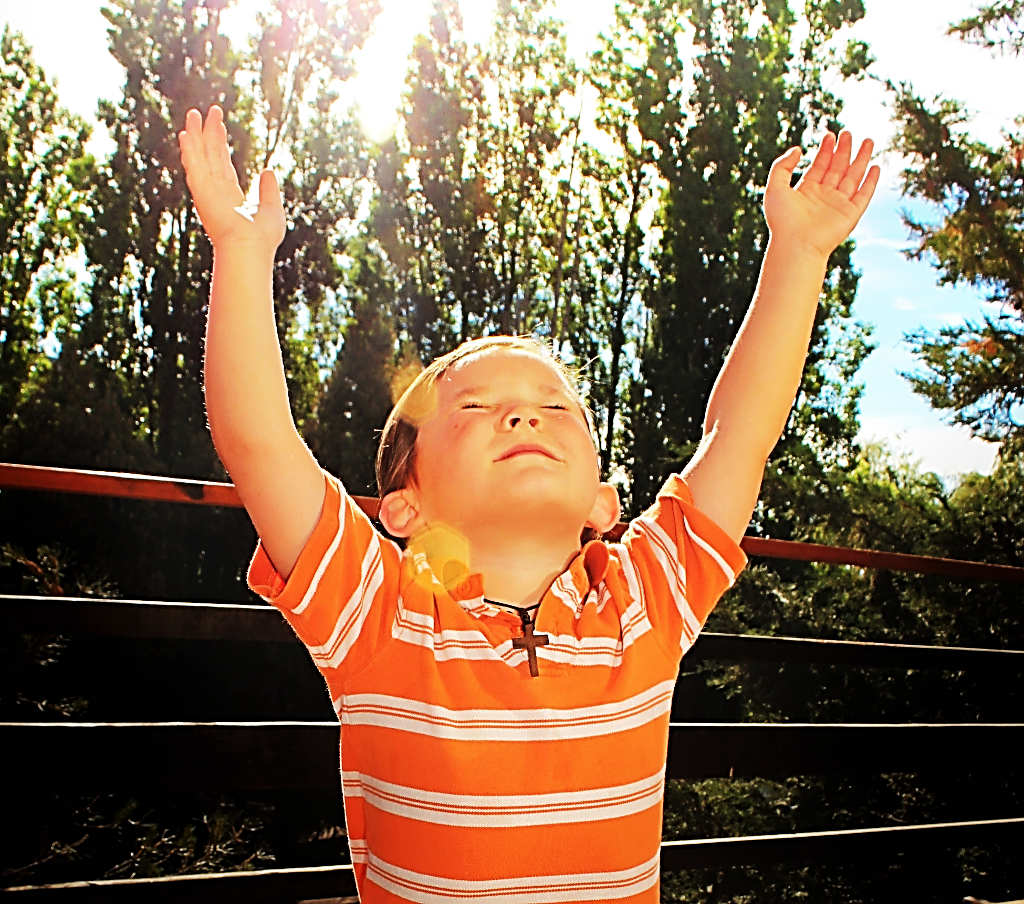
Worship like there is no one else in the whole world as wonderful as Jesus!!!

Slide 33
Psalm 103:1 CEB
“Let my whole being bless the Lord! Let everything inside me bless his holy name!”

Slide 34
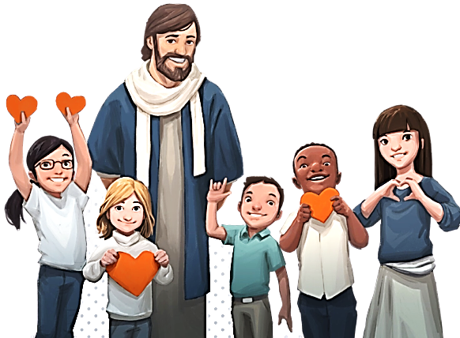
Your life will be like a house built on solid ROCK!
Hear Jesus’ words & do them & you will have peace & joy.

Slide 35
The Other Was Foolish
One Was Wise…

Slide 36
Matthew 7:24-25 ICB
“But the person who hears the things I teach and does not obey them is like a foolish man. The foolish man built his house on sand. It rained hard, the water rose, and the winds blew and hit that house. And the house fell with a big crash.”

Slide 37
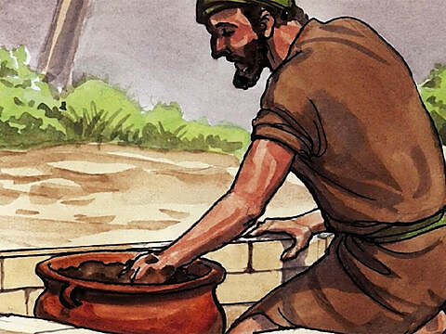
Question:
What did the foolish man use to build his house?

Slide 38
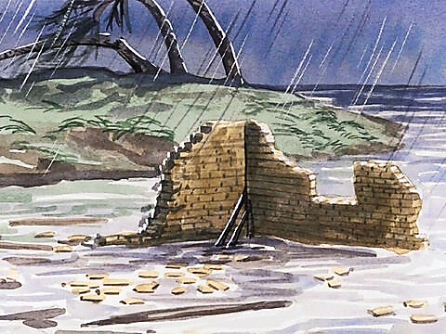
Question:
How did that work out when the rains came?

Slide 39
Like that house, a life built on sand will be washed away.

Slide 40
Here are examples of some sandy foundations foolish men & women might try to build their lives upon:

Slide 41
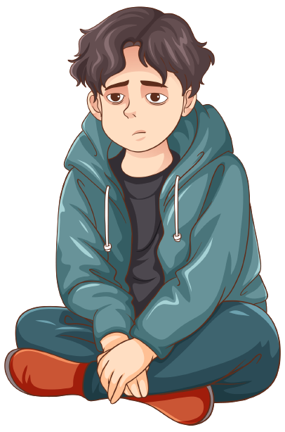
We can feel so empty, we try to fill our lives with many things.

Slide 42
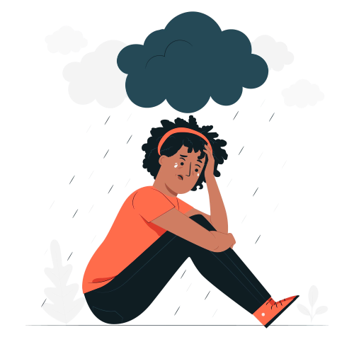
Still
Empty
She Tried Popularity

Slide 43
Proverbs 18:24 CSB
“One with many friends may be harmed, but there is a friend who stays closer than a brother.”

Slide 44
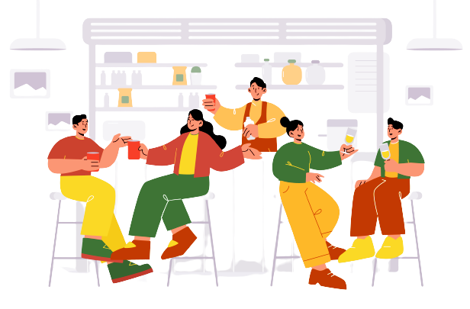
Still
Empty
He Tried Partying

Slide 45
Proverbs 21:17 CEV
“Heavy drinkers and others
who live only for pleasure will lose all they have.”

Slide 46
Still
Empty
She Tried Money

Slide 47
Ecclesiastes 5:10 CEV
“If you love money and wealth, you will never be satisfied with what you have. This doesn't make a bit of sense.”

Slide 48
Still
Empty
He Tried Dating

Slide 49
Proverbs 31:3 CEV
“Don't waste your life
chasing after women! This has ruined many kings.

Slide 50
She Tried Fame
Still
Empty

Slide 51
John 12:43 GW
“They were more concerned about what people thought of them than about what God thought of them.”

Slide 52
Still
Empty
He Tried Stuff

Slide 53
Luke 12:15 CEV
“Then he said to the crowd, “Don't be greedy! Owning a lot of things won't make your life safe.”

Slide 54
She Tried
Achievements
Still
Empty

Slide 55
1 Corinthians 4:7 CEV
“First pride, then the crash— the bigger the ego, the harder the fall.”

Slide 56
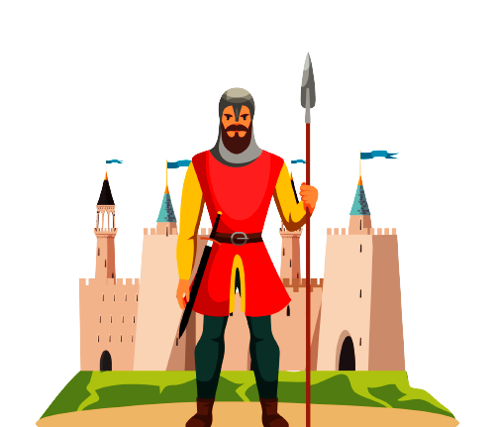
Still
Empty
He Tried Power

Slide 57
Jeremiah 17:5 ERV
“…Bad things will happen to those who depend on human strength. That is because they have stopped trusting the Lord.

Slide 58
Let us be wise and choose to build our lives on the solid-rock words of Jesus.

Slide 59
Hear His words and then do them.
Remember:

Slide 60
Love His Word.

Slide 61
Be Obedient. .

Slide 62
Be Kind

Slide 63
Be giving.

Slide 64
Tell others about Jesus.

Slide 65
Forgive

Slide 66
Tell the Truth

Slide 67
Pray Always

Slide 68
Worship Jesus with all your heart!

Slide 69
Your life will be like a house built on solid ROCK!
Hear Jesus’ words & do them & you will have peace & joy.

Slide 70
Suggested Next Slide - Video:
“Lesson of the Wise Man”
Click or Ctrl Click Here:
http://youtu.be/wDCqLFkCgOM

Slide 71
Suggested Next Slide - Song:
“One Big Mess”
Click or Ctrl Click Here:
https://youtu.be/sJqZxsR-Rno?si=r_Sh9VWXUv--iQkq

Slide 72
Is Jesus
Speaking to You?
“They said to each other, ‘Did not our hearts burn within us while he talked to us on the road, while he opened to us the Scriptures?’”
John Wesley Said:
“…the preacher was describing the change which God works in the heart through faith in Christ and I felt my heart strangely warmed.”
Jesus makes His presence Known by a small voice!

Slide 73
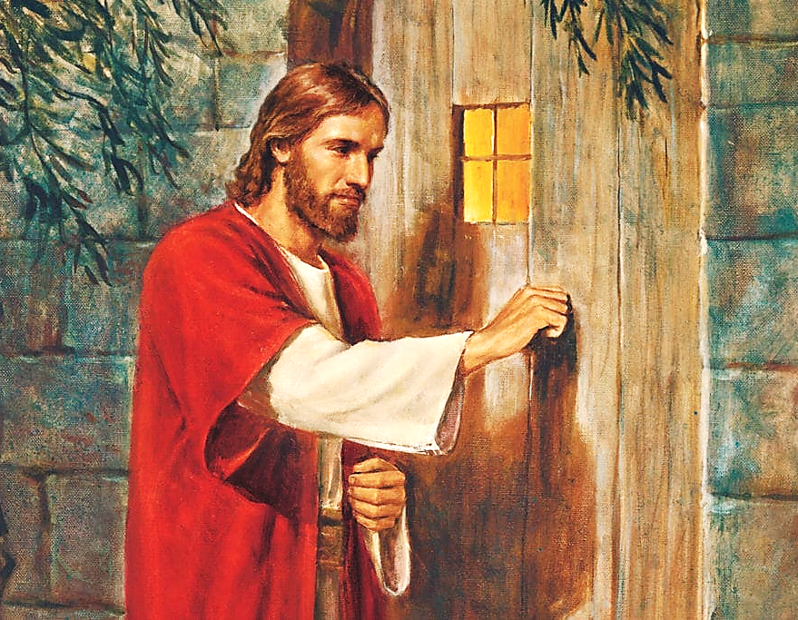

Slide 74
What is the Sinner‘s Prayer?
This is a prayer we can pray when we are ready to admit we are sinners and need Christ’s forgiveness.
It must be prayed with faith in our hearts and a readiness to have a life-changing encounter with Jesus Christ.

Slide 75
“Draw near to God, and He will draw
near to you…”
…Cleanse your hands, you sinners, and make your hearts pure, you who are half-hearted towards God.”
James 4:8 WNT

Slide 76
A prayer of faith → Pray this prayer if :
If you never have before
You have in the past, but you think it would mean more today.
You have been walking afar off and you want to come back.
You want to set an example & show others how it is done.
You just like to give your heart to Jesus again & again.
Saving Faith is a Leap of Trust in Jesus.

Slide 77
Dear Jesus,
I know I am a sinner and I need your forgiveness.
I believe you died for my sins.
I now turn from sin.
Come into my heart I pray.
Please wash away my sin.
Do you want to meet Jesus as your savior right now?
Do you believe He died to save you from your sins & that He rose from the dead?
Do you believe that He is waiting to save you right now?

Slide 78
“But some people did accept him. They believed in him, and he gave them the right to become children of God.” John 1:12

Slide 80
We Declare Our Faith Publicly Because Jesus Declared His LOVE Publicly
“If you stand before others and are willing to say you believe in me, then I will tell my Father in heaven that you belong to me.” Mat 10:32

Slide 81
“If you openly say, ‘Jesus is Lord’ and believe in your heart that God rfrom death, you aised him will be saved.”
Rom. 10:9
What did you learn today?
What have you been thinking about God lately?
What do you want to tell others about Jesus?

Slide 82
Close in Prayer

